Slide 2
What They Are and Why We Should Be Using Them
{
Microinteractions:

Slide 3
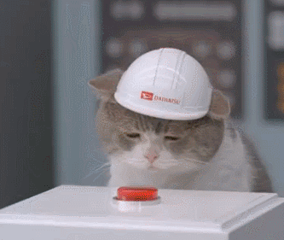
Any interaction a user has with a design to accomplish a single task.
Microinteractions
…what?

Slide 4
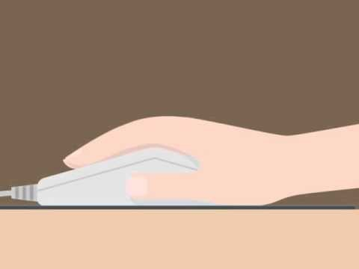
Microinteractions
…wait…what??

Slide 5
Communicate Feedback
What Are They Good For
…absolutely nothing?
See Results of an Action
Help the User Manipulate Something

Slide 6

Upload/Download
Identifying Opportunities
…dónde están las oportunidades?

Slide 7
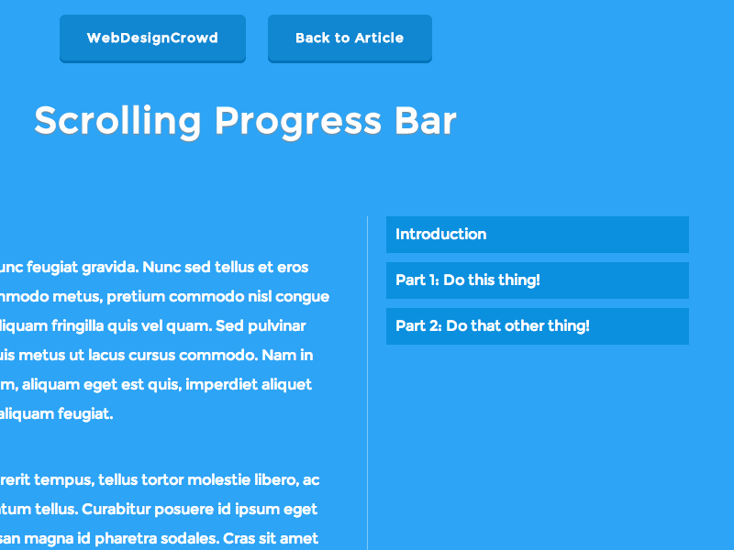
Where the User Is
Identifying Opportunities
…and?

Slide 8

Highlighting Changes
Identifying Opportunities
…aand?

Slide 9
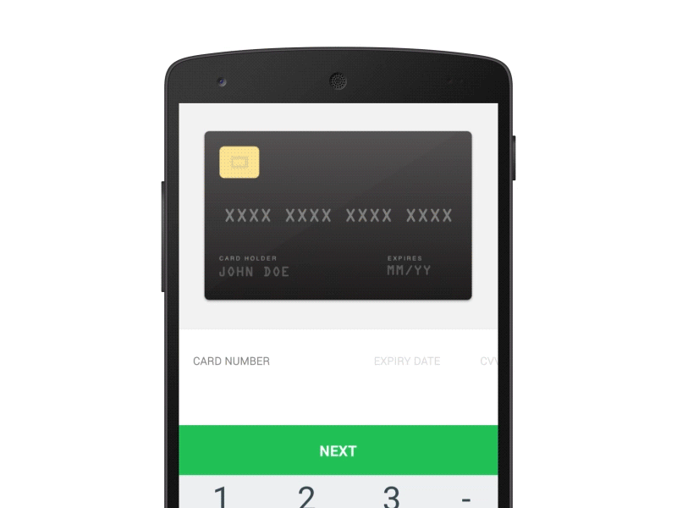
Visual Input
Identifying Opportunities
…aand?

Slide 10
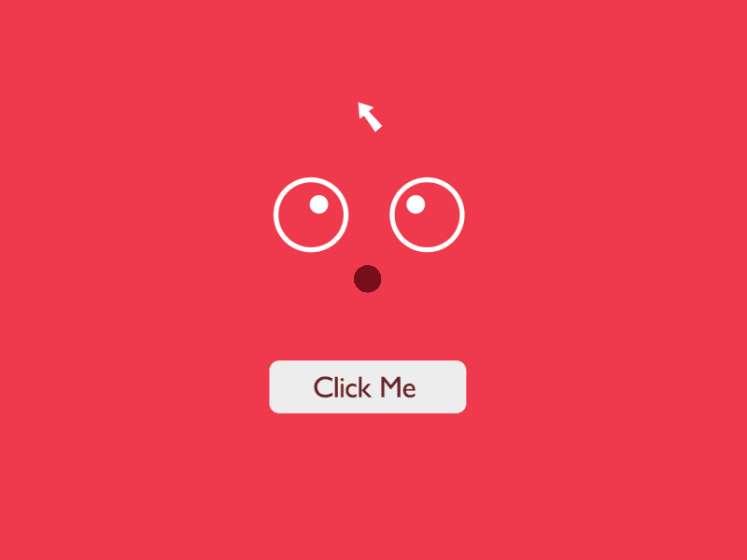
Call to Action
Identifying Opportunities
…aaaand?

Slide 11
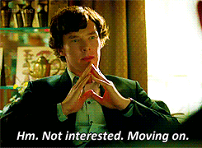
1. Instant Feedback 2. Guide Users 3. Feels Dynamic, Alive 4. Fun 5. Human
The Why of it All
…about time!

Slide 12
1. KISS 2. Unifying Theme 3. Don’t be Annoying 4. Use a Human Voice 5. Use Existing Elements 6. Draw from Context and User Research
A Few Tips
…oh goody ;)

Slide 13
path.com http://workmode.show mariner.com pinterest.com/uxinmotion/micro-interactions/
Examples
…YAAASSS

Slide 14
thank you ;-)
…you’re welcome
Notes:
Fallback to black

