Slide 2
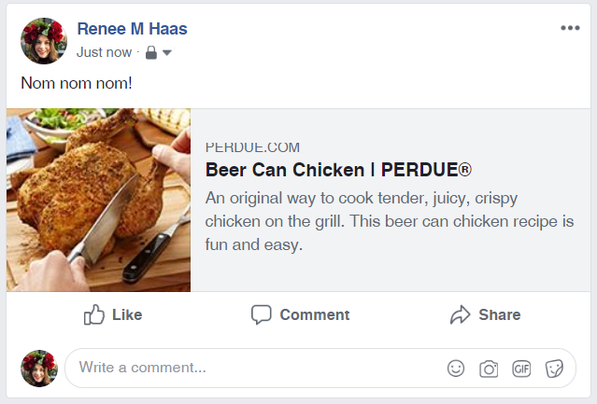
Facebook Open Graph
Special metadata for Facebook sharing
Defines an image, title, description and url
Facebook caches this data
Debugging url: https://developers.facebook.com/tools/debug/

Slide 3
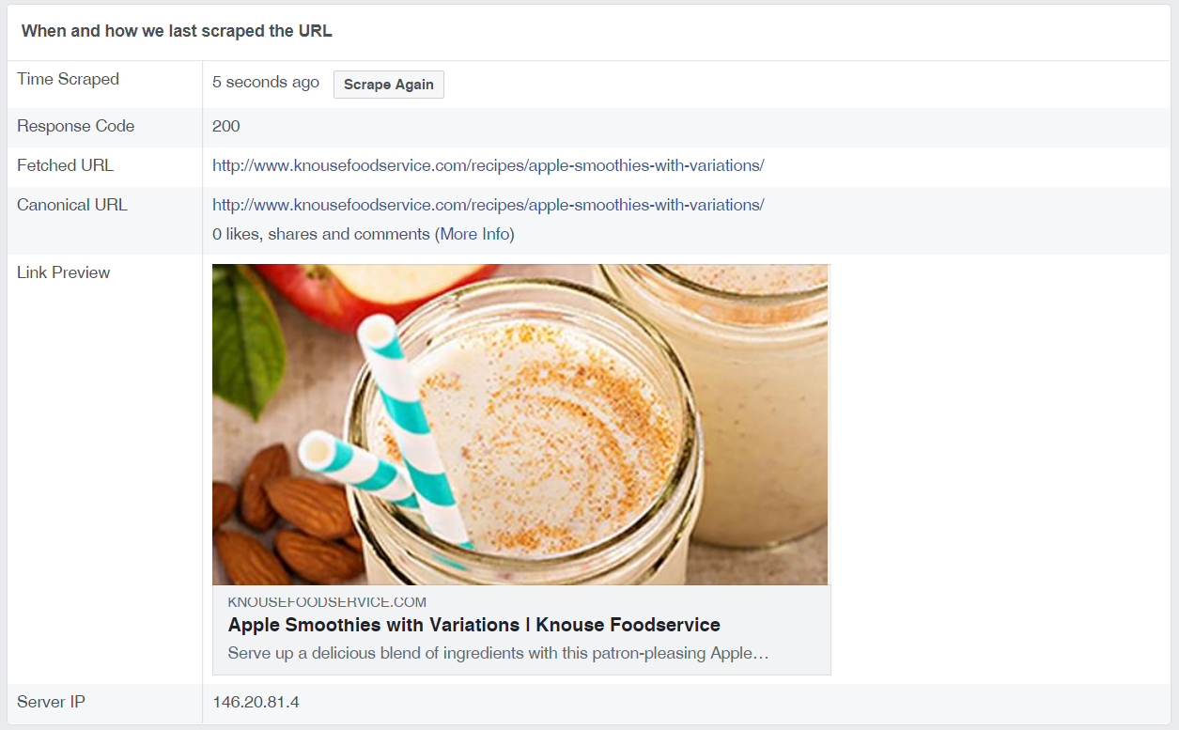
Facebook Open Graph

Slide 4
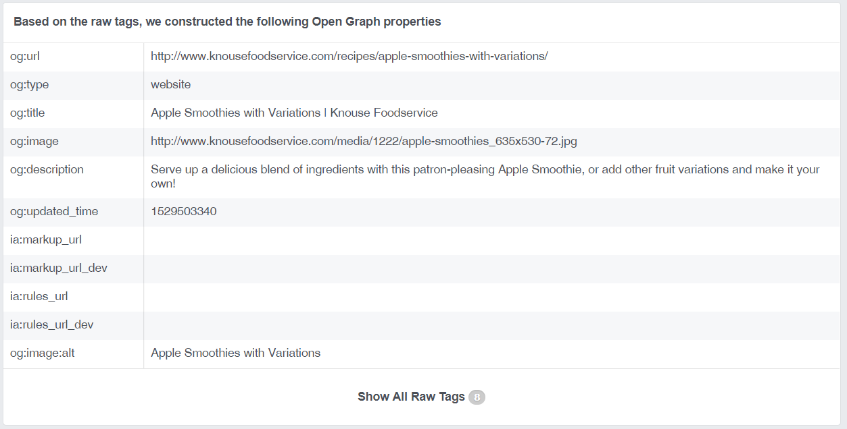
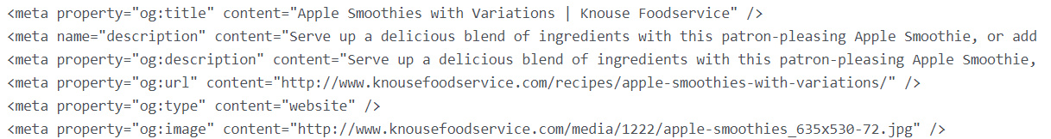
Facebook Open Graph

Slide 5
Facebook Open Graph- Best Practices
Image
minimum 600 x 315 pixels
recommended 1200 x 630 pixels
max 8MB
Title
A clear title without branding or mentioning the domain itself.
Description
Good: A clear description, at least two sentences long.
Bad: Generic, boring

Slide 6
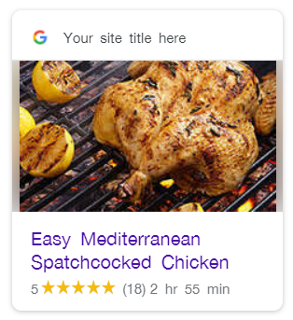
Google Structured Data
Also referred to as Rich Snippets
Defines what shows in google results (enhanced)
JSON-LD (recommended), Microdata, RDFa
https://search.google.com/structured-data/testing-tool

Slide 7
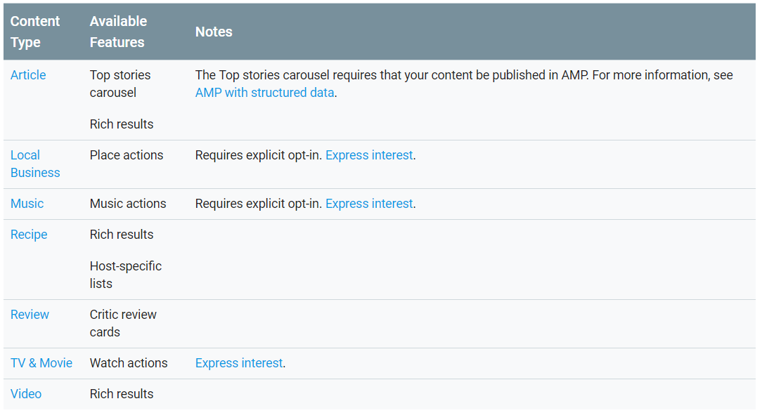
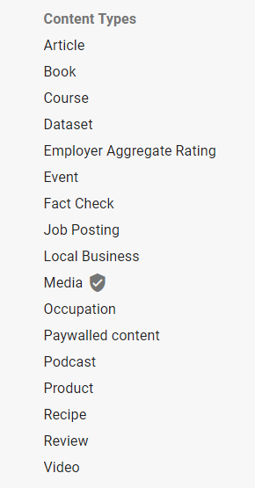
Google Structured Data

Slide 8
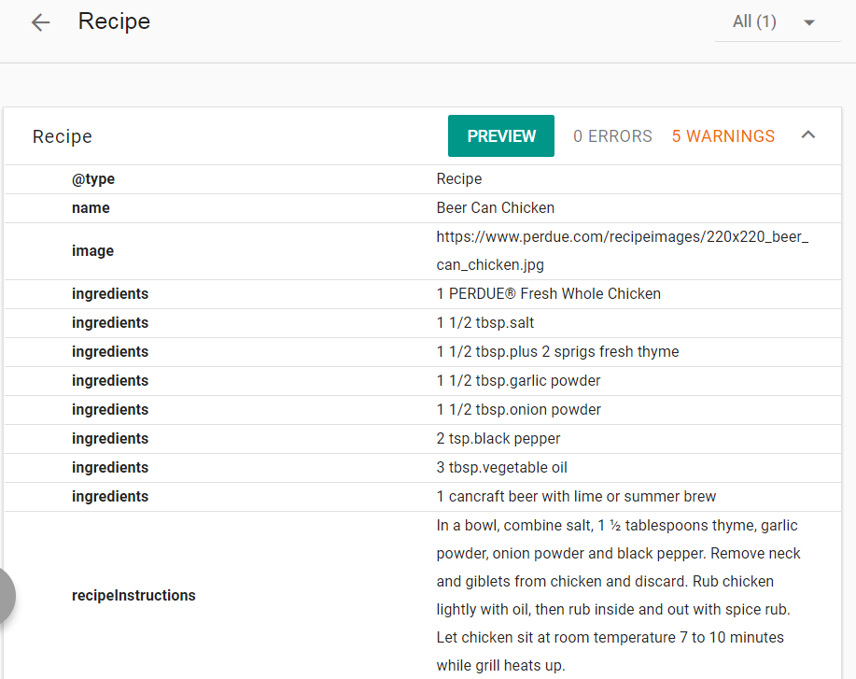
Google Structured Data

Slide 9
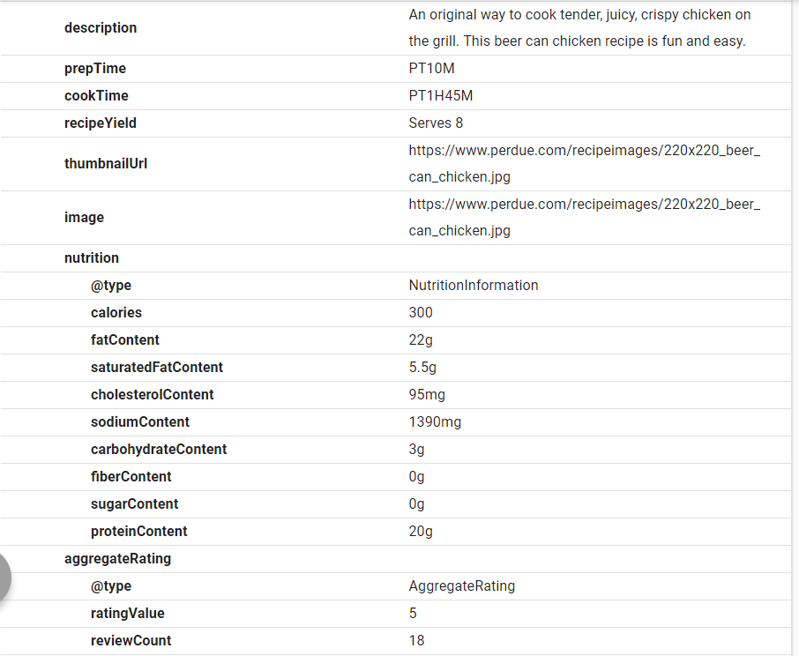
Google Structured Data

Slide 10
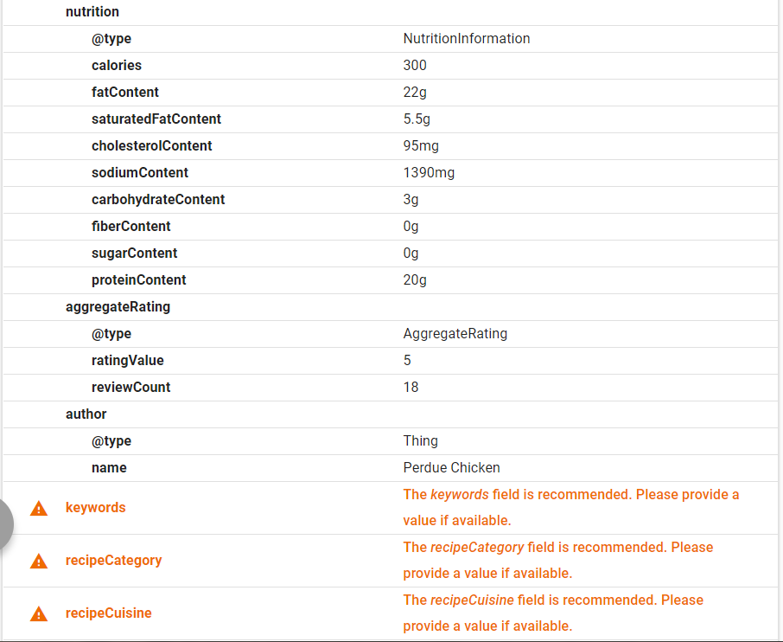
Google Structured Data

Slide 11
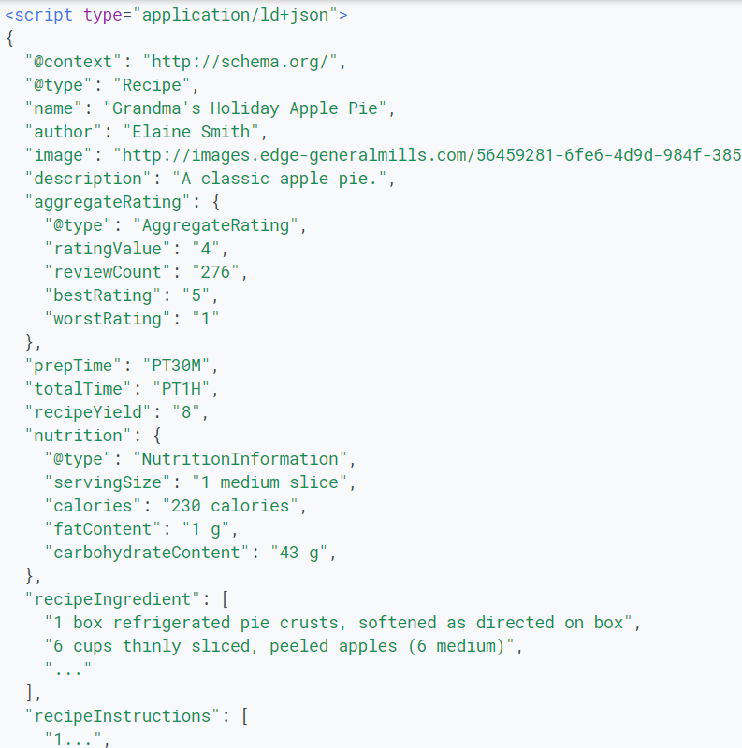
Google Structured Data

Slide 12
Google Structured Data- Best Practices
Make pages primarily for users, not for search engines.
Avoid creating pages with little or no original content
Don't deceive your users.
Avoid tricks intended to improve search engine rankings.
Avoid hidden text and links

Slide 13
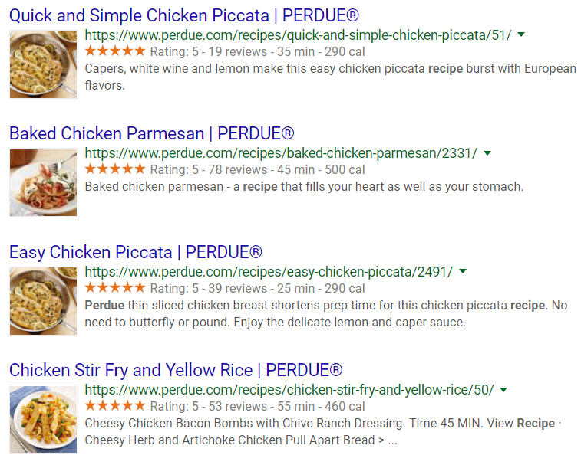
Google Structured Data

Slide 14
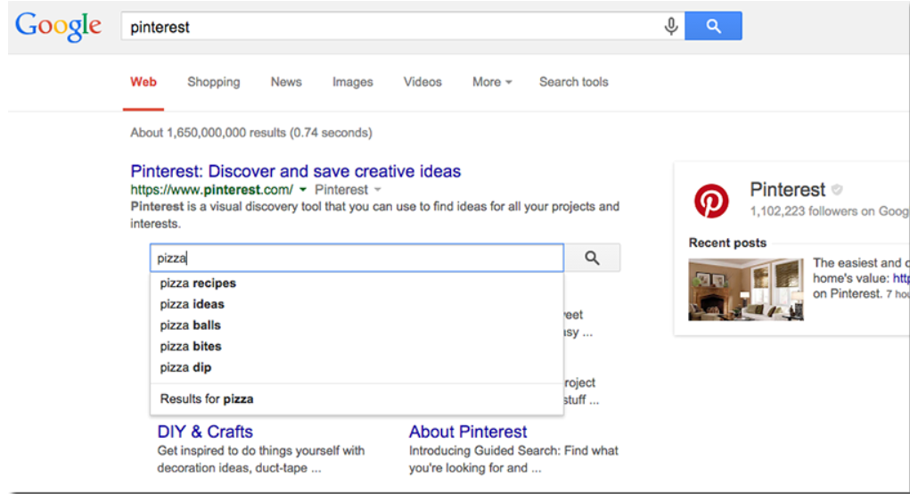
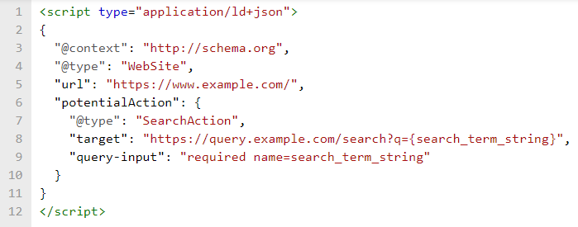
Google Structured Data

