Slide 1
Notes:
Today we are going to review client billing methods and how client fee structures may inform project, campaign, retainer or advance billing decisions in WMJ. We’ll review past FMP terminology and how it translates to the WMJ terminology.
Understanding client fee structures is an important part of your role as an account manager at Marriner. You must be able to confidently explain these details to clients that request customized billing that may not be within our agency accounting practices.
All of the material (including client fee structures and examples) is highly confidential and should not be shared with anyone.

Slide 2
WMJ Training: Client Billing Methods

Slide 3
Client Billing Methods
Marriner will use four WMJ methods for billing Agency Services:
Retainer – a contractual fixed billing arrangement, typically invoiced over an agreed period of time for an agreed amount. Projects or services that fall outside the retainer scope will be incremental and billed as a fixed fee.
Advance Bill – taking a “deposit” from a Client and applying future projects to the deposit until it’s exhausted. This is similar to the past FMP Pre Bill.
Fixed Fee – billing the Client for agency services from an approved project estimate.
Campaign – used to link multiple fixed-fee projects to one Client invoice – similar to the past FMP Lump.
Marriner will not bill “time and materials” as shown in WMJ.
WMJ Training: Client Billing Methods

Slide 4
Client Examples
Examples of Retainer Accounts: Butterball, Campbell’s, Gehl’s, NB+C and Perdue.
Examples of Advance Bills:
A Client has a budget surplus at the end of their fiscal and would like MMC to invoice the surplus to use on future projects.
A Client allocated a budget for a new product launch and would like MMC to invoice for the product launch, but is not sure of the launch elements.
Examples of Fixed Fee Accounts: Cholula, Knouse, Nestle, The Plastics Association and The Sugar Association.
Examples of a Campaign: Nestle Tea/Lemonade Product Launch, Libby’s Operator Promotion, Butterball New Product Launch—GF Meatballs, Turkey Crumbles and Turkey Bacon.
WMJ Training: Client Billing Methods

Slide 5
Client Details
CLIENT * Requires P.O. | PREFIX | ACOUNT RETAINER | DIGITAL RETAINER | CREATIVE RETAINER | TM/PM | MEDIA | MARKUP | SALES TAX
Butterball Foodservice | BTB | YES | YES | NO | TBD | GROSS | YES | NO
Campbell's Foodservice - U.S.* | CFA | YES | YES | YES | YES | NET | NO | NJ 6.625%
Campbell's Foodservice – Canada* | CFC | NO | NO | NO | YES | NET | NO | NO
Marriner Marketing Communications | MMC | NO | NO | NO | YES |  | NO | MD 6%
Maryland Tourism* | OTD/MDT | YES | NO | YES | YES | NET | NO | EXEMPT
Nestle Professional – Beverages* | NEB | NO | NO | NO | YES | NET | NO | NO
Nestle Professional – Desserts* | NED
Nestle Professional - Prepared Foods* | NES
Perdue* | PDR/PDC | YES | YES | NO | TBD |  | YES | MD 6%
Atlas Metal | ATM | NO | NO | NO | YES |  |  | NO
Cholula | CHA | NO | NO | NO | YES | NET | NO | NJ 6.625%
Knouse Foods | KNO | NO | NO | NO | YES | GROSS | YES | NO
Plastics Industry Association | PLA | NO | YES | NO | YES |  | YES | NO
The Sugar Association | TSA | NO | YES | NO | YES | YES | YES | NO
Food For Life | FFL | NO | NO | NO | YES |  |  | NO
Gehl Foods, Inc. | GHL | YES | NO | NO | YES | GROSS | YES | NO
HoCo Economic Development Authority | HCE | NO | NO | NO | YES |  | YES | MD 6%
Network Building + Consulting | NBC | YES | NO | NO | NO | GROSS | YES | MD 6%
Sweets & Snacks Expo | SSE | NO | NO | NO | YES |  | YES | NO
Vulcan | VLC | NO | YES | NO | YES | YES | YES | MD 6%
WMJ Training: Client Billing Methods
Notes:
Again, this is highly confidential.

Slide 6
How Does Each Method Work?
Retainer
Account will establish with Accounting the total retainer amount, invoice period and frequency (i.e. $150,000 invoiced over 12 months from June 1, 2019 – May 31, 2020 at $12,500/month). Each retainer will have a unique name that includes the Client name.
Accounting will set up the retainer and submit monthly invoices to the Account Lead for approval—no project is opened.
If the retainer includes all agency services (like Campbell’s), projects must be opened as non-billable and linked to the retainer to manage the annual budget plan.
If the retainer includes limited or partial agency services (like Perdue and Butterball), billable fixed-fee projects must be opened for agency services not covered and will be invoiced upon estimate approval.
Reports will be pulled by Accounting for the Account Lead to monitor projects applied to retainer.
WMJ Training: Client Billing Methods

Slide 7
How Does Each Method Work?
Advance Bill
Account will establish with Accounting the total advance bill amount and invoicing schedule (if total can not be invoiced all at once). Each advance bill will have a unique name that includes the Client name.
Accounting will set up the advance bill and submit invoice(s) to the Account Lead for approval—no project is opened.
Billable, fixed-fee projects must be opened for agency services and applied to the advance bill by Accounting.
The Project Request must direct “Apply to Advance Bill” in the billing method area and include which specific advance bill.
Reports will be pulled by Accounting to monitor projects applied to the advance bill.
Fixed Fee
Billable projects will be opened and invoiced upon estimate approval.
WMJ Training: Client Billing Methods

Slide 8
How Does Each Method Work?
Campaign
Account will open a Client Campaign in WMJ.
As Project Requests are submitted, Account will select the Campaign to link projects and choose the ”Billable” billing method on the Project Request for all projects to be linked.
As projects estimates are approved, Account will notify accounting the project is part of a Campaign that will be invoiced as a Campaign summary (similar to a past lump).
Media cannot be invoiced through a Campaign because of the progressive invoice schedule; however, it can be linked to a Campaign when preparing budget summaries.
Additional projects may be linked later to a Campaign by Production.
Agency services and expenses are not entered against a Campaign. All agency services and expenses remain part of a project. The Campaign is a way to summarize budgets for multiple projects.
WMJ Training: Client Billing Methods

Slide 9
Media, Outside Costs & Expenses
Media
Media projects must be created for the total media buy cost and progressively invoiced by IO as established with Accounting. The ”Billable” billing method must be selected on the Project Request.
Outside Costs
Outside costs, such as printing and photography, must be invoiced upon estimate approval, except for Maryland Tourism and Cholula that will be invoiced with final vendor invoices. The ”Billable” billing method must be selected on the Project Request.
Expenses
Reimbursable expenses are invoiced from expense reports. Expenses can be assigned to and invoice through a specific client project, if needed.
WMJ Training: Client Billing Methods

Slide 10
WMJ Training: Campaign & Project Request

Slide 11
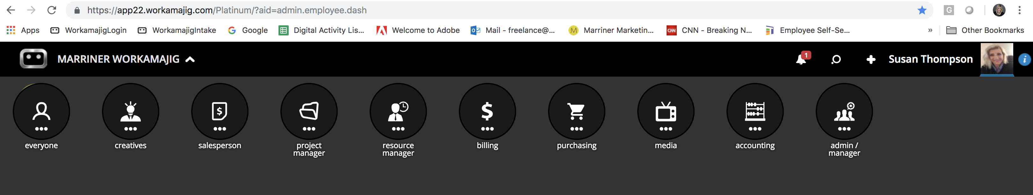
Creating A Campaign
From the Marriner WMJ header:
1
1
Click on the + to create a new Campaign.
WMJ Training: Campaign & Project Request

Slide 12
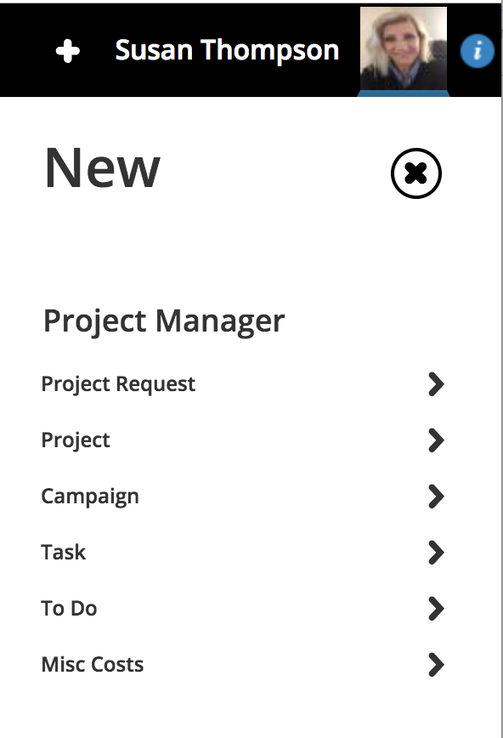
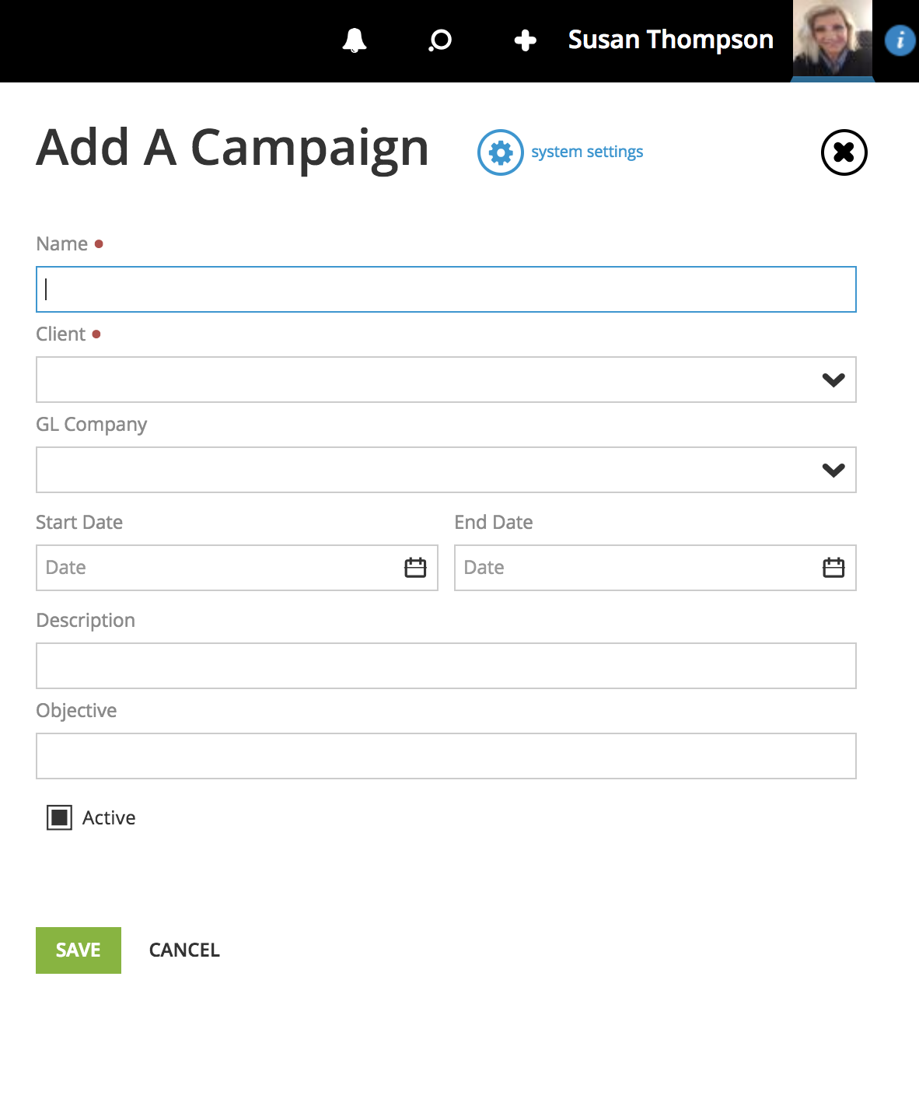
Campaign Detail
2
WMJ Training: Campaign & Project Request

Slide 13
Creating A Project Request
PROJECT TYPES
Banner Ad
Brainstorm Meeting
Brand Identity & Standards
Clarity Capture
Collateral
Concept Development
Content Development
Culinary
Digital Marketing – MMA
Digital Marketing – SEM
Digital Marketing – SEO
Digital Performance – Analytics & Insights
Digital Production
Email
Enewsletter
Flipbook or Online Collateral
Hardware
Hero or Slider
Hosting
Illustration
Landing Page
Maintenance
Mechanical
Media
Media Planning & Buying
Photography
Planning
Print Ad
Printing
Production Management
Public Relations
Reimbursable Expenses Research Analytics & Insights
Retainer
Retouching
Social Media
Software
Strategy
Supplies
Text
Video
Website New
Website Update
WMJ Training: Campaign & Project Request
Notes:
Production will associate your project with one of these project types when the project is opened.

Slide 14
Creating A Project Request
From the Marriner WMJ header:
1
1
Click on the + to create a new Project Request.
WMJ Training: Campaign & Project Request

Slide 15
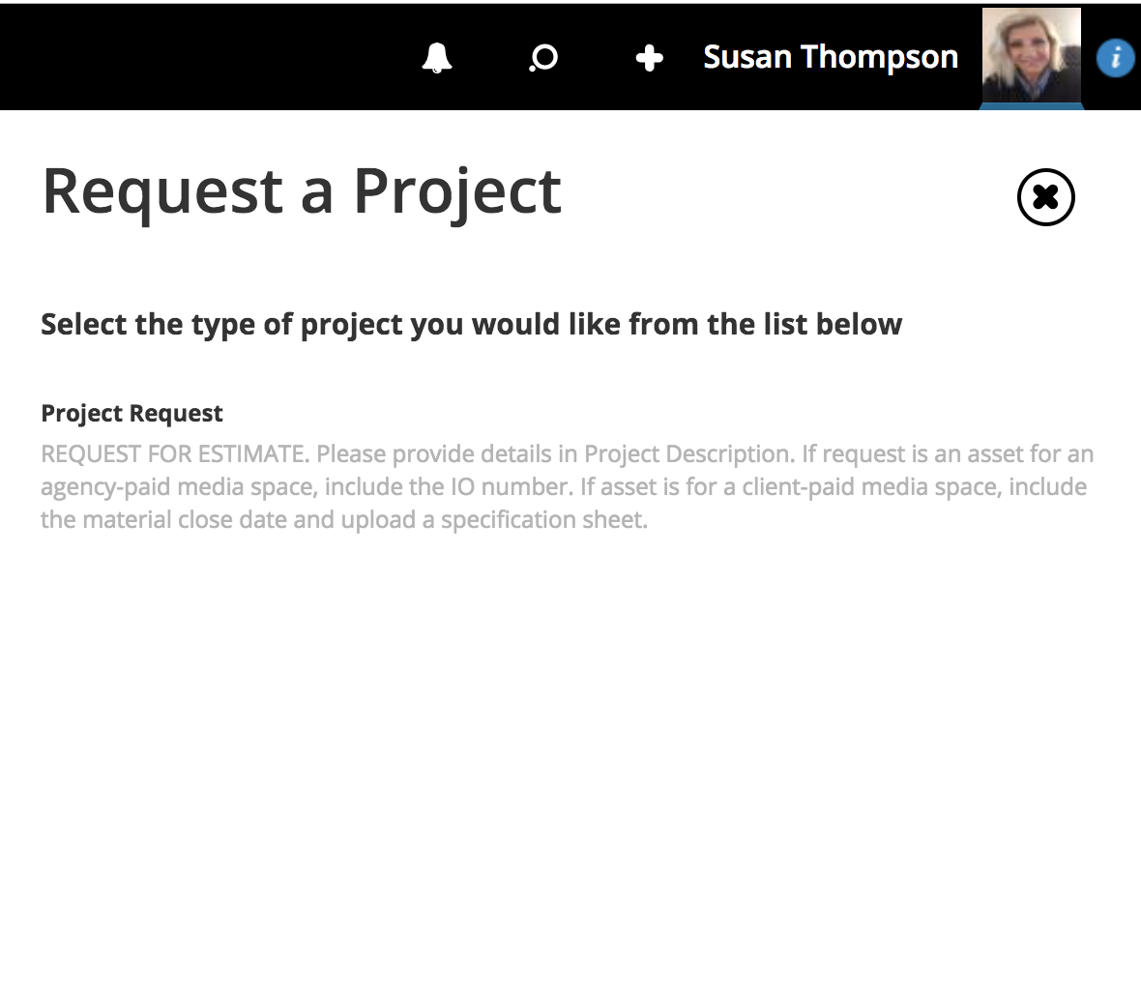
Project Request
3
2
Click on this Project Request form.
WMJ Training: Campaign & Project Request

Slide 16
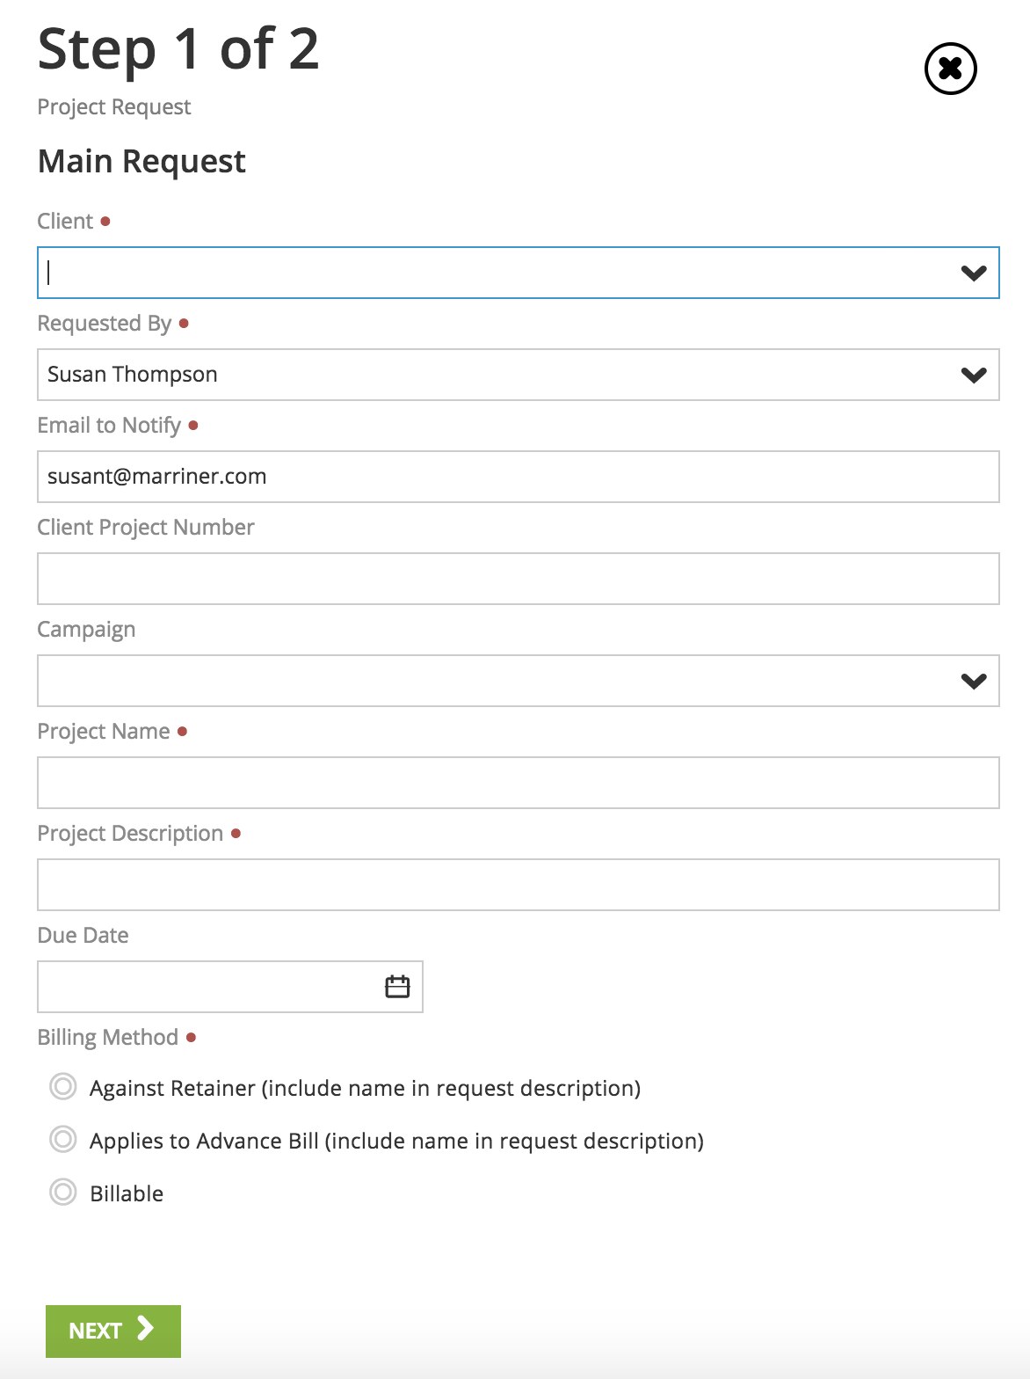
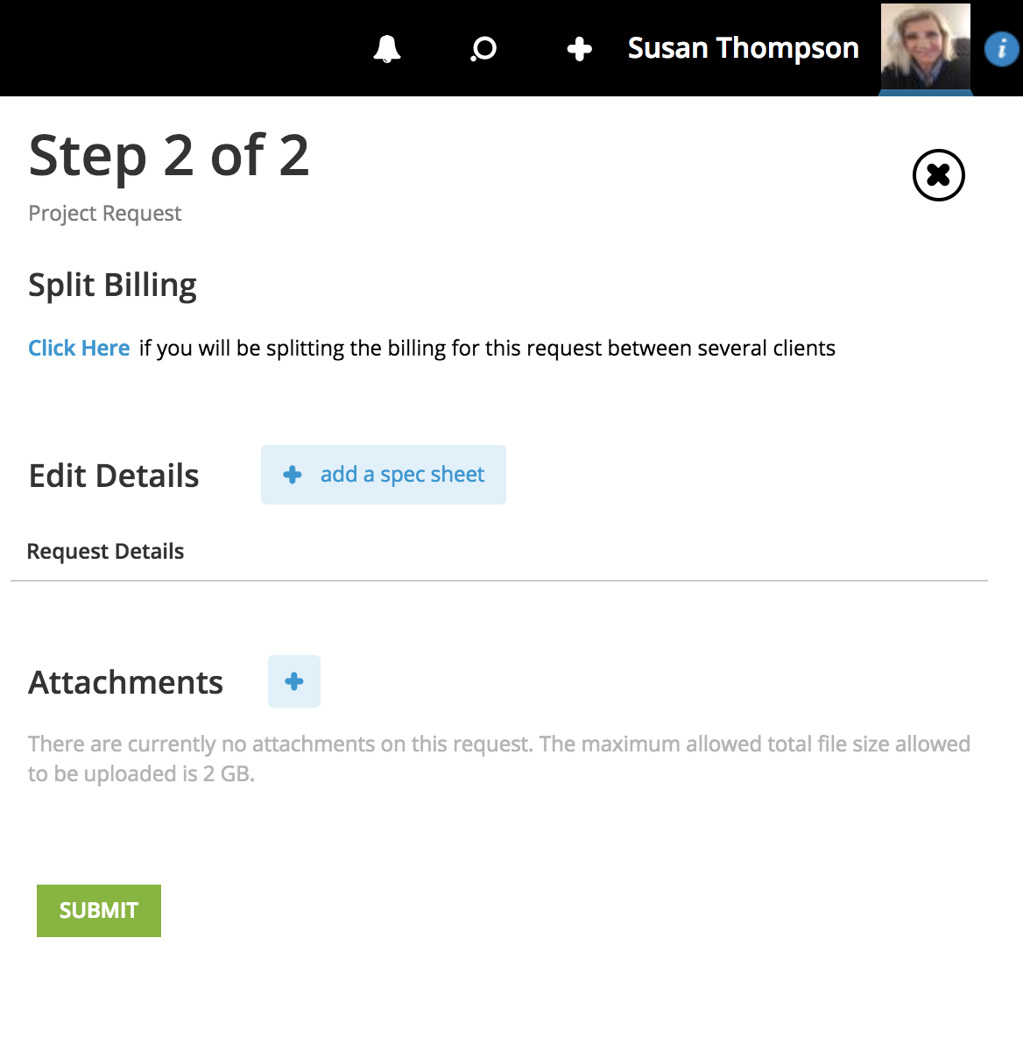
Project Request Detail
Complete Step 1
Red dots = mandatory fields.
Add a spec sheet or attach documents.
Enter Client PO number, retainer or advance bill name, if applicable.
Submit sends to Production for a project estimate.
Link the project to an existing Campaign here.
Account to direct if this project applies to a retainer, advance, or is billable.
WMJ Training: Campaign & Project Request

Slide 17
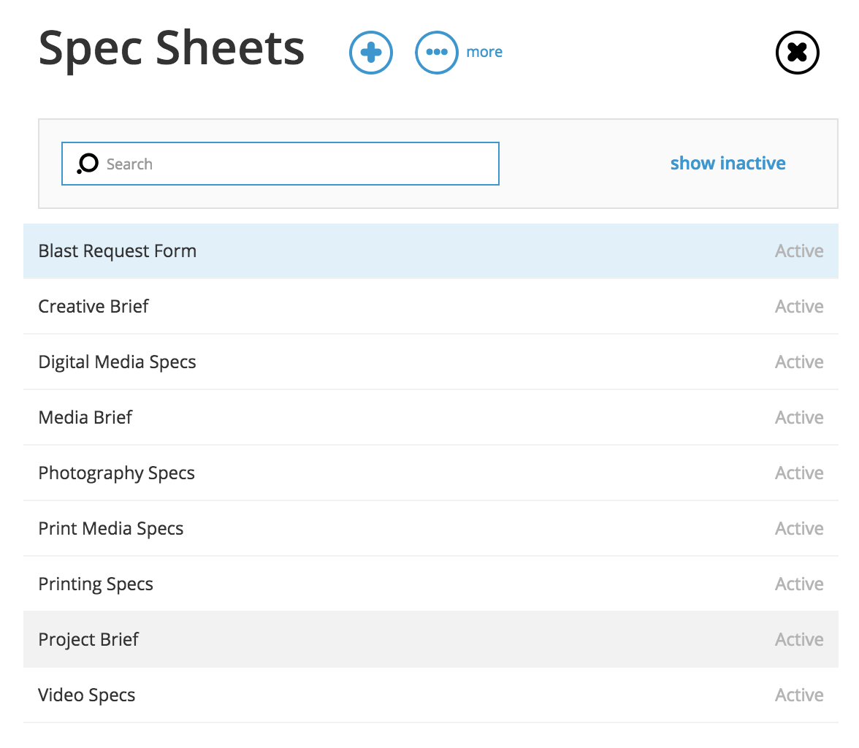
Spec Sheet Options
Account to complete the Digital or Print Media Spec sheets if client purchased media.
WMJ Training: Campaign & Project Request

Slide 18
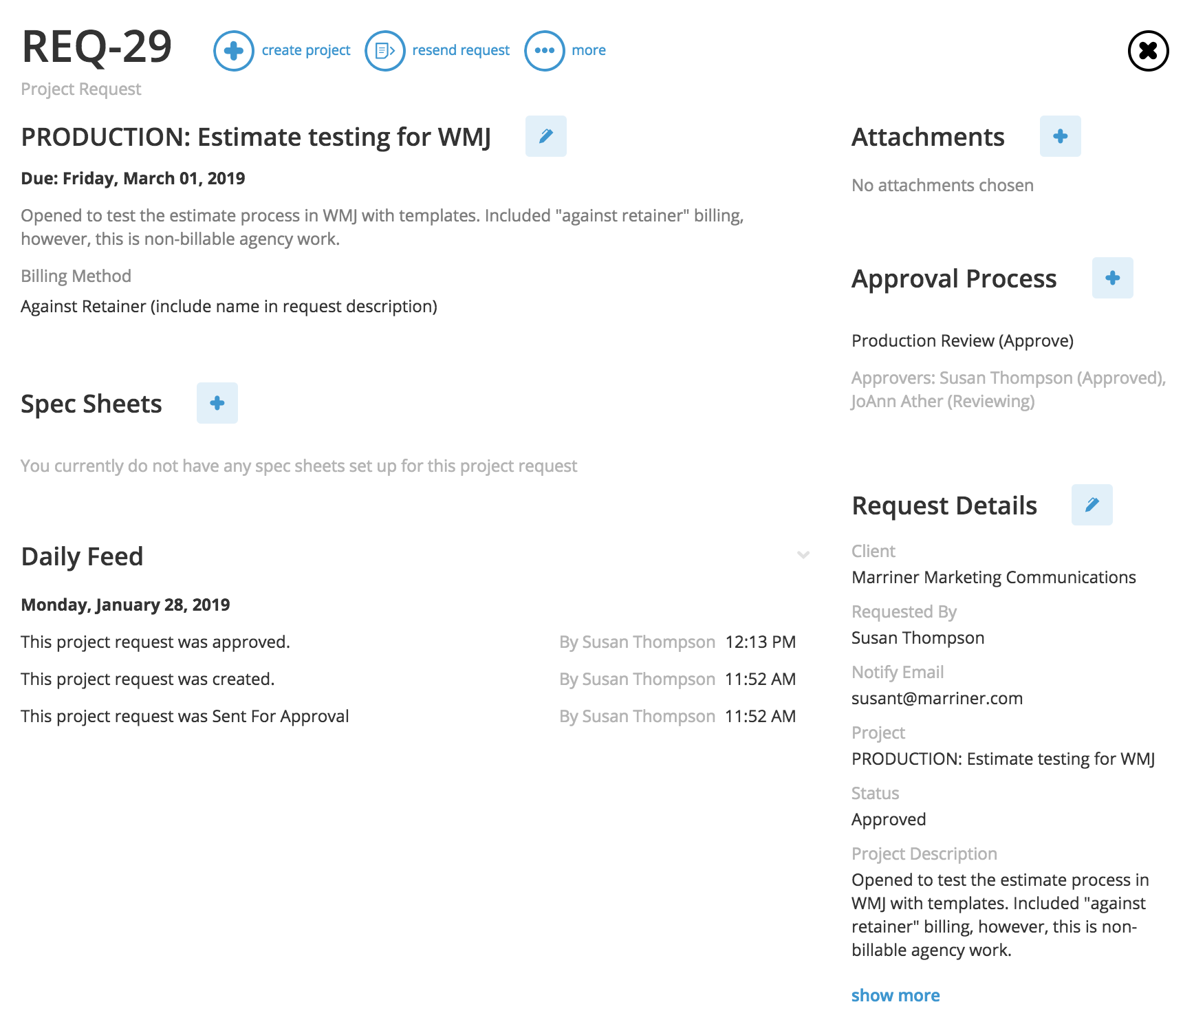
Moving Project Request to Project
This pushes all attachments and spec sheets into a new client project (with Client prefix and #).
Production will review the request.
If good to move forward, the submitter will receive an approval email notification.*
* If more details are needed, production may reject the request, email questions or request a meeting along with a creative/digital leader to finalized details.
WMJ Training: Creating A Project
Notes:
This is what Production will receive.

Slide 19
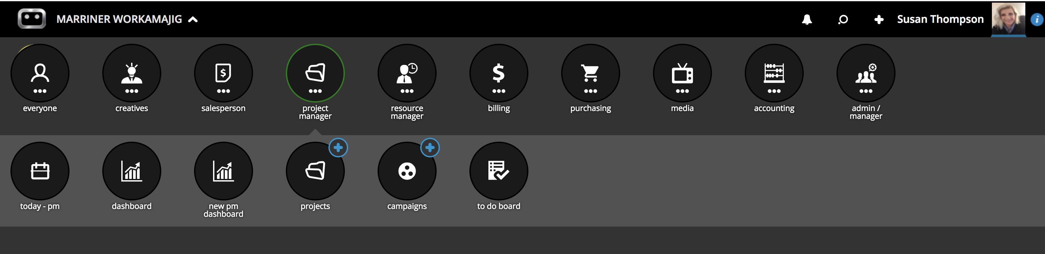
Opening a Project
Production is ready to estimate and opens a Client Project using the Client prefix and an auto-assigned number. View the project by selecting the Marriner WMJ, project manager, projects.
1
2
3
WMJ Training: Creating A Project

Slide 20
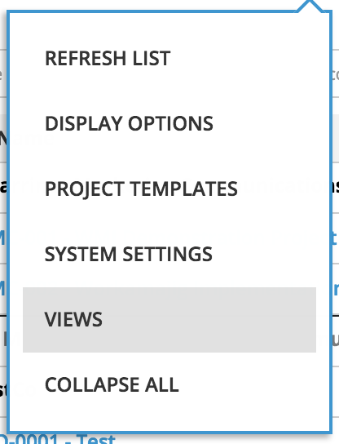

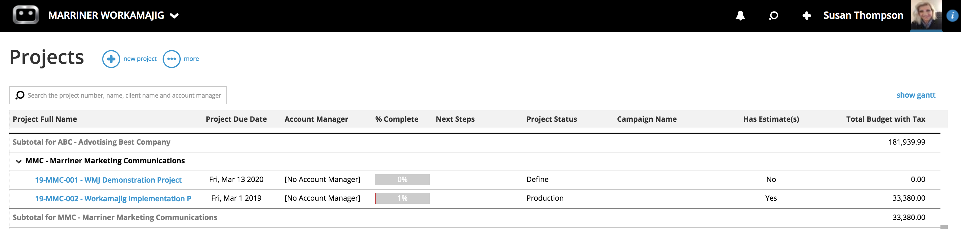
Projects Screen
Display Options allows sorting by Client, project type, status, team and assignments.
Views allows filtering by active or inactive projects.
1
6
3
4
5
2
1
…more
4
Has Estimate
2
Project Links to Summary
5
Total Budget
3
Project Status
6
Show Gant
WMJ Training: Creating A Project
Notes:
Project Status, stays in Define until the estimate is approved. Then it’s moved to Production to push assignments to the team.
If the Total Budget = $0.00 but there is an estimate, it means the estimate is not approved and the project is not ready for creative to work on.

Slide 21
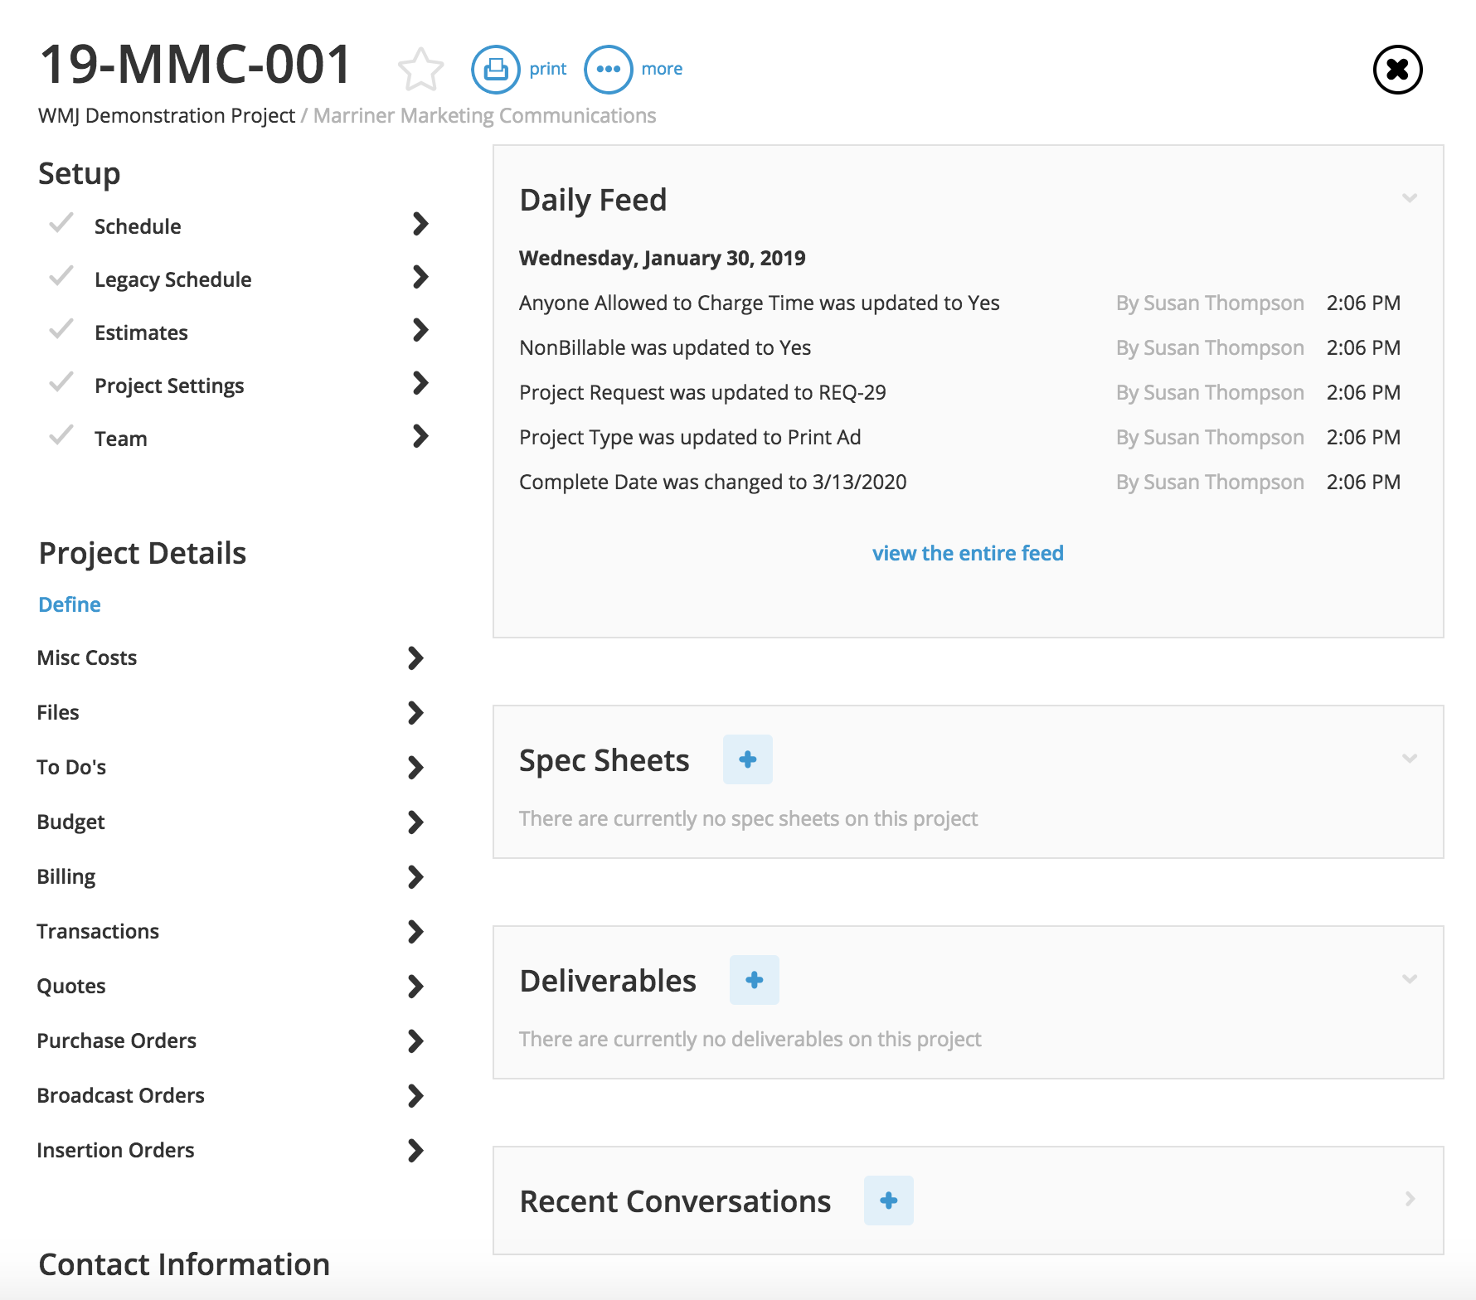
Project Summary
Click on the Team Setup to remove the Resource Manager or Digital Project Manager, depending on who the Digital Director assigns to the project.
WMJ Training: Creating A Project

Slide 22
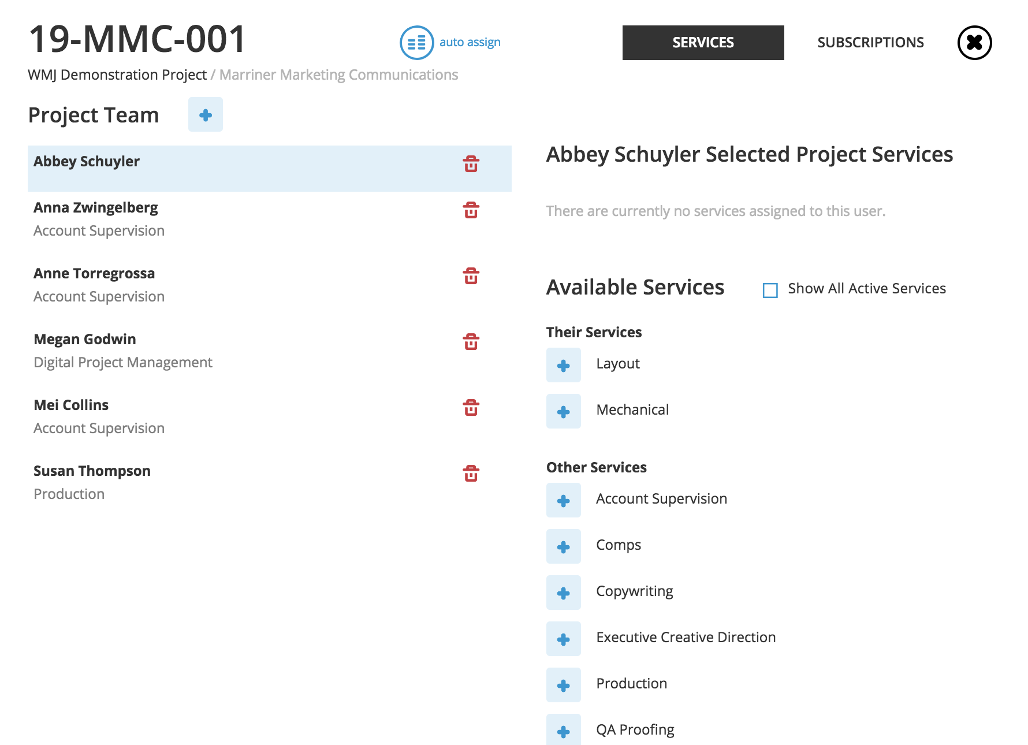
Project Team
Use the + to search and add team members.
Use the trash can to remove team members.
WMJ Training: Creating A Project

Slide 23
Project Settings
Click on Project Settings to check template defaults for each Client.
WMJ Training: Creating A Project

Slide 24
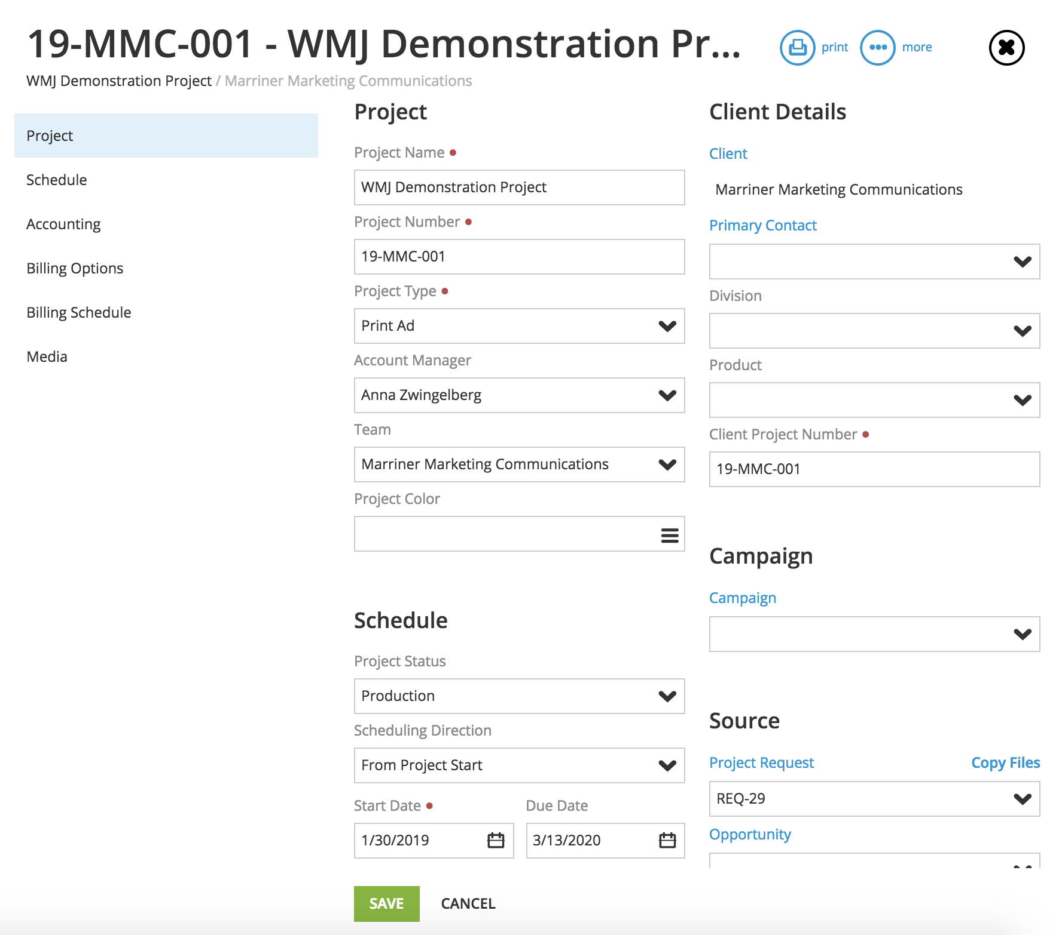
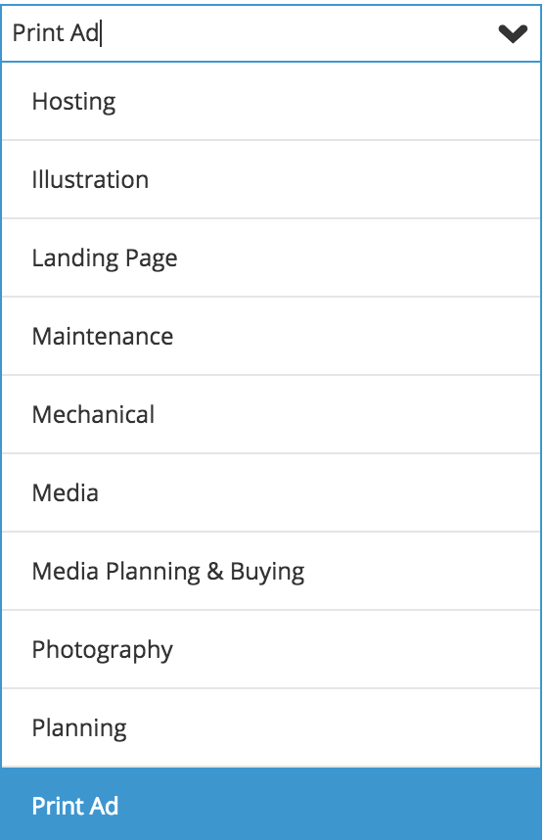
Project Settings – Project
Project Number auto assigns.
Select a Project Type from the pull down.
Account Manager and Team default from Client.
WMJ Training: Creating A Project

Slide 25
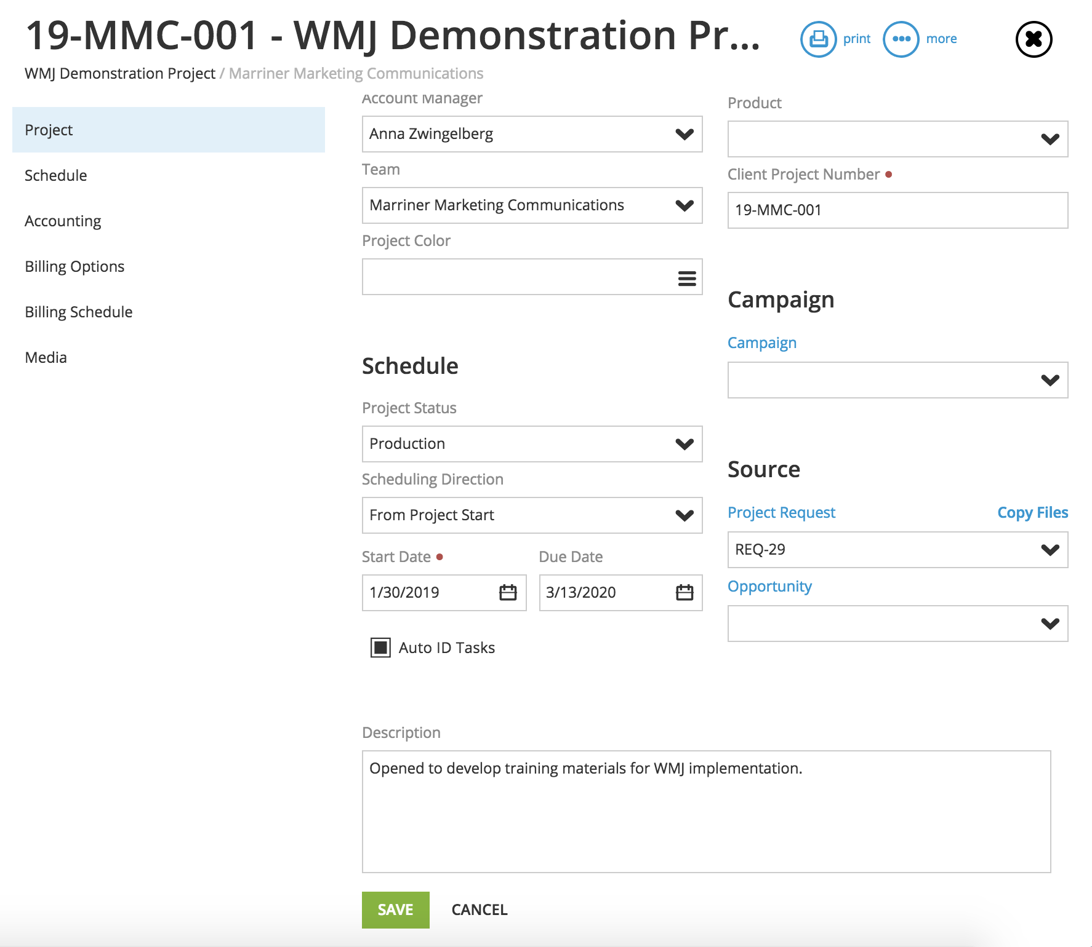
Project Settings – Project Cont.
Links to Campaign selected on the Project Request.
Links to original Project Request.
Edit Project Description here.
Always SAVE.
WMJ Training: Creating A Project

Slide 26
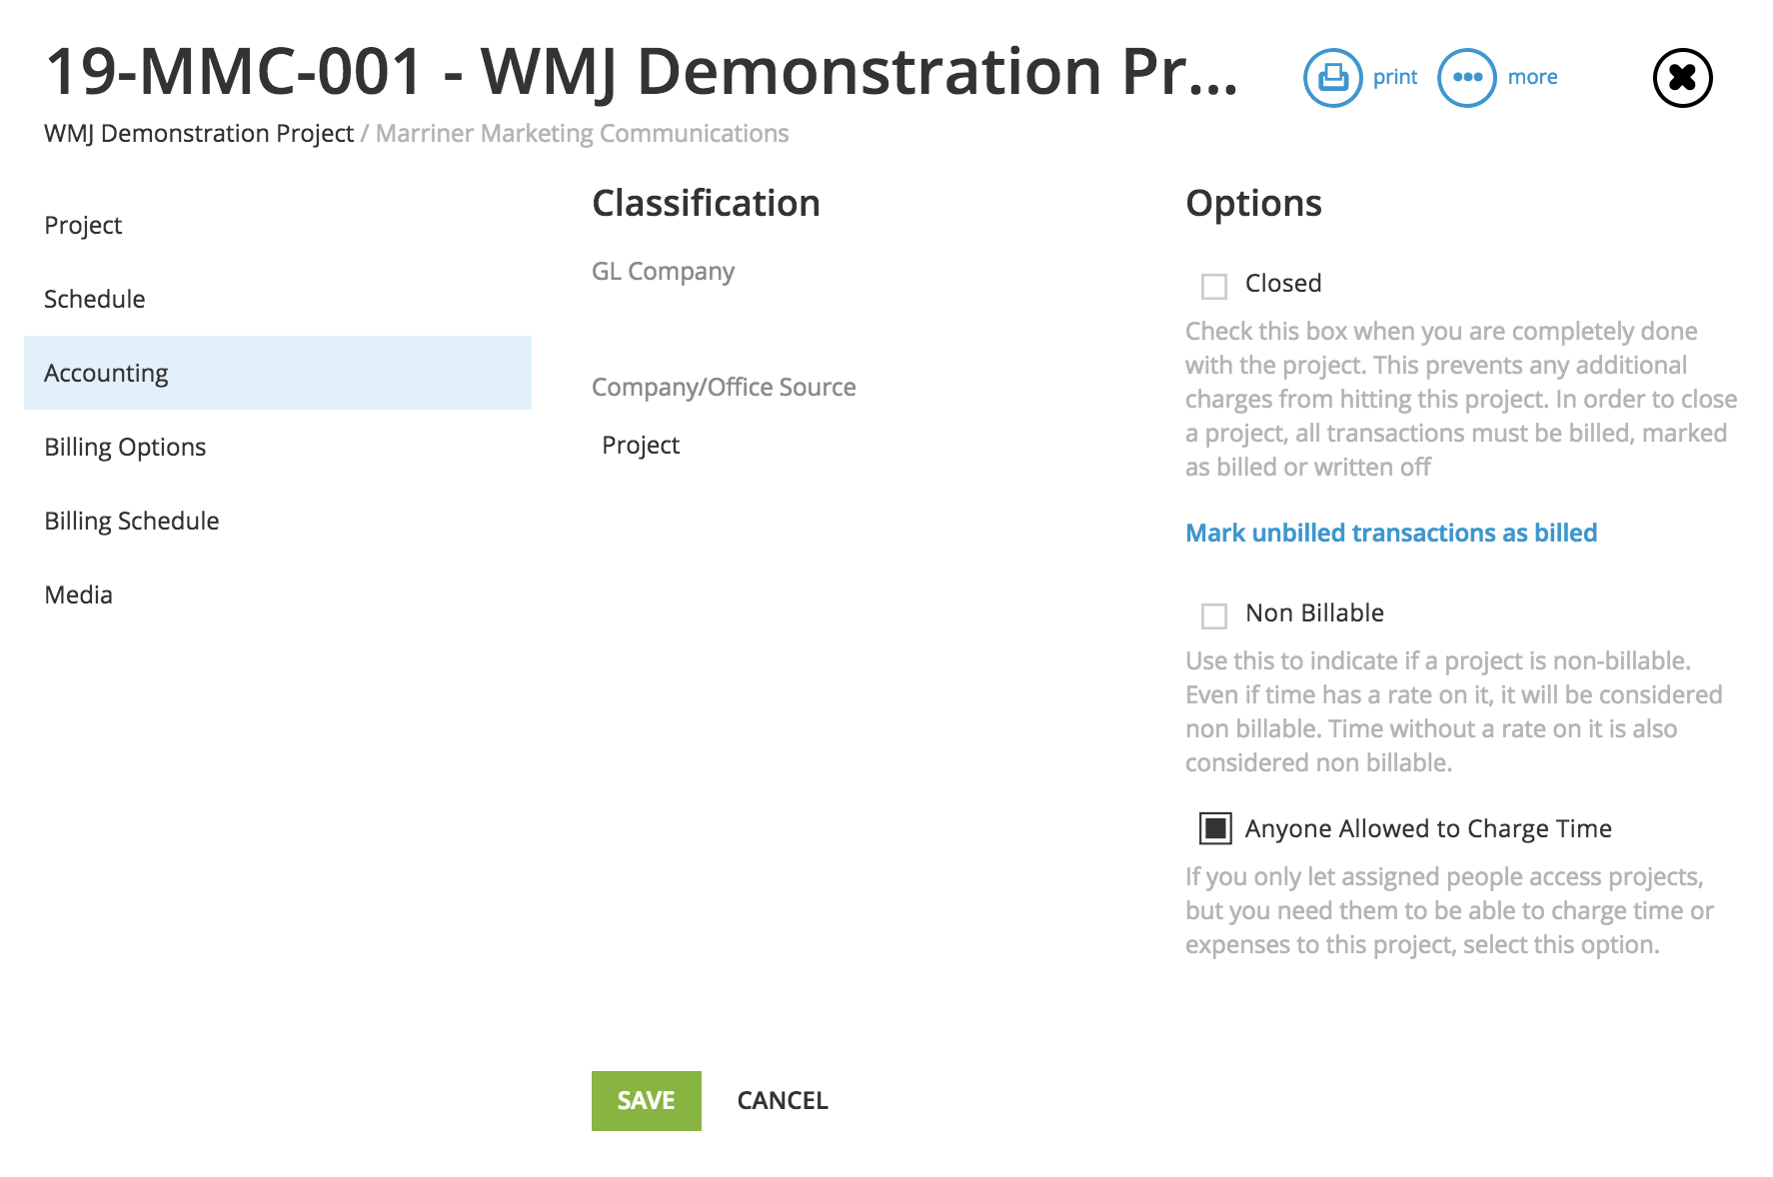
Project Settings – Accounting
Mark projects Non Billable here.
Always SAVE.
WMJ Training: Creating A Project

Slide 27
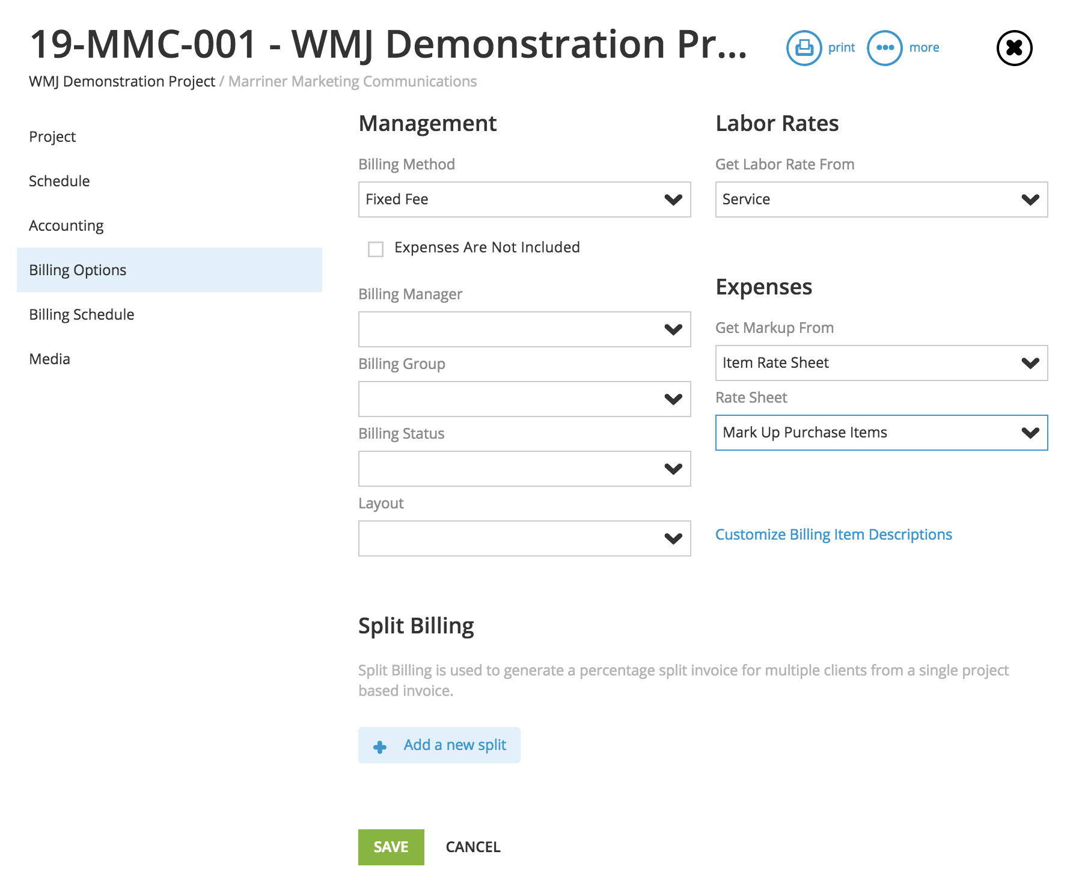
Project Settings – Billing
Confirm Billing Method matches Project Request. If retainer is selected a drop down menu will appear to choose the Client retainer.
Confirm Labor Rates and Expenses default from Client record.
Always SAVE.
WMJ Training: Creating A Project

Slide 28
Project Settings
Click on Estimates to create a new record.
WMJ Training: Creating A Project

Slide 29
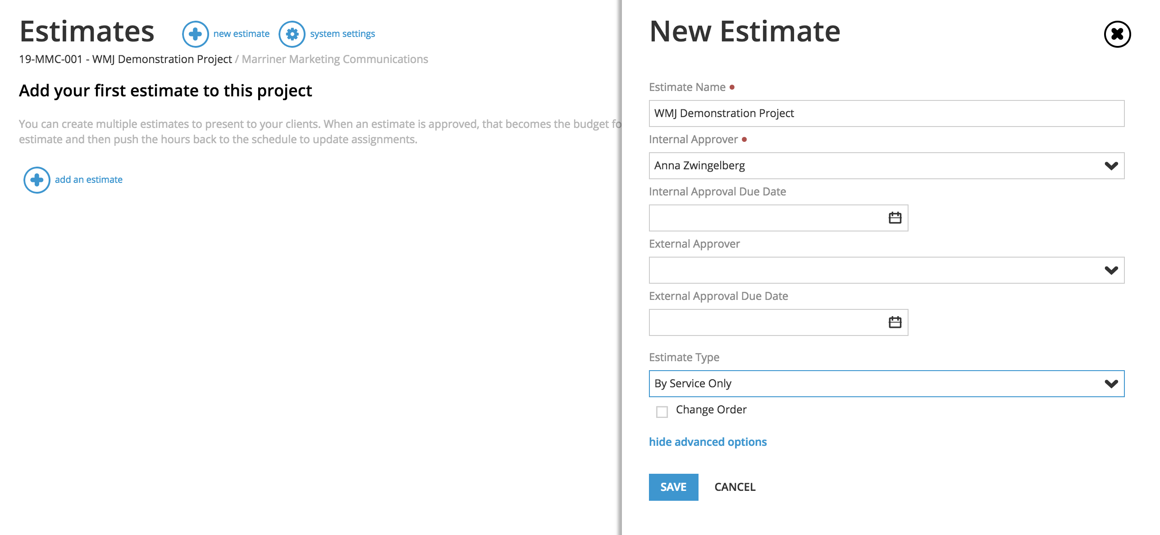
Project Estimates
Name each estimate.
Estimate Approver should be the Account Lead.
Leave External Approval fields blank.
Click Show Advance Options to check the Estimate Type is By Service Only.
Click SAVE for new estimate record.
WMJ Training: Creating A Project

Slide 30
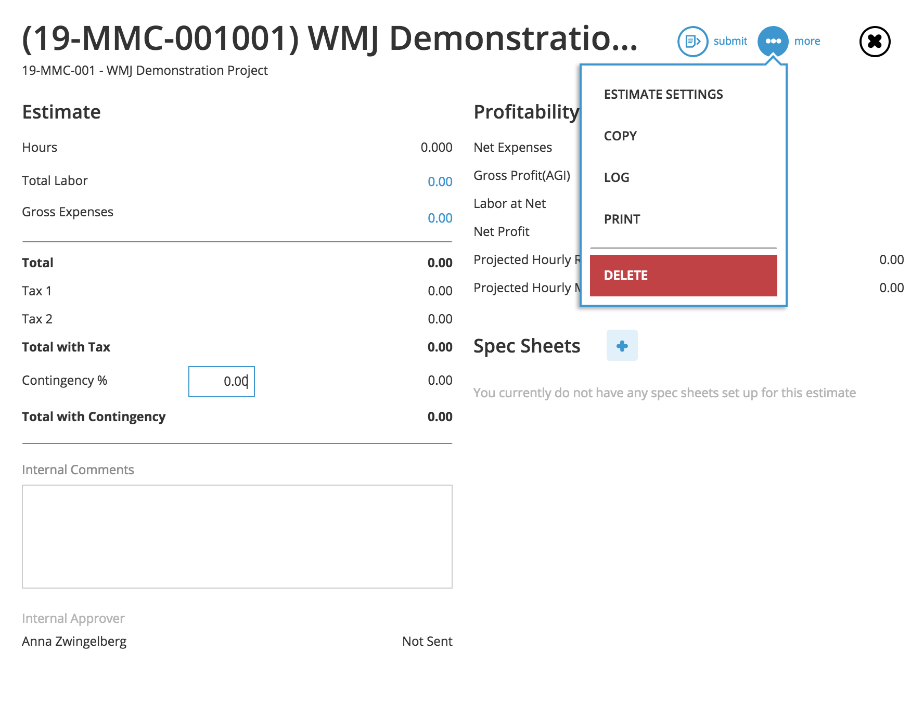
Project Estimates
Click More to review Estimate Settings.
WMJ Training: Creating A Project

Slide 31
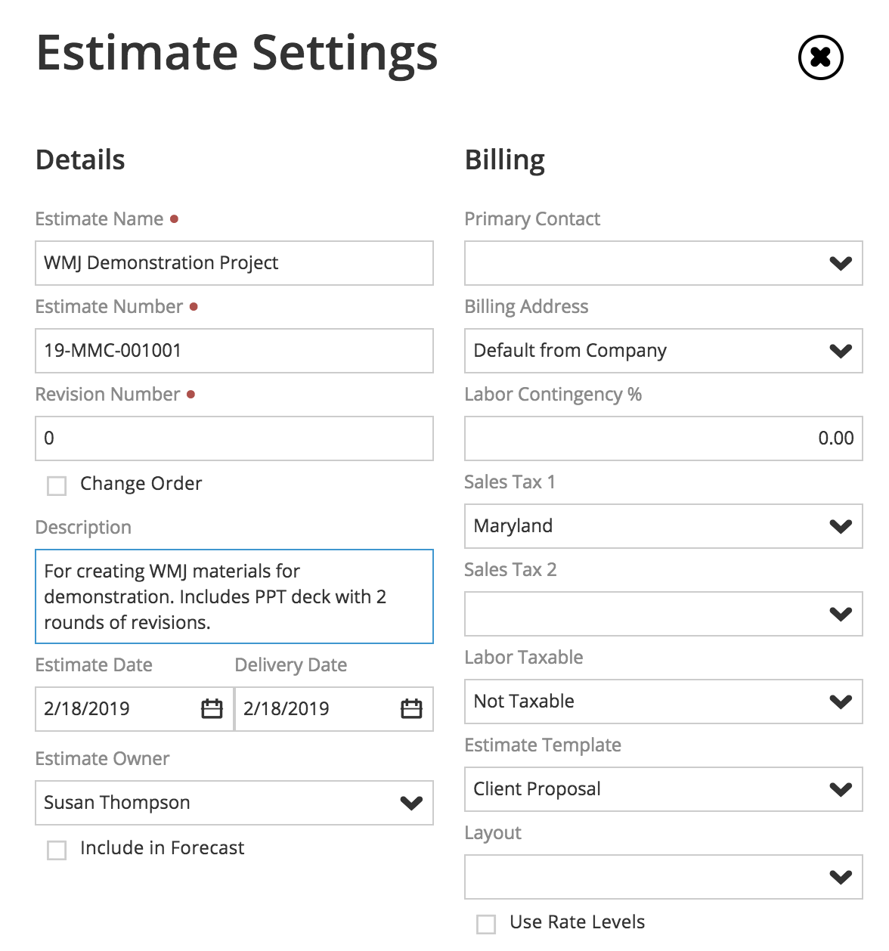
Project Estimate Settings
Estimate Description defaults from template. Make any adjustments needed.
Estimate Template for printing will default from Client settings.
Estimate Owner is Production Manager preparing estimate.
WMJ Training: Creating A Project

Slide 32
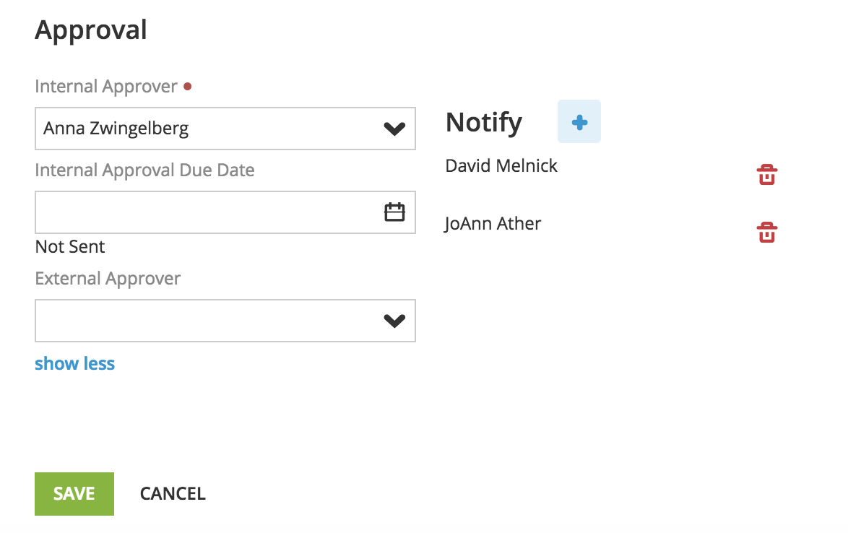
Project Estimate Settings Cont.
Add staff on estimate notification. Or delete by clicking on the trash can.
Always SAVE.
WMJ Training: Creating A Project

Slide 33
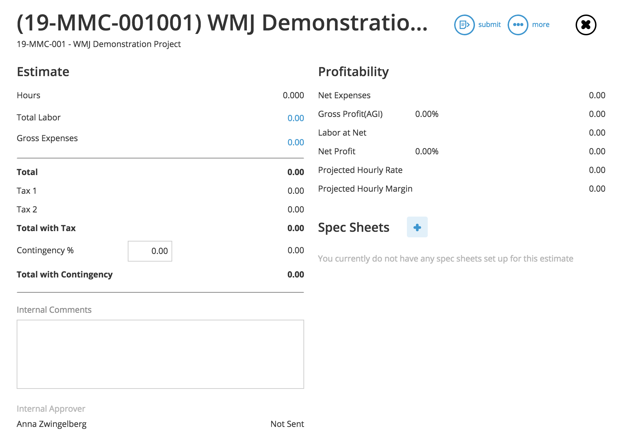
Project Estimate
Click on the blue Total Labor to add Agency services.
Click on the blue Gross Expenses to add outside vendor costs.
WMJ Training: Creating A Project

Slide 34
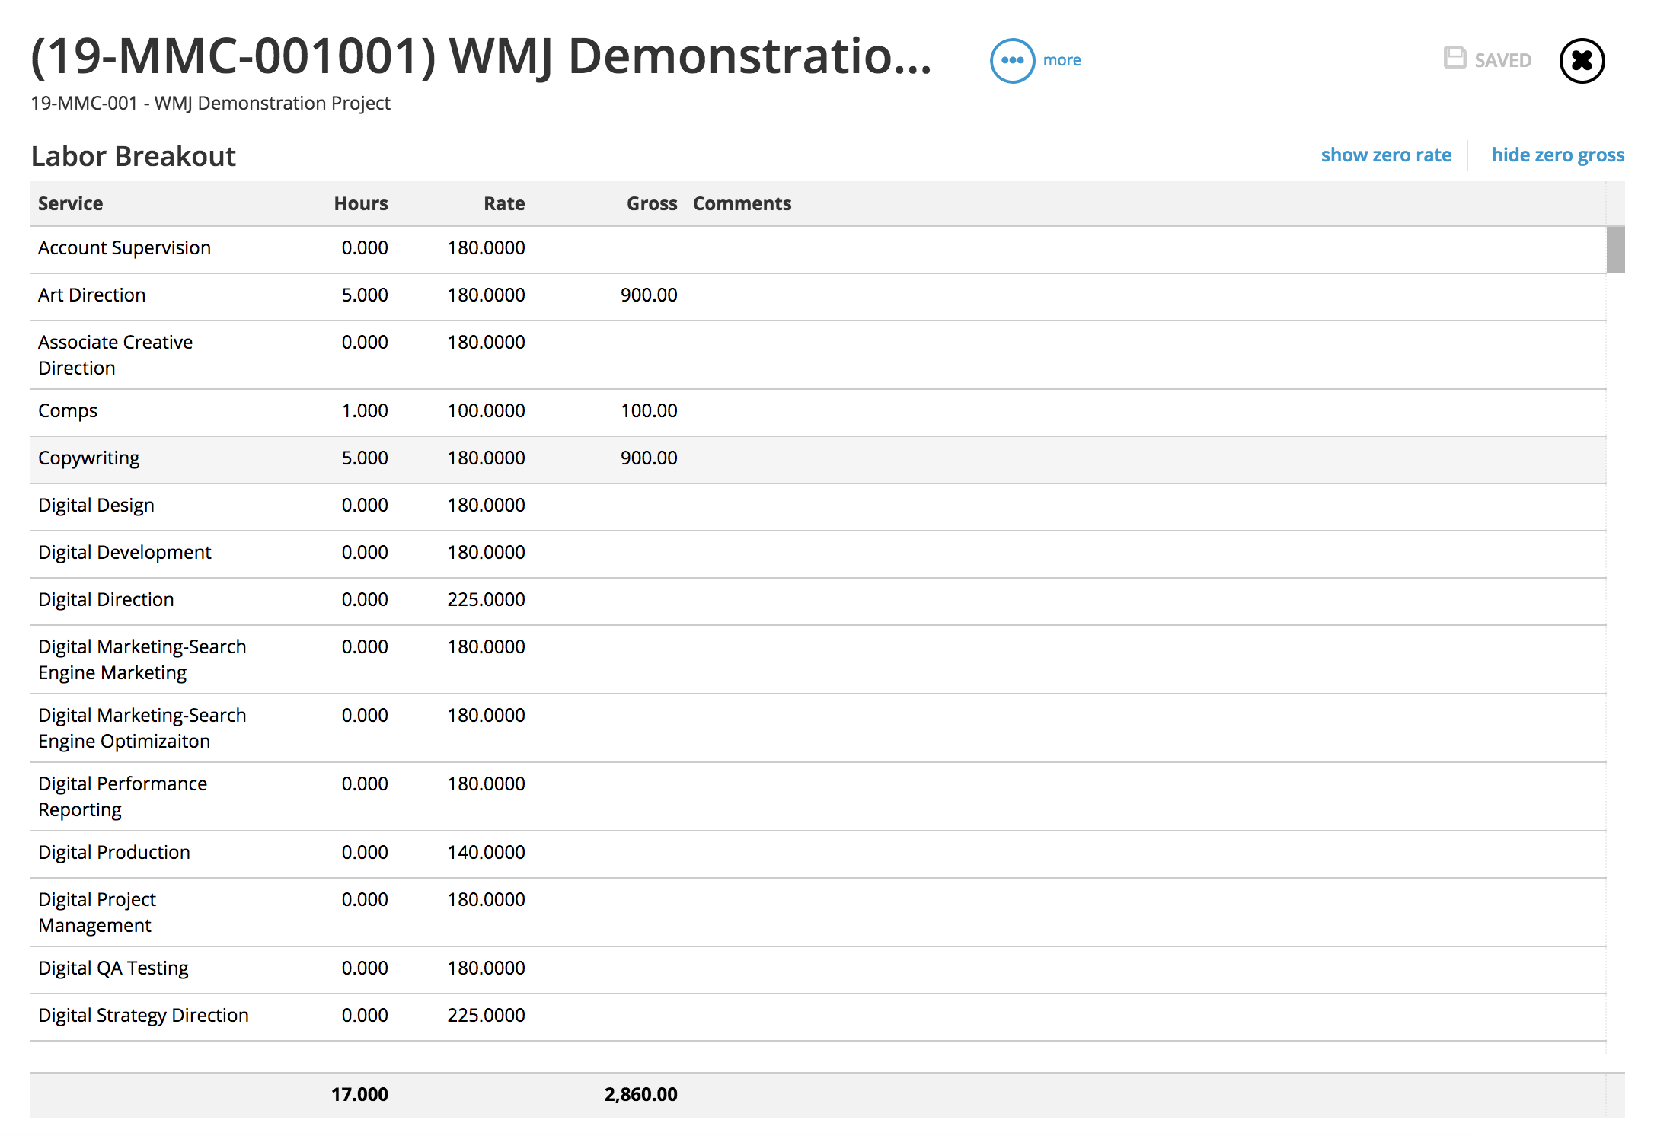
Project Estimate – Total Labor
Rates default from Client Settings.
Hours will default from template; adjust and save.
WMJ Training: Creating A Project

Slide 35
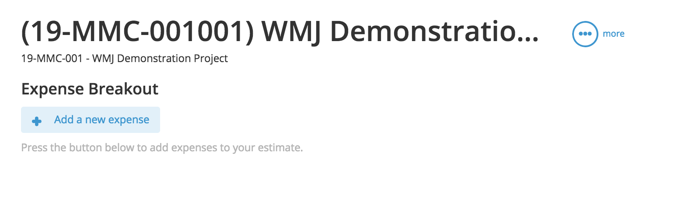
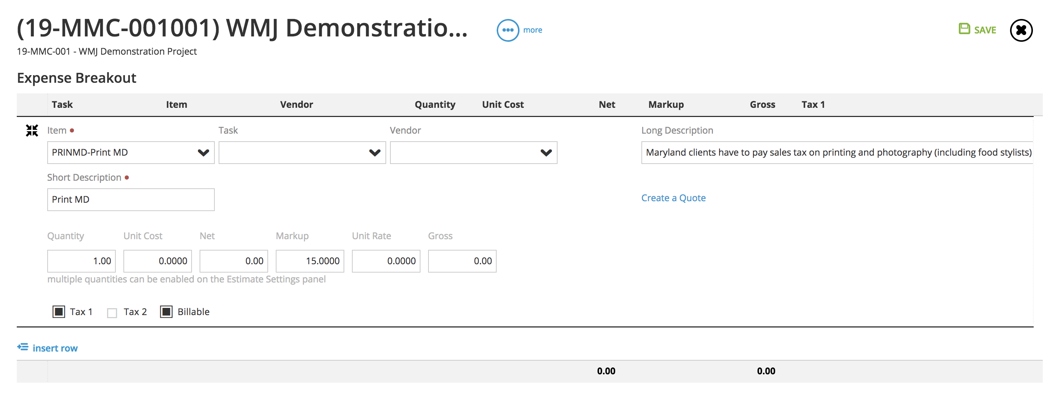
Project Estimate – Gross Expenses
Click + to add new expense.
Select Item from pull down options.
Check Tax 1 and Markup are correct for Client. If not check the correct item was selected.
WMJ Training: Creating A Project

Slide 36
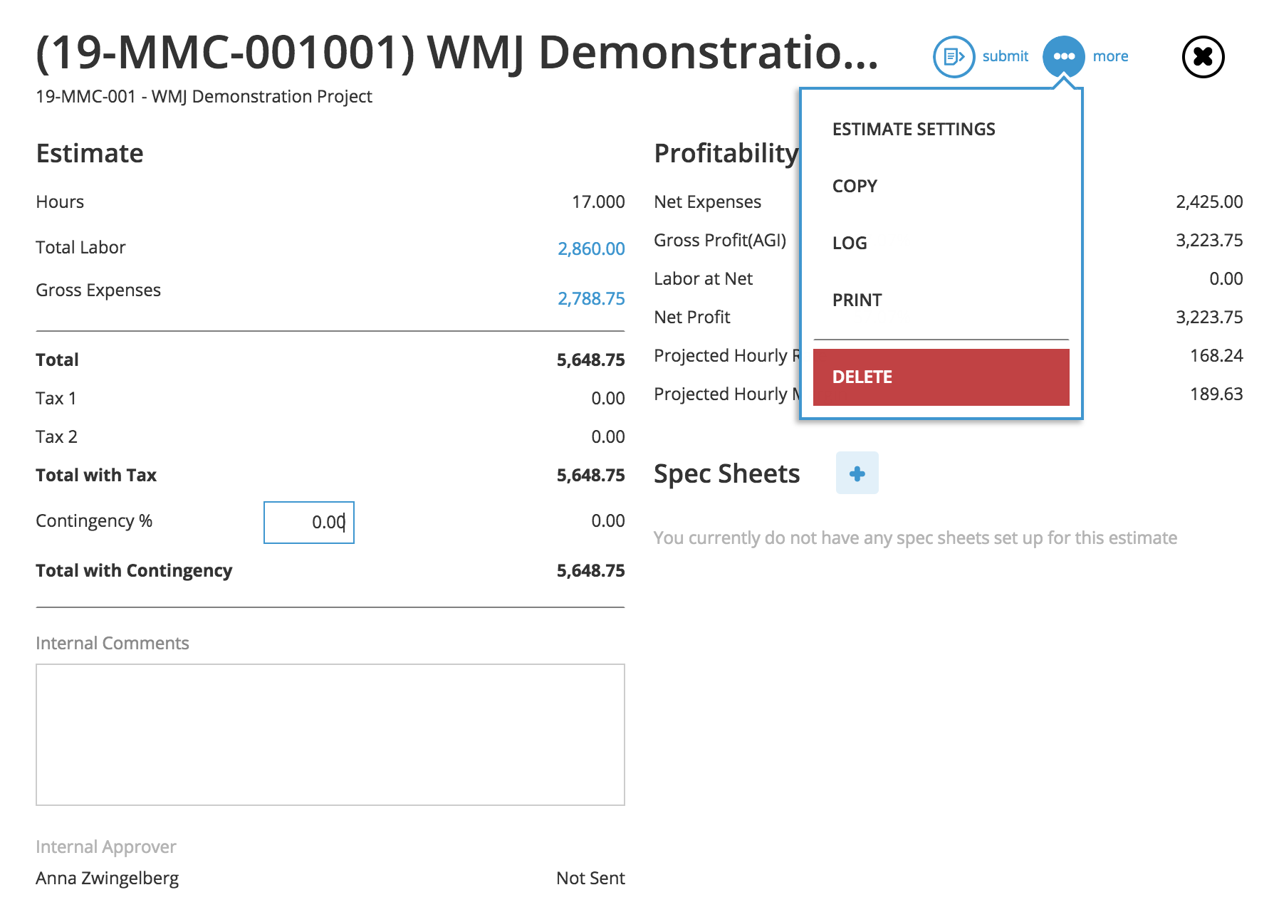
Project Estimate
2
If okay, click Submit for estimate notification to be sent to Account Lead.
Click + to add new expense.
1
Return to Estimate Summary and select Print from More to review estimate template.
WMJ Training: Creating A Project

Slide 37
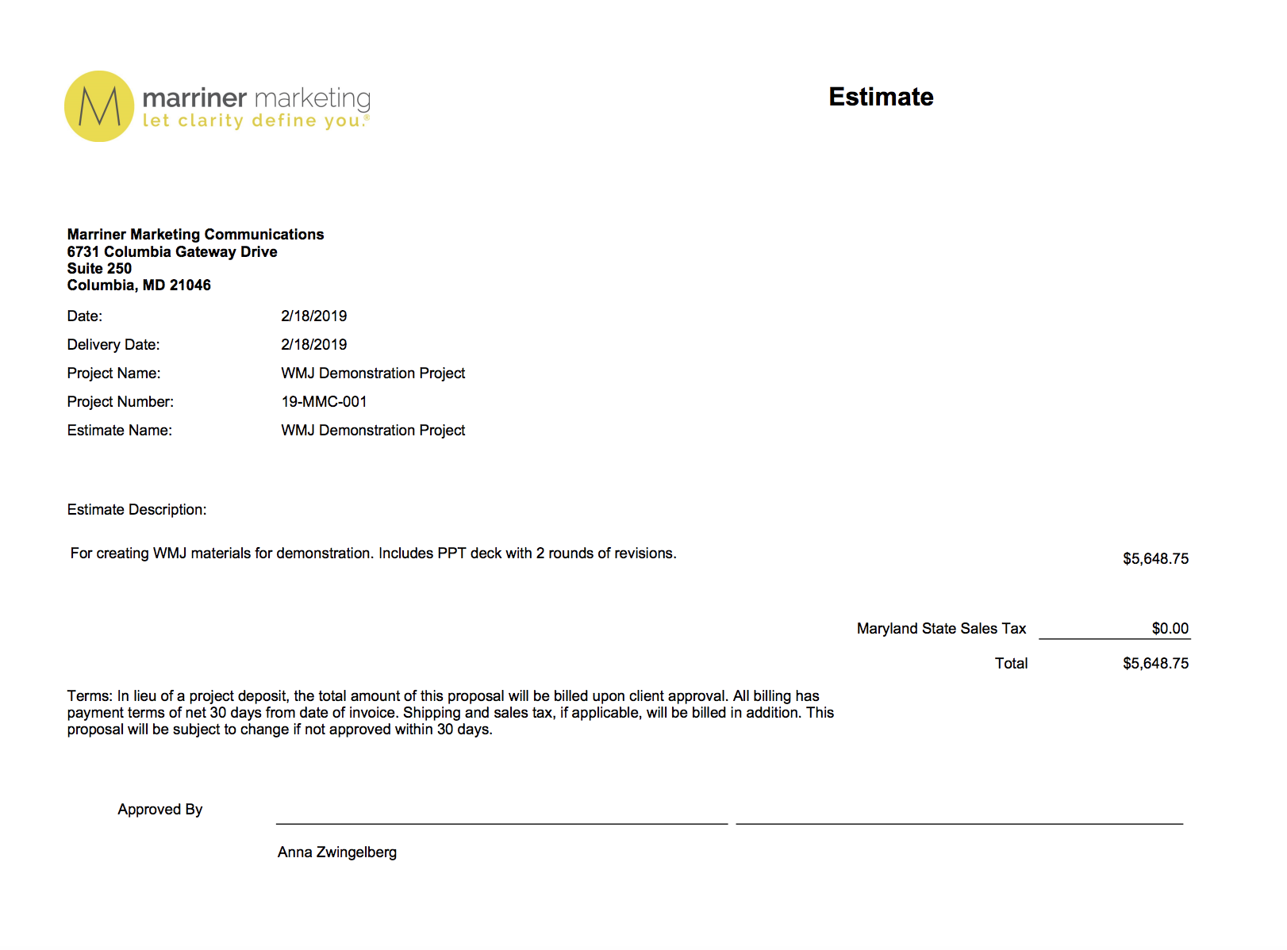
Project Estimate
The Account Lead receives a notification for estimate review/approval.
Estimate approval notifications are sent to the Marketing Assistant, Production, Resource Managers, Digital Project Manager and Creative leaders.
Active job folders will be created on the server by the Marketing Assistant.
Resource Manager or Digital Project Manager will send a Assign Team conversation and await kick off meeting invite.
*Estimate approval initiates a Client invoice.
WMJ Training: Creating A Project
Notes:
Only jobs NOT needing server folders will be noted.

