Slide 2
WMJ Training: Creating Tickets

Slide 3

New To Do – From Project
**Note: To Dos and Tickets will be used interchangeably throughout this presentation
For each client that has a Maintenance Contract, you will see a ”Digital Maintenance 20xx” Project listed under the Account.
Go to Projects to see all projects for each client. Be sure there is a Maintenance 20xx Project prior to creating a Ticket.
1
Maintenance Project listed under current Client (PLA – The Plastics Industry Association)
1
WMJ Training: How to Create & Assign Tickets

Slide 4
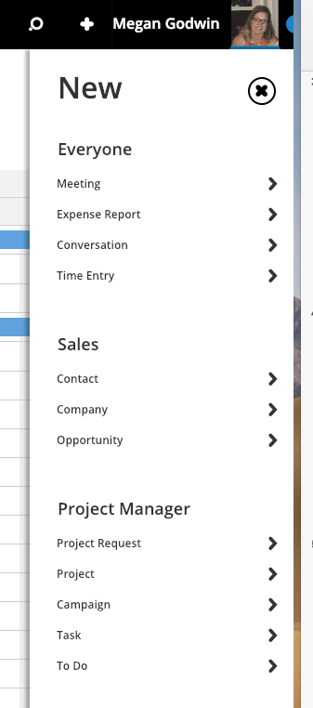
New To Do – From Toolbar
Select the “ + “ to create a new TO DO
1
Select "+” to create a New To Do/Ticket
2
Select “To Do”
WMJ Training: How to Create & Assign Tickets

Slide 5
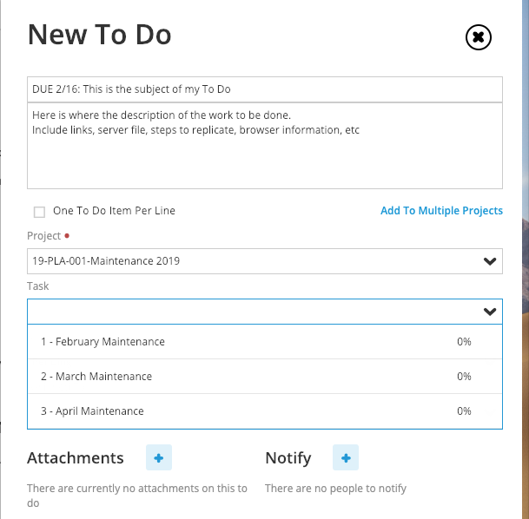
Create To Do - Details
1
Enter a Subject for your TO DO (i.e. Update Homepage Hero image) and lead with the due date
2
Enter a very specific description of the work that needs to be completed.
Please provide URLs, images (if applicable, browser information, or steps to replicate).
3
Select the PROJECT for this To Do (essentially which client is requesting the work).
If you are already in the Project, this will default to the ”active project” that you are working in.
4
Task Dropdown; select the month this To Do should fall under.
Cont..
WMJ Training: How to Create & Assign Tickets

Slide 6
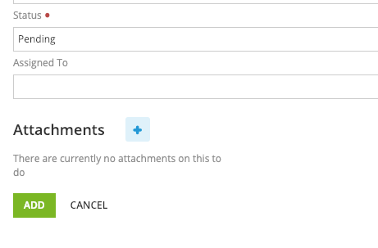
How to Create a Ticket
Once those fields are populated, make sure to look over your To Do to be sure all relevant information is included.
5
Status Field. Keep as Pending
6
Assign the TO DO to the Digital PM (Megan Godwin). This will ensure that Digital receives a notification that a ticket/To Do has been submitted.
7
Attachments; upload attachments as needed for this To Do.
WMJ Training: How to Create & Assign Tickets

Slide 7

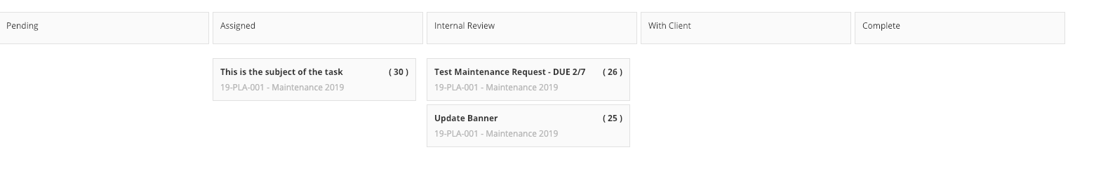
How to Create a Ticket
Once your To Do is created, it will automatically be assigned a #
You can view the ticket # different ways (Editing To Do, To Do Board)
1
Ticket #
WMJ Training: How to Create & Assign Tickets

Slide 8
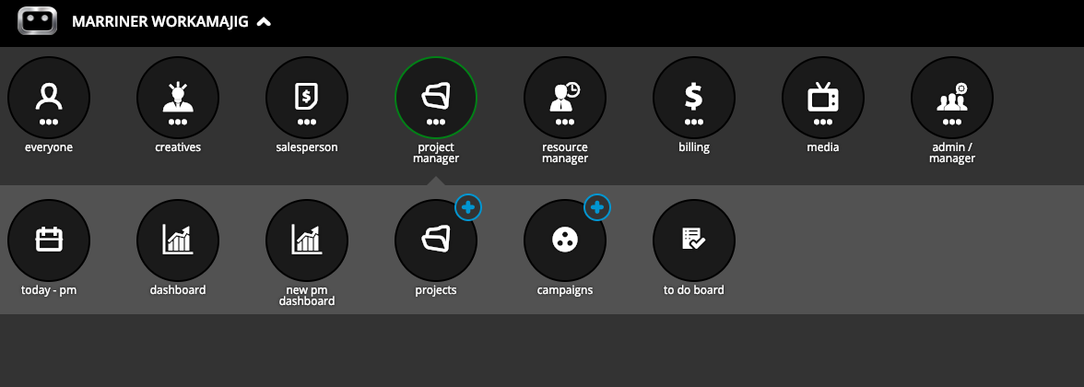
View To Do Board (active tickets)
If you want to see the Ticket Status for any Ticket you created, navigate to your To Do Board
PROJECTS ---- TO DO BOARD
WMJ Training: How to Create & Assign Tickets

Slide 9
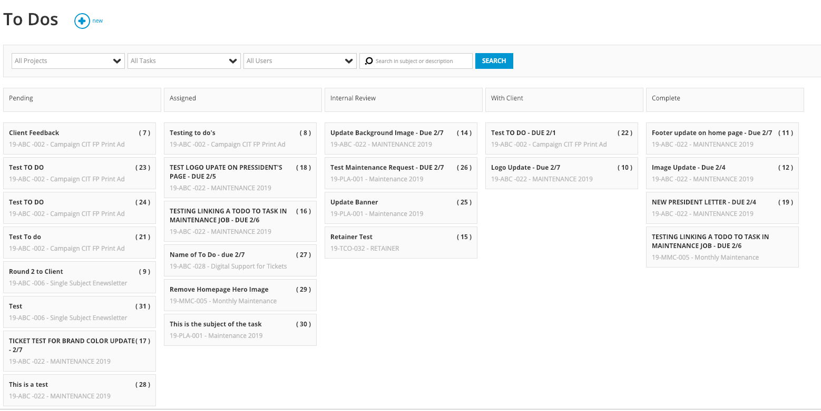
To Do Board
WMJ Training: How to Create & Assign Tickets

Slide 10
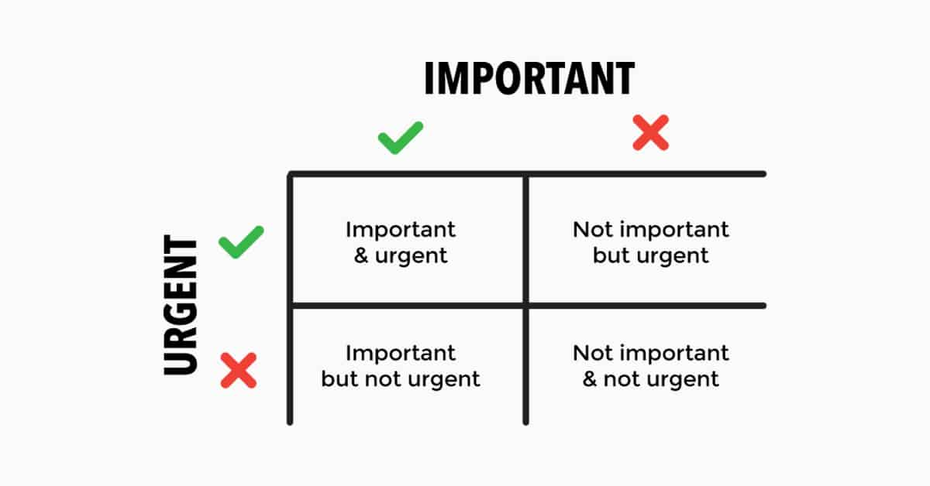
Things to Keep in Mind
Is the Website Down completely? Is a form not functioning on a Landing Page for an active campaign?
If a ticket is URGENT, please indicate that in the Subject Line. In the description, please explain WHY this request is urgent
Standard turn around time for ticket completion is 72 hours, unless otherwise communicated by the Digital Project Manager. However, if a ticket is submitted after 4:30pm, the due date may shift.
EVERYTHING IS IMPORTANT, BUT NOT EVERYTHING IS URGENT
WMJ Training: Creating Tickets
Notes:
Eisenhower Matrix
Helps you decide and prioritize tasks by urgency and importance.

Slide 11
Who Does What?
Ticket Status | Who Updates | Resource Assigned | Who to Include on Notification
Pending – Assigned | DPM (Megan) | Digital Resource | Digital Resource completing the work
Assigned – Internal Review | Digital Resource **Once work is completed, Digital Resource will mark To Do at 100% | Megan G. | Make sure Megan G is assigned to receive updates on the To Do
Internal Review- With Client | Megan | Account Team | Megan will review and assign to whomever submitted the Ticket, with a note
With Client – Complete | Account Team | Megan G | Once the updates are completed, the Account
With Client - Pending | Account Team | Megan G | AT will re-open the ticket if there are questions or they are not seeing the changes
WMJ Training: Managing Your Tickets

Slide 12
WMJ Training: Assigning Tickets

Slide 13
Assigning Tickets
As To Dos/Tickets are created, the DPM will review each request.
Should any questions arise when reviewing tickets, all questions/feedback will happen in COMMENTS of that ticket.
For To Dos that are submitted and anticipated to take more than 72 hours, the DPM will comment back to the account person within 24 hours of receiving the ticket.
Once the request is fully baked, the ticket will be assigned.
For the individual responsible for the work within the To Do, they will receive an email notification that a To Do has been assigned to them.
WMJ Training: Assigning Tickets

Slide 14
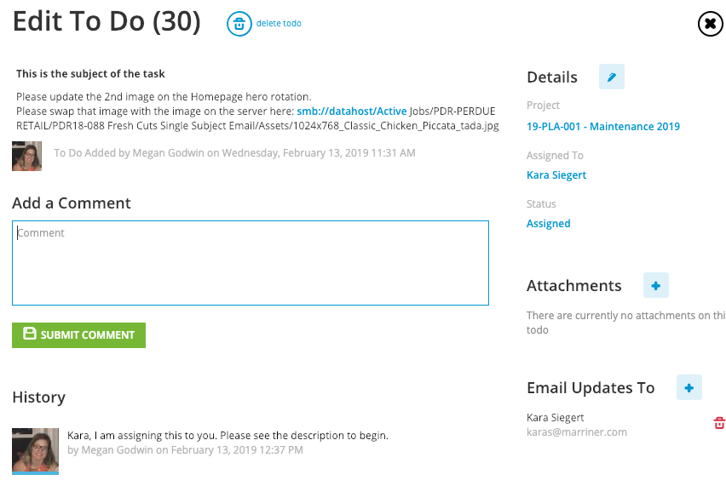
Assigning Tickets
1
Ticket Communication happens in the Comments of a To Do
2
Ticket Assignment
WMJ Training: Assigning Tickets

Slide 15
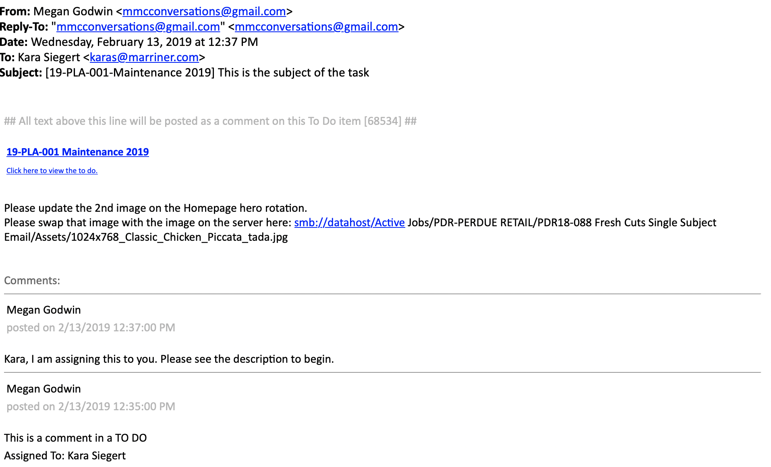
Assigning Tickets
Email notification that a To Do has been assigned and work can begin
WMJ Training: Assigning Tickets

Slide 16
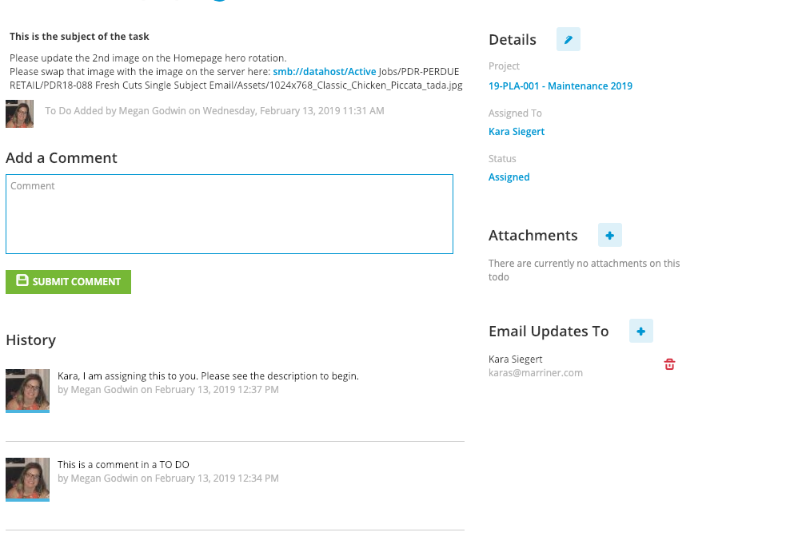
Assigning Tickets
From here, you can click directly in to the To Do
You can also view details of the To Do from your To Do Board
WMJ Training: Assigning Tickets

Slide 17
WMJ Training: Managing Tickets

Slide 18
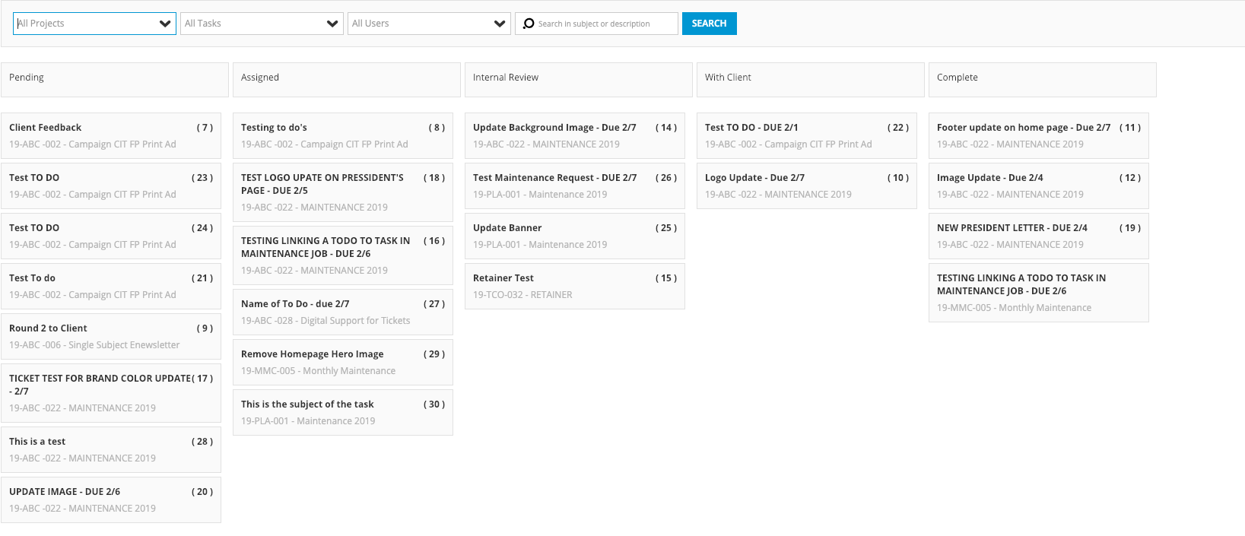
Managing Your Tickets
Go to Projects > To Do Board
This allows you view all tickets and the status of those Tickets assigned to you
WMJ Training: Managing Your Tickets

Slide 19
Who Does What?
Ticket Status | Who Updates the Ticket | Resource Assigned | Who to Include
Pending – Assigned | DPM (Megan) | Digital Resource | Digital Resource completing the work
Assigned – Internal Review | Digital Resource **Once work is completed, Digital Resource will mark To Do at 100% and move to Internal Review | Megan G. | Make sure Megan G is assigned to receive updates on the To Do
Internal Review- With Client | Megan | Account Team | Megan will review and assign to whomever submitted the Ticket, with a note and/or link
With Client – Complete | Account Team | Megan G | Once the updates are completed, the Account team will comment and move the status to complete
With Client - Pending | Account Team | Megan G | AT will re-open the ticket if there are questions or they are not seeing the changes
WMJ Training: Managing Your Tickets

Slide 20
WMJ Training: Tracking Time

Slide 21
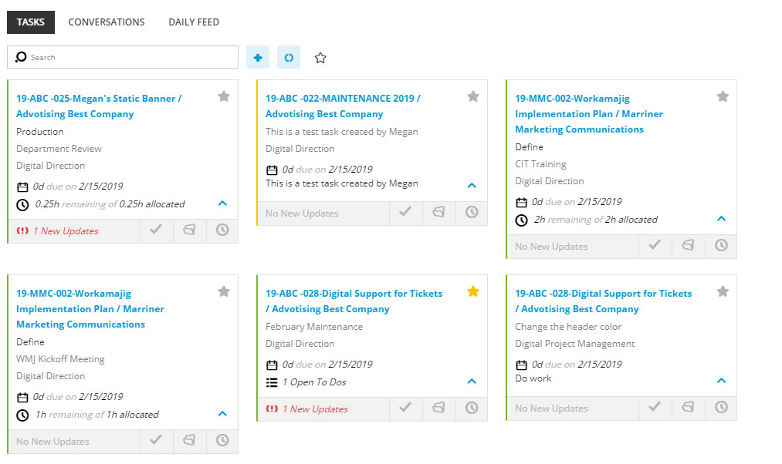
Track Time to Task
Find the task for the month that is assigned to you on your Creative Today page
WMJ Training: Tracking Time

Slide 22
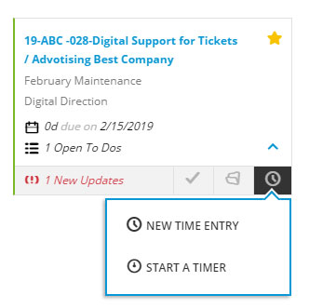
Track Time to Task
2. Click on the clock icon and then “NEW TIME ENTRY”
WMJ Training: Tracking Time

Slide 23
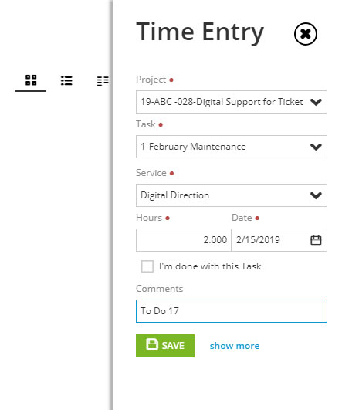
Track Time to Task
3. A slide-out form will appear for you to add your time.
Be sure the Digital Support project is selected for the correct client
Track your time to the appropriate month task
Select the type of service that you provided
Enter the number of hours in 15 minute increments
(.25, .5, .75, 1, etc.)
Enter the To Do number that you completed in the format on the left
WMJ Training: Tracking Time

