Slide 2
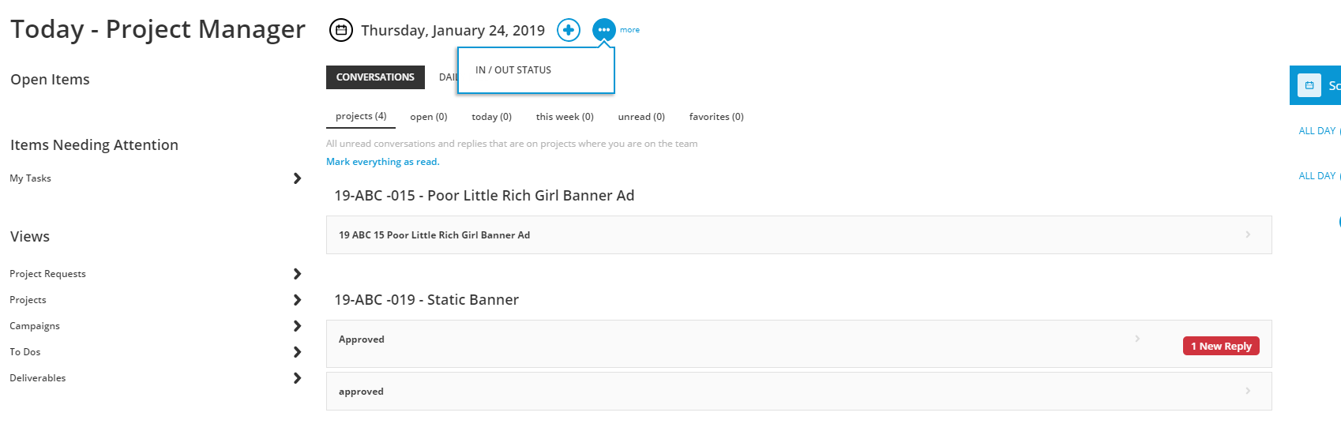
In/Out Status
Workmajig allows custom in/out office status to keep staff informed. Comments can also be added.
Go to the “Today” page and select “… more”
Workamajig: Viewing Staff Status
Notes:
Let’s Define IN and Out
IN means you are working (from home, at a client

Slide 3
In/Out Status
Let’s define IN and OUT
IN
You are working in the office.
Or remotely, from home, at a client office, or in a different office than expected.
Please include your location in the comment box if you are not in the Marriner office at Columbia Gateway.
OUT
You are not working (you are on vacation or sick).
People should not bother you.
Workamajig: Viewing Staff Status
Notes:
You are still responsible for communicating with your supervisor and front desk.

Slide 4
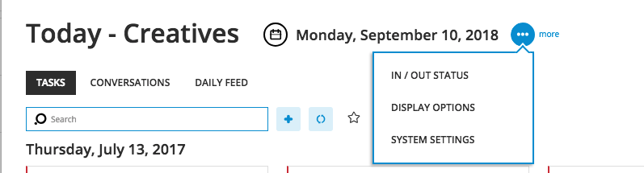
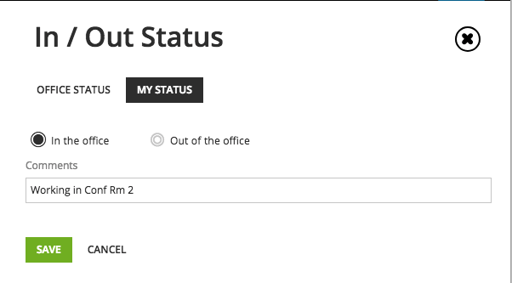
In/Out Status
The “My Status” tab allows each person to adjust status.
Enter comments here.
Workamajig: Viewing Staff Status

Slide 5
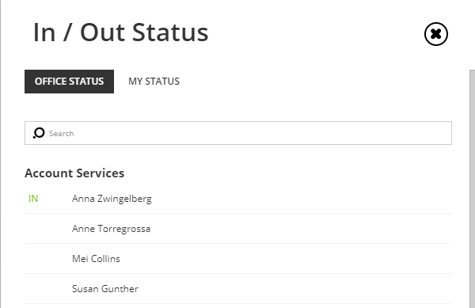
In/Out Status
The “Office Status” Tab allows access to coworker status.
Workamajig: Viewing Staff Status

