Slide 2
the mobile web experience

Slide 3
background

Slide 4
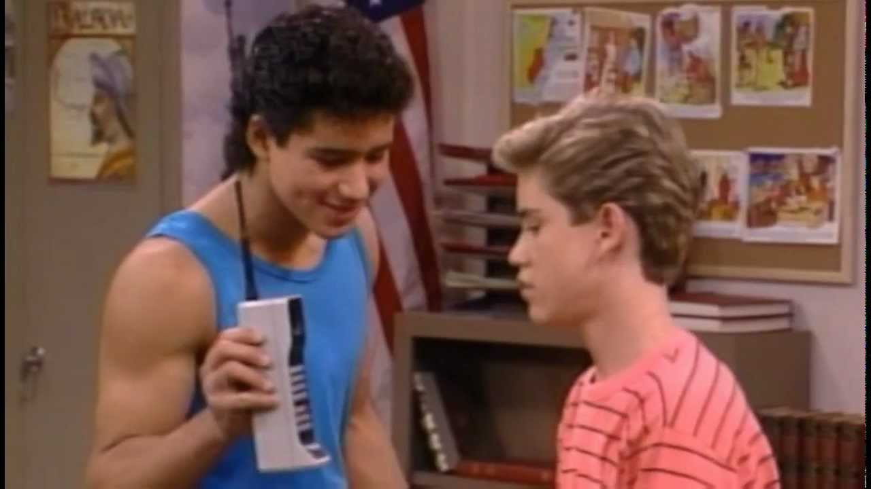
what is mobile?
Right now we think of phones, perhaps a smart watch or tablet device. But basically any computing experience while on the go.
Websites
Dedicated Applications
Communication (Phone, Text, Social)
Games
Video
Audio
Tools (Maps, camera, etc.)

Slide 5
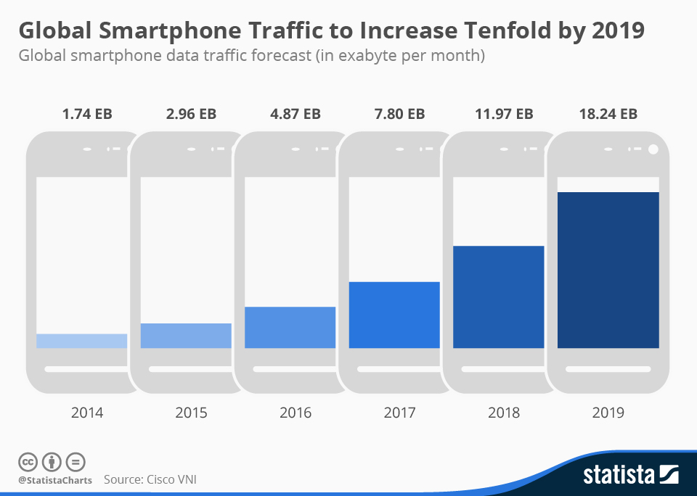
growth
It’s growing exponentially. (But I’m sure you knew that. It’s not new news)

Slide 6
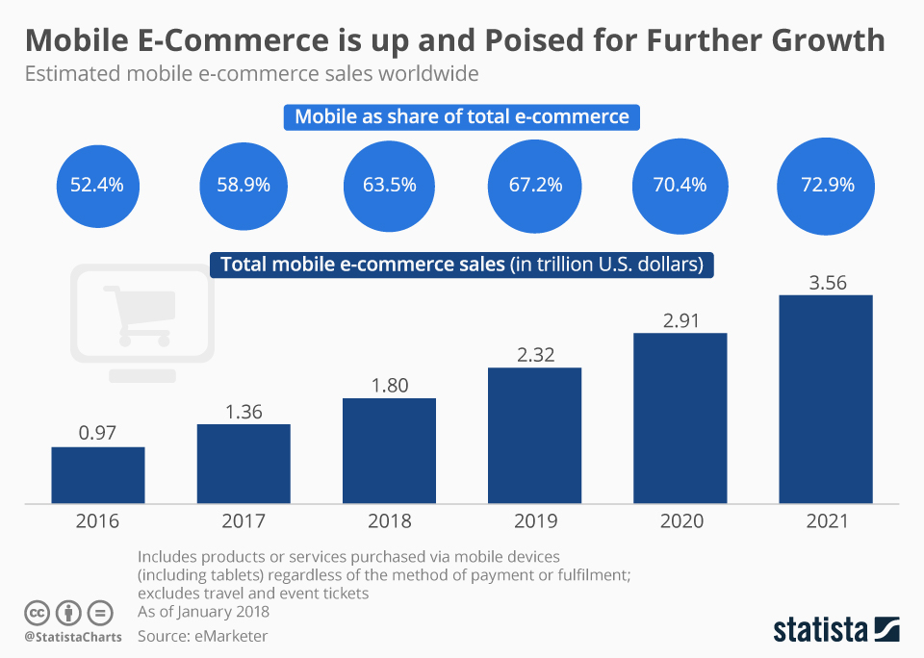
e-commerce
Customers are online and they’re more and more likely to be mobile. We need to be moving in this direction.

Slide 7
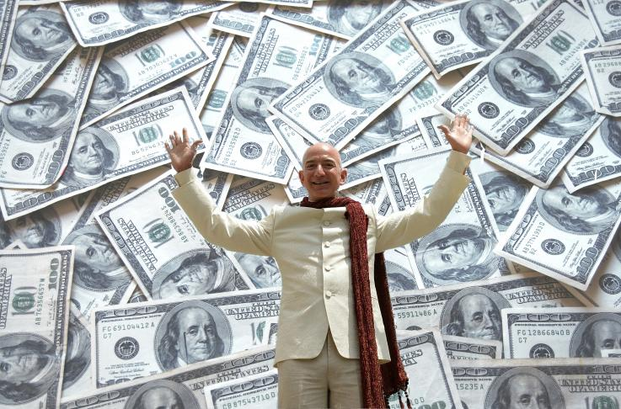
e-commerce
After all, websites are sales tools.
So let’s make them sell.

Slide 8
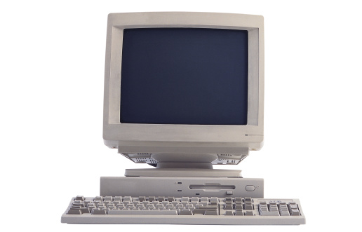
the good old days
Websites were originally designed for desktop computers. You only needed one design.
Screens got bigger and so did designs.
Then small screens began showing up, although the mobile web was slow, mostly text-based and expensive to use.

Slide 9
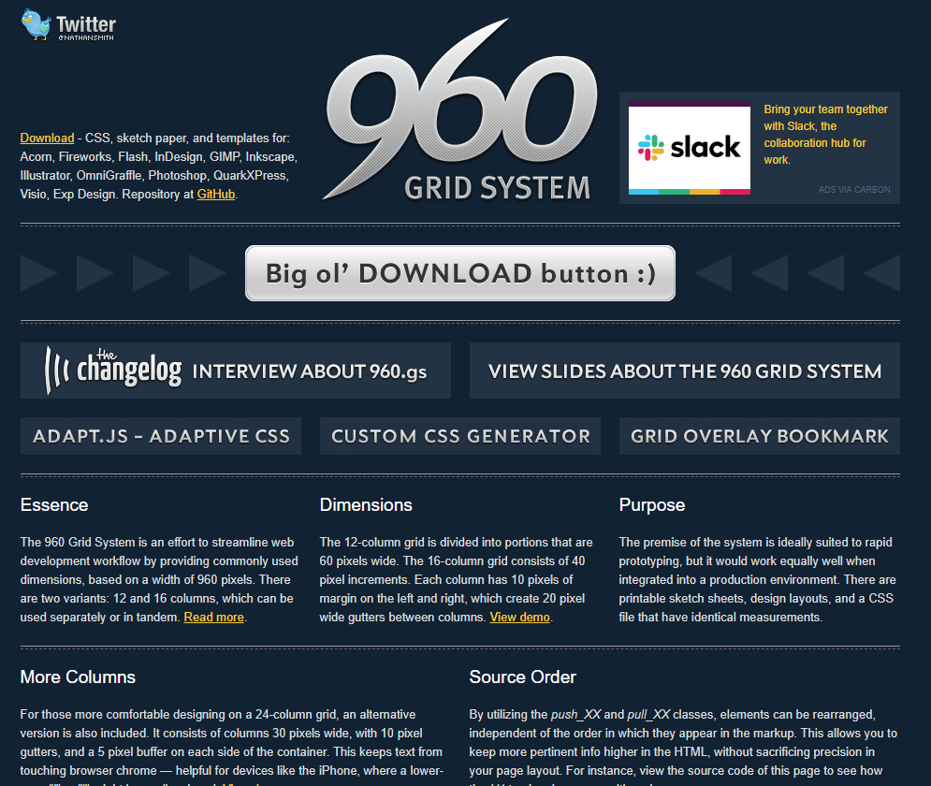
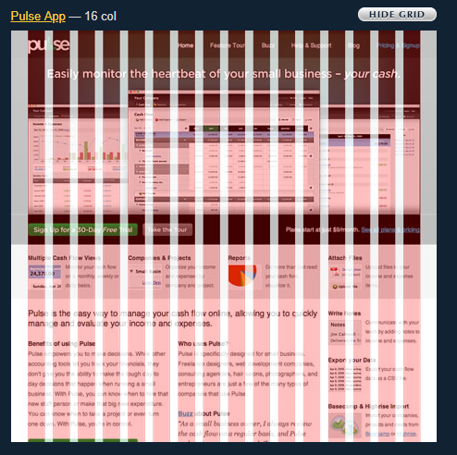
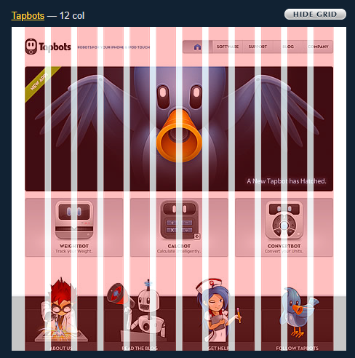
gridlocked
We finally nailed desktop design layouts with columns, general sizing not larger than 960px.

Slide 10
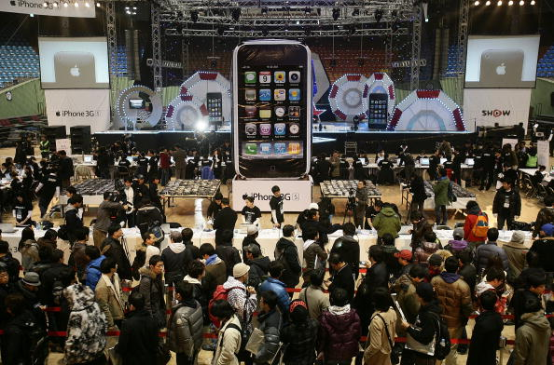
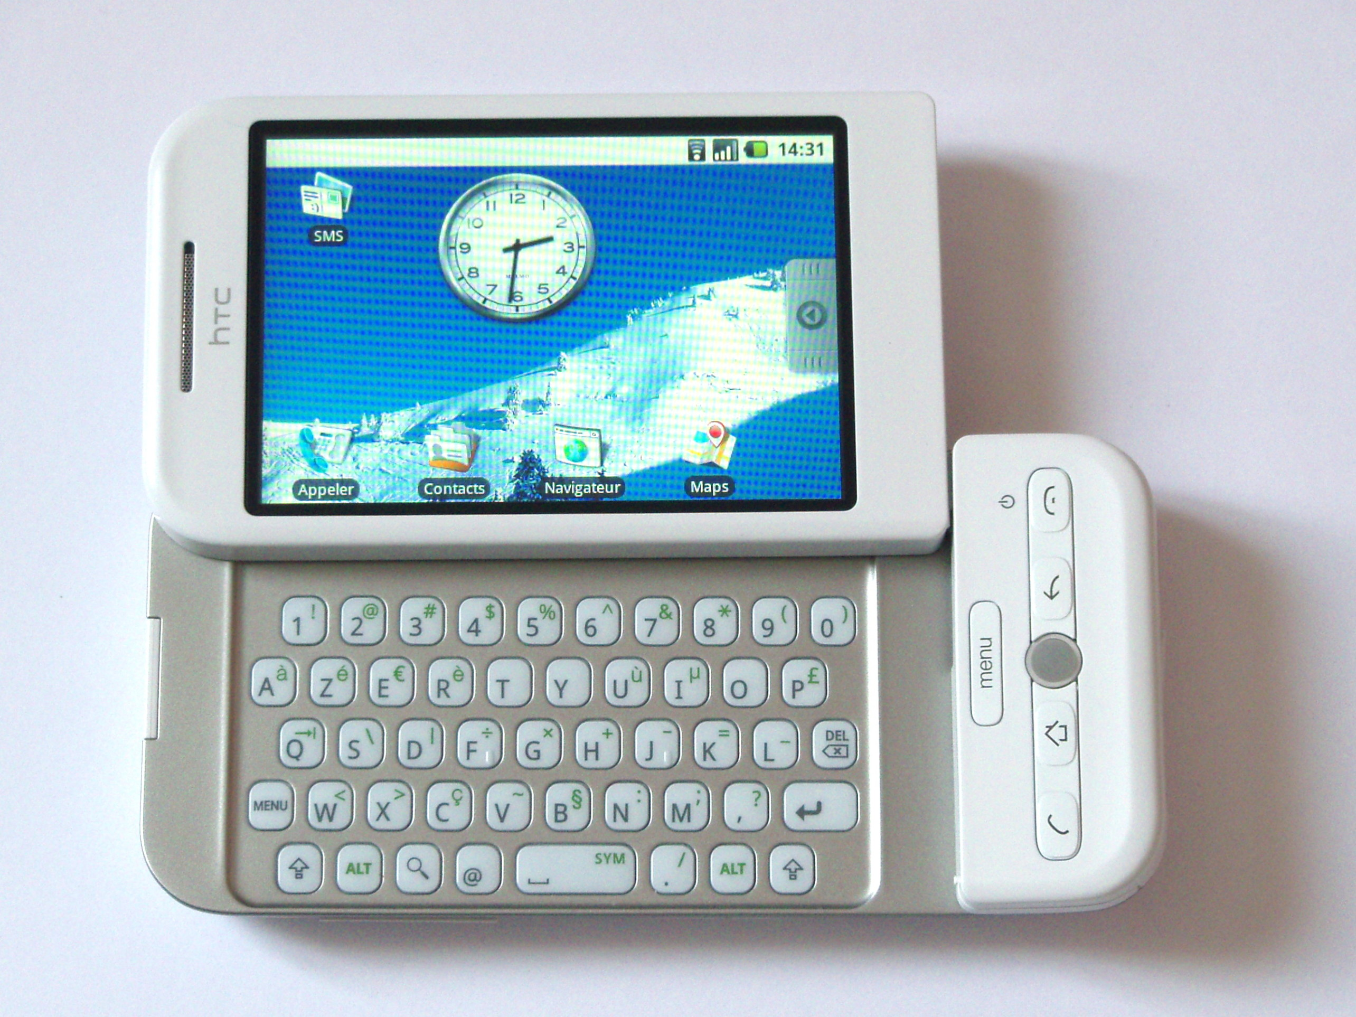
the wild west
Then mobile truly happened. Faster cell networks, more powerful phones and mobile devices. But mobile design was still separate. Even separate subdomains, sites, apps and experiences.

Slide 11
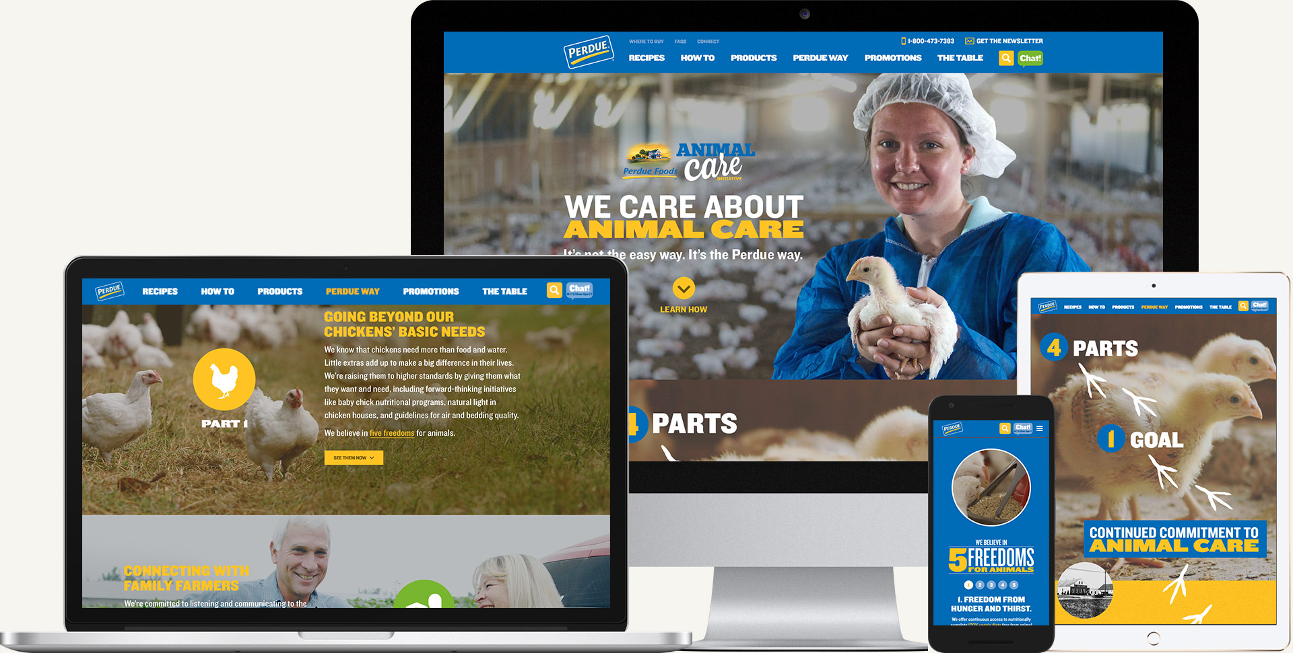
Fluid layouts
Breakpoints were everywhere. Fluid layouts are better. Expand, contract, fill, shrink or grow for any device, not just a list of certain devices.

Slide 12

mobile first?
But does mobile really need to be FIRST?
It’s a buzz word.

Slide 13
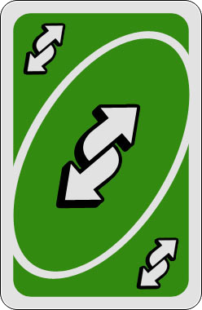
to mobile and beyond
I get it. I do. Mobile is important. But if all we do is put mobile first, that means desktop is last.
And we’re left with the reverse of the old situation:
Desktop works great but mobile is an afterthought and feels a bit off.
Now mobile is great, but desktop is the afterthought and is awkward.

Slide 14




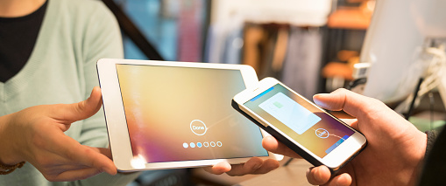
Design for the entire web experience, not each device.

Slide 15
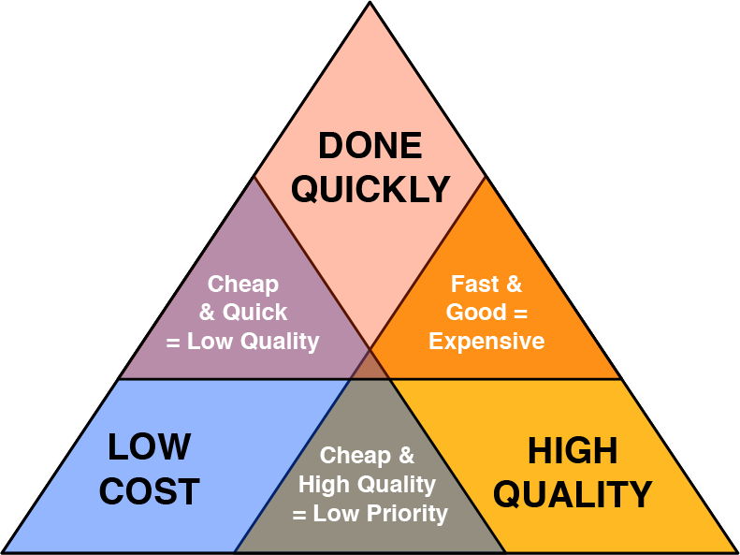
an ideal world
There’s not always the time or budget to pull off all of the thinking, planning, designing and programming necessary for a perfect web experience. But, we’ll make compounding gains with each new project.

Slide 16
groundwork

Slide 17




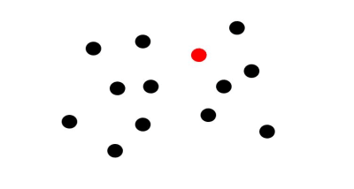
get the brain’s attention
Make things stand out naturally. Not with annoying or overcomplicated gimmicks.
Orientation
Size & Shape
Color
Also movement. Think simple motion, hovers, and micro-interactions to improve the experience.
https://www.smashingmagazine.com/2019/01/grabbing-visual-attention-with-the-visual-cortex/

Slide 18
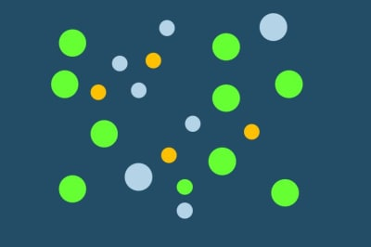
don’t overdo it
Please, educate the clients that less is more. Whitespace is good. Use simple, clear and concise messaging.
When everything stands out, nothing stands out.
The message is missed.
Or worse: ignored.
https://www.smashingmagazine.com/2019/01/grabbing-visual-attention-with-the-visual-cortex/

Slide 19
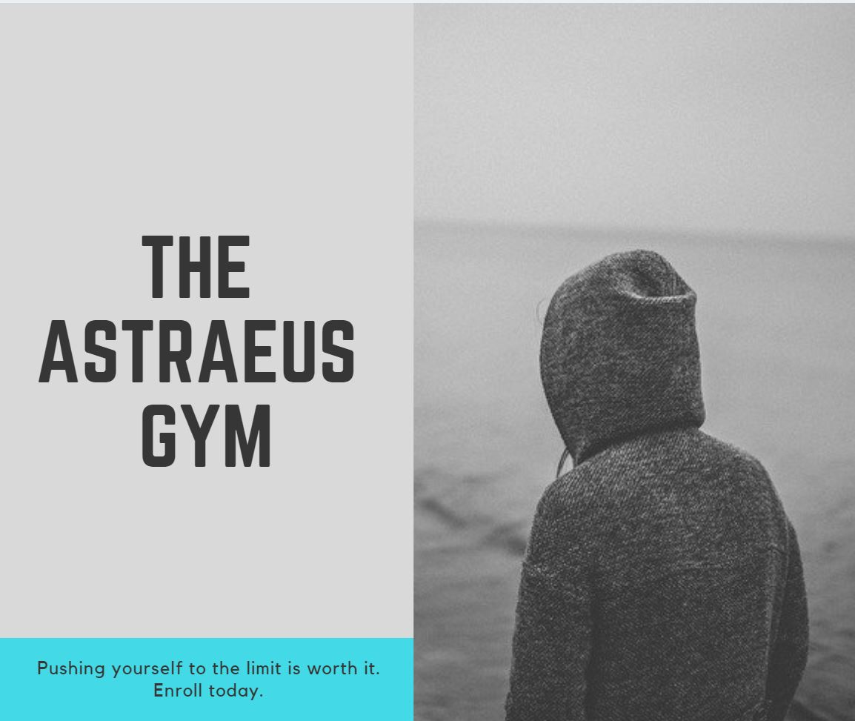

for example
Which one draws your attention to the CTA? Functional design is even more important in the world of mobile.
(Maybe the CTA design could be better, more button like, “ENROLL TODAY,” but it certainly gets lost in the one on the right)
https://www.smashingmagazine.com/2019/01/grabbing-visual-attention-with-the-visual-cortex/

Slide 20

people like people
Our brains are sensitive to faces.
Is this a face?
Someone I know?
Someone I know personally?
What are they feeling?
https://www.smashingmagazine.com/2019/01/grabbing-visual-attention-with-the-visual-cortex/

Slide 21


make eye contact
Eye contact with the user gets attention. It takes the primary focus of the layout.
Profiles may eventually get attention, but not as fast and if they’re obscured, perhaps not at all.
Objects work, too.
https://www.smashingmagazine.com/2019/01/grabbing-visual-attention-with-the-visual-cortex/

Slide 22
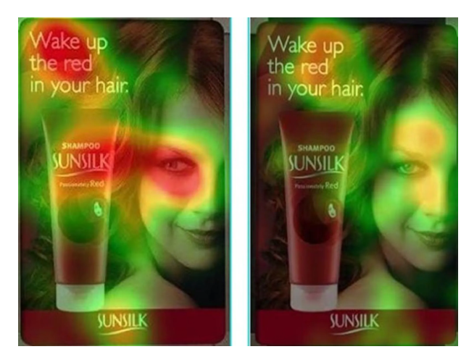
their focus sets your focus
https://www.smashingmagazine.com/2019/01/grabbing-visual-attention-with-the-visual-cortex/

Slide 23
be unique

Slide 24
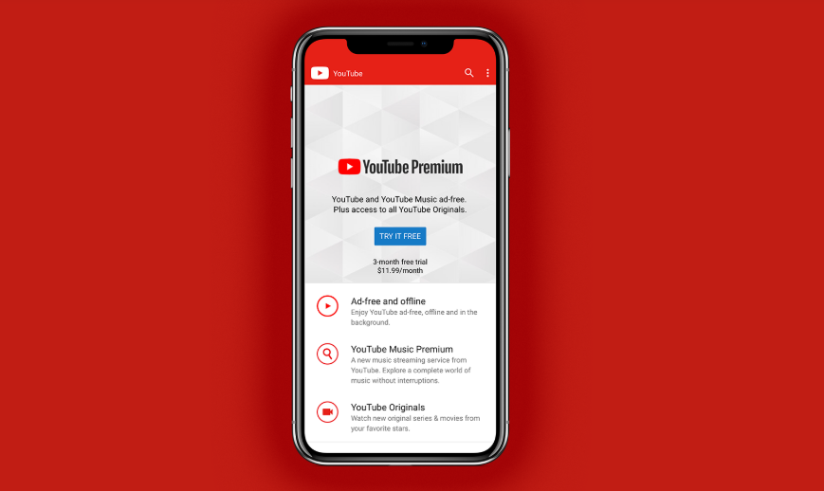
your experience is unique
“YouTube built their strategy around what everyone else was doing, and now they are coming to grips with a truth that is all too frequently ignored: Emulation is not a product strategy.”
“YouTube was never going to pull off the Netflix model. It’s not part of their fingerprint. It doesn’t align with the role YouTube plays in its customers’ lives. The platform’s big pivot has little to do with the public’s willingness or unwillingness to pay for another subscription.”
Full disclosure: I pay $9.99/mo for YouTube (and music) but I do it to get rid of the ads, not to watch their “premium” content.
https://medium.com/s/user-friendly/emulation-is-not-a-product-strategy-cfecdbffce96

Slide 25
you do you
Good design is good design, but remember your brand, product, target audience and any unique experiences, identifiers and lifestyles and let the UI be an extension of that.
“When a company copies another product, they assume that what they’re copying is actually successful for the company they’re emulating, and that original product was designed to accomplish the same goal.”
“We all fall victim to the pull of emulation. Just look at how similar the UI for most apps has become. But what opportunities are we missing by playing copycat?”
https://medium.com/s/user-friendly/emulation-is-not-a-product-strategy-cfecdbffce96

Slide 26
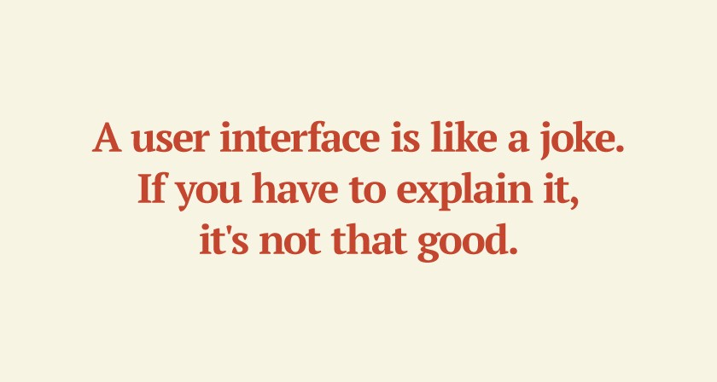
mobile users people
“The judge of a good UI/UX design shouldn’t be the designer, the manager, or even the CEO. It should be the user. Why else would it be called user interface and user experience?”
I’d add that the designs should be data driven: based on user actions and the funnel we’re looking for them to take. Ultimately all the way to the sale.
https://medium.com/s/user-friendly/three-bad-habits-of-ui-ux-designers-75b9fa0d889a

Slide 27
search

Slide 28
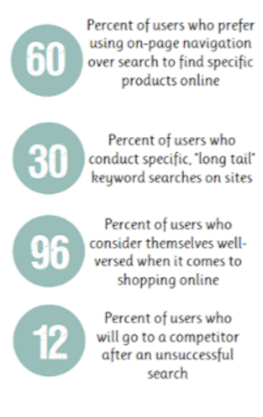
search first menu design
Mobile Search Is Non-Negotiable.
Things like placement, hint text, and the way search results are displayed contribute to how users engage with search as well as your app/site as a whole.
Mobile menus can be hard to use (even the best-designed ones).
https://www.smashingmagazine.com/2019/01/design-search-mobile-app/

Slide 29

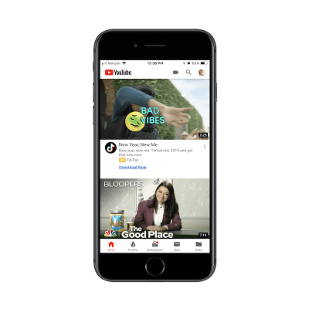
method to the madness
Search bar, tab or magnifying glass?
YouTube needs the mini-magnifying glass because it serves two types of users:
Users that come to the app to search for videos.
Users that come to the app to upload their own videos.
https://www.smashingmagazine.com/2019/01/design-search-mobile-app/

Slide 30
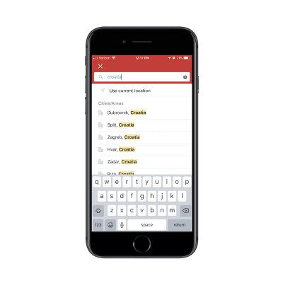
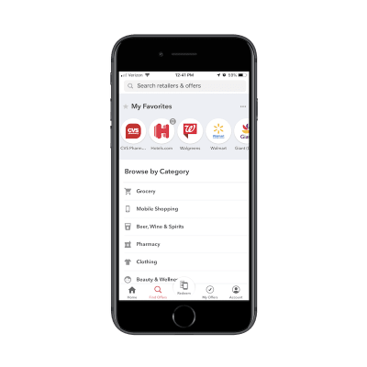
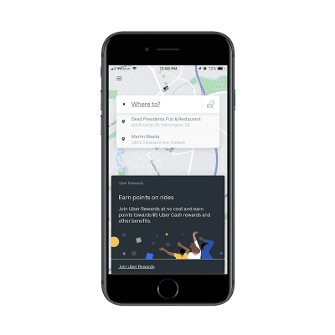
search isn’t small
We need to give more thought to search.
It’s how people find our client’s products and services. If they can’t find them, they can’t buy them.
Simple text or give a hint?
Suggested search?
Results in context?
Full screen input?
Filters (and breadcrumbs)?
Ecommerce?
Predictive?
Autocomplete ?
Recent/popular?
Limit results?

Slide 31
some basics

Slide 32
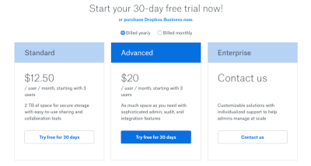
consistent CTAs
CTAs should look like buttons: rounded, squared, pill, outline, solid, drop shadow, brighter color, and more. They need to stand out from the rest of the design. This is true, especially on mobile, where space, time and screen real estate are limited.
Use multiple styles to draw attention to the most important/desirable CTA in a group.
https://www.smashingmagazine.com/2018/01/ghost-button-design/

Slide 33
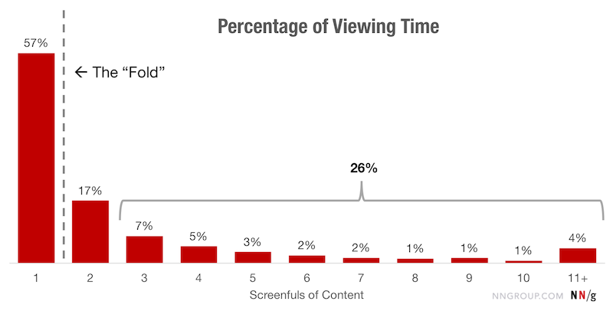
Scrolling and attention
57% don’t mind scrolling past the “fold”
74% of all viewing time occurs within the first two screens
https://www.smashingmagazine.com/2018/12/elements-ditch-repurpose-mobile/

Slide 34
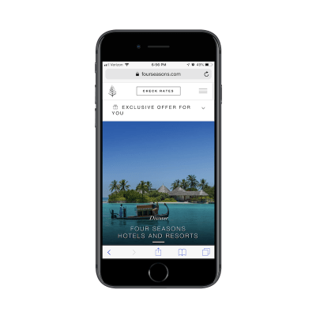

rethink and remove elements
Sidebars: content gets pushed to the bottom or buried in a select menu. This ads a lot of scrolling and unnecessary content on mobile.
Pop-ups: does it really have a place on mobile? They block the content and requires you to do work to view the entire message.
https://www.smashingmagazine.com/2018/12/elements-ditch-repurpose-mobile/

Slide 35
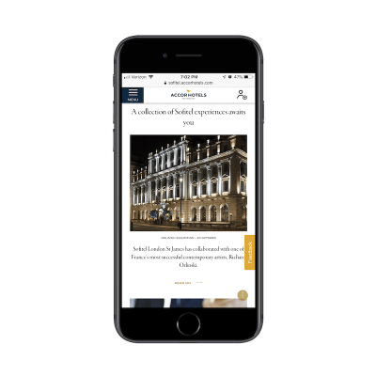

rethink and remove elements
Sticky side elements: a sticky main nav encourages scrolling because the user always has an easy way back or forward. Side elements may work on desktop, but can be intrusive and create an awkward or unusable experience on mobile.
https://www.smashingmagazine.com/2018/12/elements-ditch-repurpose-mobile/

Slide 36
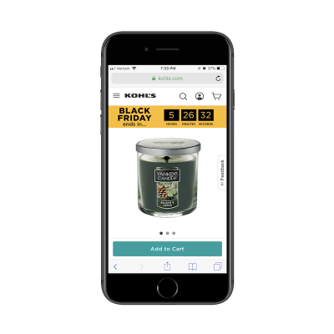
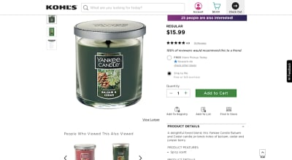
rethink and remove elements
Content: desktop (non-touch) interaction is different than mobile (touch) interaction. Remove elements and even content on mobile that is not best suited for it. Focus on the essentials for a streamlined experience.
https://www.smashingmagazine.com/2018/12/elements-ditch-repurpose-mobile/

Slide 37
email

Slide 38
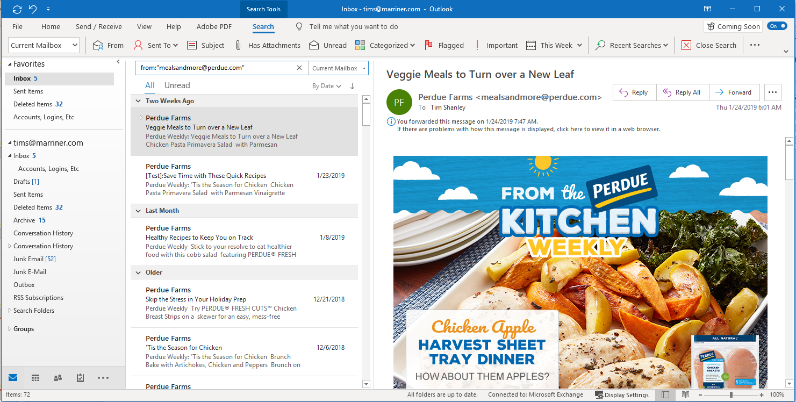
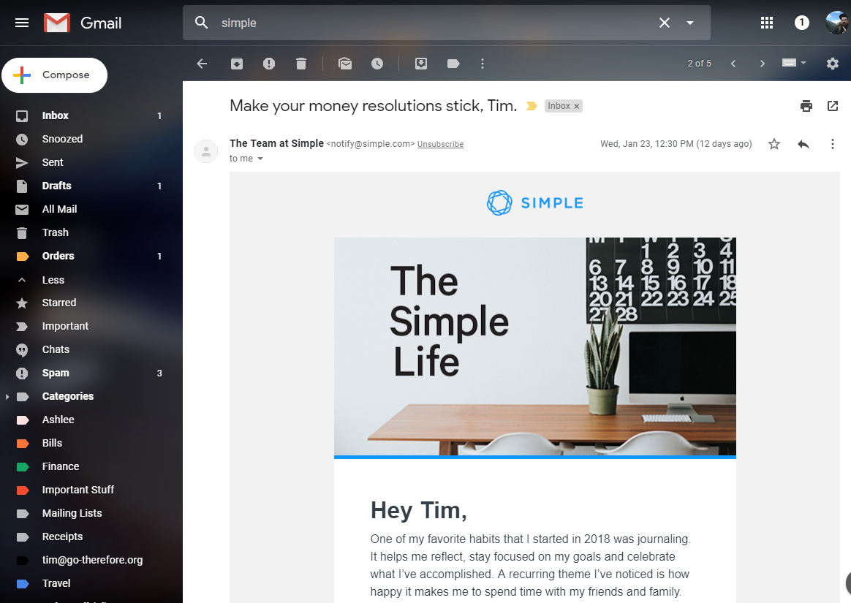
mobile email
Let’s make email truly mobile first and simple. We’re not really using the entire screen for email anyway.
We can also make simple email designs and layouts that are visually impactful and simpler to program. The complexity in the design and programming doesn’t bring a better ROI.

Slide 39
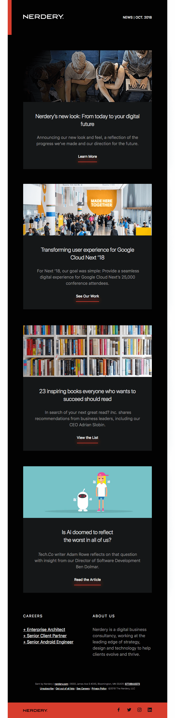
quick examples
https://reallygoodemails.com/

Slide 40
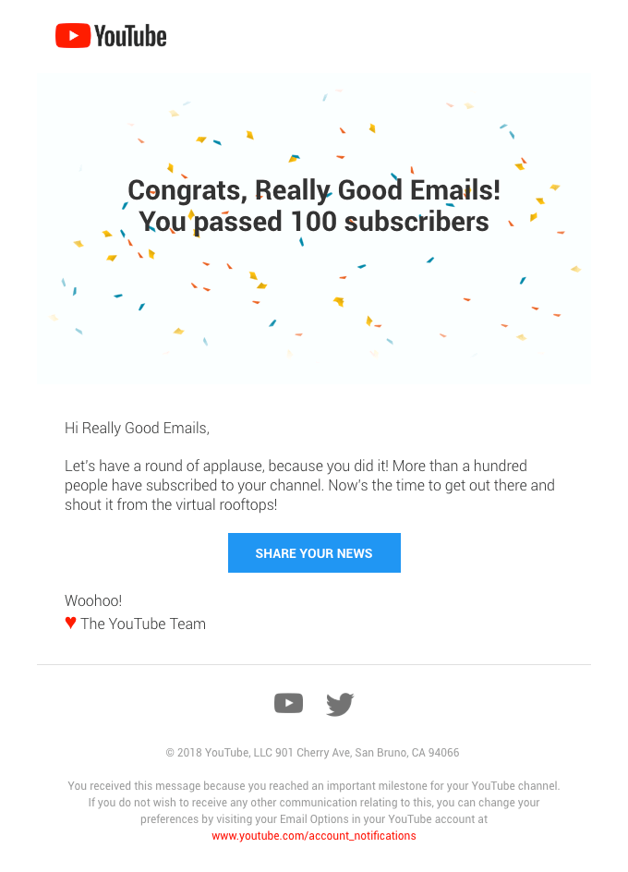
quick examples
https://reallygoodemails.com/

Slide 41
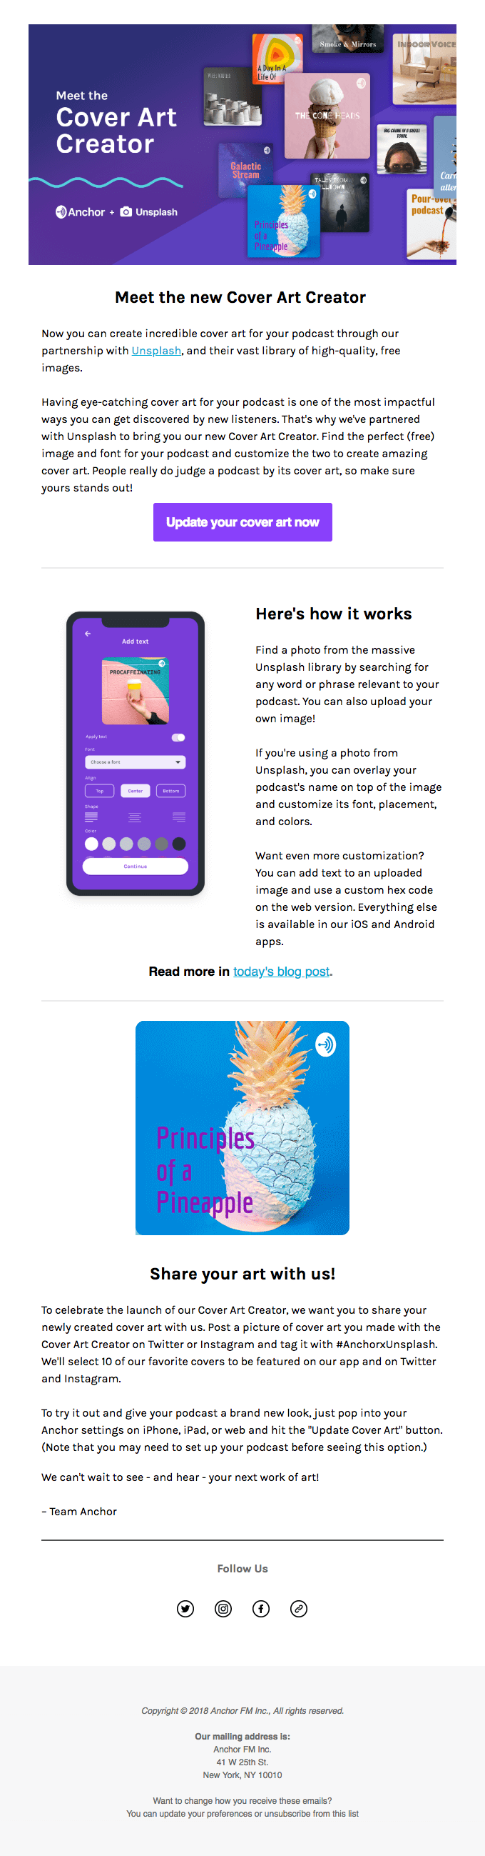
quick examples
https://reallygoodemails.com/

Slide 42
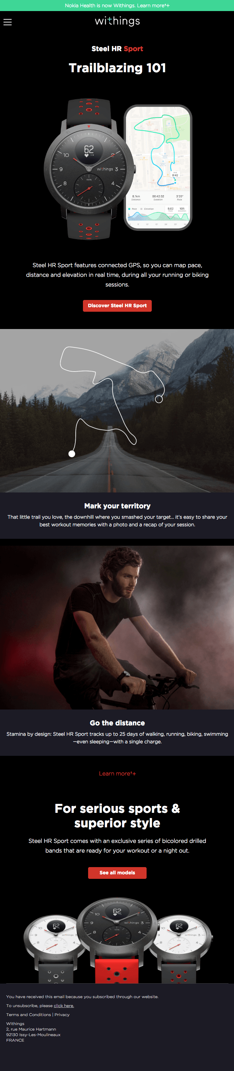
quick examples
https://reallygoodemails.com/

Slide 43
mark as read
What do we see?
Simple, one-column layouts
Use of live text throughout
Large, simple graphics
Bold use of color (and creative whitespace/negative space to frame the design)
No borders or complicated visual framing in the design
Linear content flow (designed for plenty of scrolling)
Bold CTAs

Slide 44
good mobile designs

Slide 45
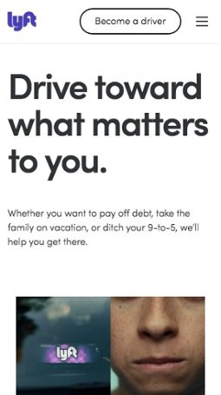
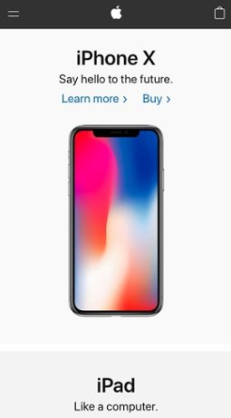
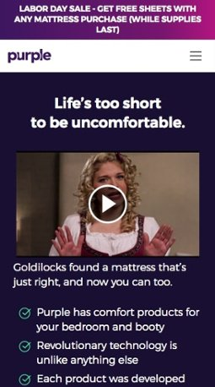
mobile designs
https://www.impactbnd.com/examples-of-effective-mobile-website-design

Slide 46
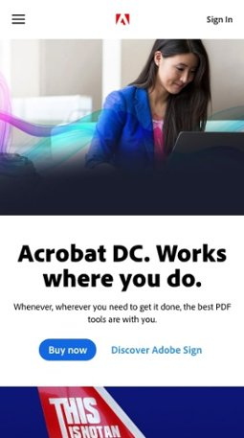
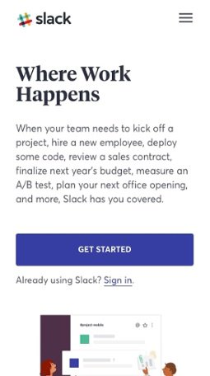
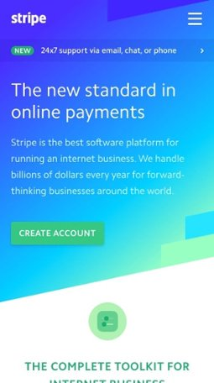
mobile designs
https://www.impactbnd.com/examples-of-effective-mobile-website-design

Slide 47
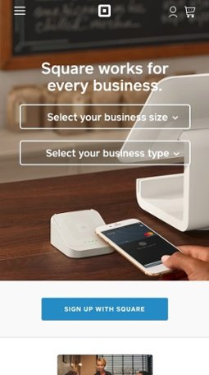

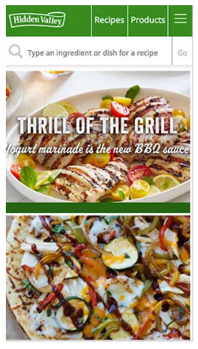
mobile designs
https://www.impactbnd.com/examples-of-effective-mobile-website-design

Slide 48
add to bookmarks
What do we see?
Simple, clean navigation
Use of the hamburger menu button WITHOUT words
Clean nav logo
Shopping cart when applicable
Simple and bold hero imagery and colors
Text kept to the top when necessary
Large, bold, consistent CTAs
Search bar exposed on Hidden Valley’s site (a site where search is probably most important)

Slide 49
what’s next

Slide 50
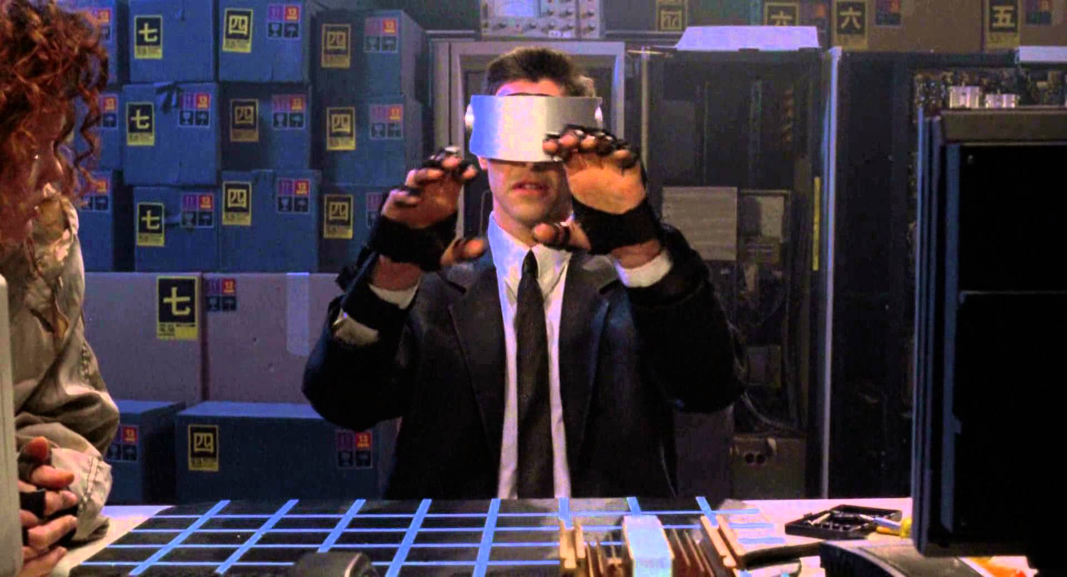
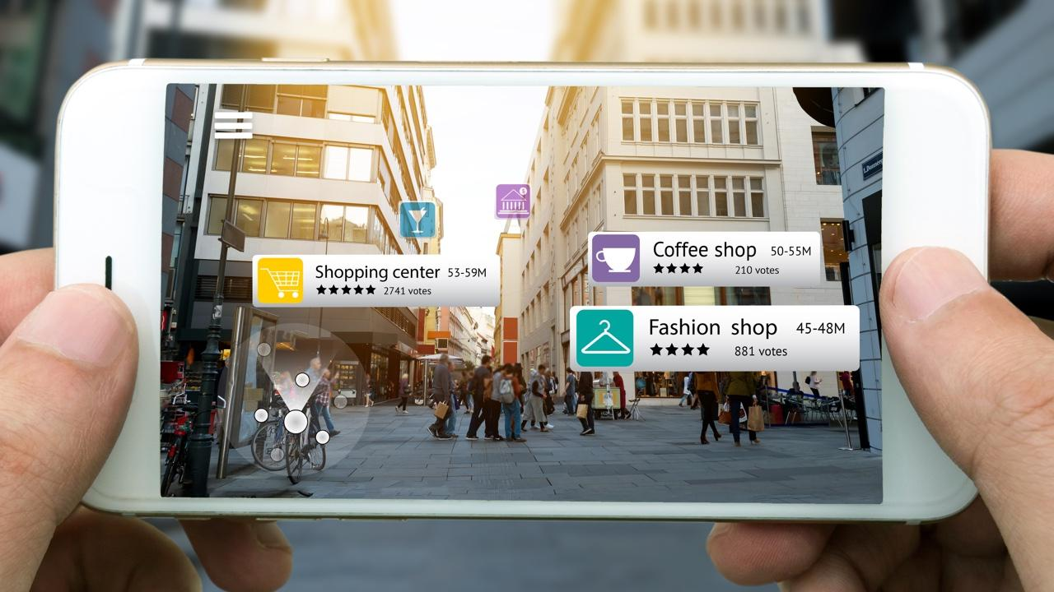
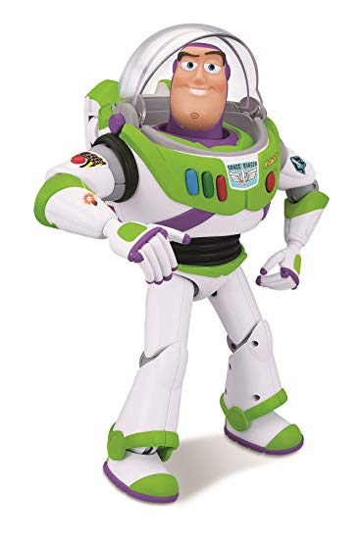
the future
Virtual Reality (VR)
Augmented Reality (AR)
These things, while visionary experiences, still don’t have a lot of real-world, day-to-day, value. As prices come down, devices change, we may see more of this in the future. Let’s not ignore these sectors and consider them when possible, but let’s also keep our feet on the ground when developing solutions.

Slide 51
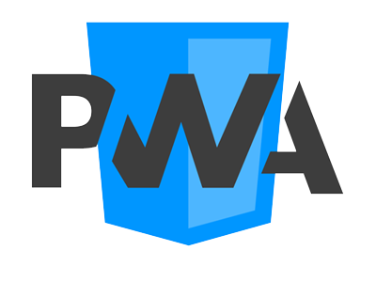
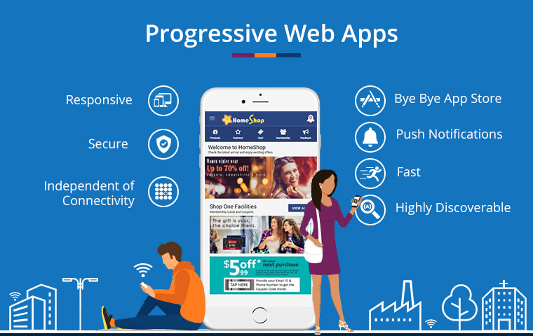
today and tomorrow
Are dedicated apps even necessary?
Progressive Web Apps (PWAs)
The jury is still out on these as it’s early, but the concept is solid. Bring the app experience and power to a website. Data can be stored locally, no need for an app store, works on any device (no need for multiple code bases).
“One recent survey shows that people are turning away from Android/iOS apps, because not all app experiences are satisfying or worthwhile. Some people simply don’t want any more apps on their phone…The irony is that most of the apps have a fully responsive website performing the same functions.”
https://codeburst.io/all-you-need-to-know-about-progressive-web-app-4ba73368da66

Slide 52


today and tomorrow
https://codeburst.io/all-you-need-to-know-about-progressive-web-app-4ba73368da66

Slide 53
go create amazing, effective, mobile, desktop & everywhere-else web experiences.

Slide 54
bonus

Slide 55

take the test
cantunsee.space

