Slide 1



Senior Living:
Assessing the Opportunity DRAFT
Prepared for:
Version: January 2023
Project: 12693

Slide 2
Table of Contents
Introduction & Background 3
Research Objectives and Consulting Approach 4
Operator Research Composition 5
Key Findings, Implications & Growth Considerations 6
Top 5 Findings and Observations
Senior Living Segment: Growth Considerations 9
Develop and Execute a Senior Living Foodservice Strategy 10
Emphasize “Better for You” Comfort Foods 11
Regularly Provide Segment Trend Insights 12
Become a Trusted Advisor to the Senior Living Foodservice Segment 13
Senior Living Segment Statistics 14
Older Persons Population 15
Share of Older Persons in the U.S. Living with Limitations in Daily Living Activities 16
Senior Living Sub-Segments 17
Healthcare Market Foodservice Size 18
Outlook: Future Issues Facing Healthcare Operators 19
Senior Living Operator Profile 20
Type of Facility 21
Resident Average Age 22
Total Full-Time Employees by Sub-Segment 23
Presence of Executive Chefs and Dieticians on Staff 24
Foodservice Staffing Capacity 25
Financial Orientation of the Foodservice Department 26
Target Total Meal Cost Per Resident 27
Resident Meal Plans 28
Food Service Systems in Facility 29
Cafeteria Service Systems 30
Meals by Daypart 31
GPO Participation 32
Purchases Through GPO Program 33
Menu Innovation 34
Menu Change Frequency 35
Publications as Menu Inspiration 36
Foodservice Program Influence on Resident Selection 37
Use of Chains Restaurants for Menu Inspiration 38
Snack Area Penetration and Offerings 39
Attitudes Toward Lowering Food Costs 40
Reliance on Food Manufacturers 41
Desire for Premium Products 42
Product Switching Frequency 43
Plant-Based Proteins 44
Adding an Item to the Menu 45
Adding an Item to the Menu– by Sub-Segment and Type of Facility 46
Supply Chain Dynamics 47
Interest in External Support & Services 48
Supplier Selection Criteria 49
Products & Trends 50
Usage of Product Categories 51
Importance of Trends 52
Operator Challenges 53
Senior Living Facility Operator IDIs 54
Top 5 Healthcare Foodservice Challenges 55
Meridian Assisted Living 56
St. Andrews Memory Care 58
Allmar Assisted Living 59
Allegro Independent Living 60
Fountain Care Center Assisted Living 61
Emerald Court (Kisco Senior Living) 62
Carmel Oaks Assisted Living (Legacy Care) 63

Slide 3
Introduction & Background

Slide 4




Research Objectives and Consulting Approach
The primary objective of this study is to develop insights and perspectives for suppliers to most effectively and efficiently target the senior living foodservice arena.
Specific client proprietary questions were addressed as well, and have been included within those designated sections.
Engagement initiation
Existing data review
Healthcare Operator Research
Analysis, report development and delivery
Foodservice IP met privately with each sponsor to discuss objectives of the program.
Foodservice IP gathered and reviewed all publicly available information as well as prior non-proprietary research.
Foodservice IP quantified the attitudes and practice of 300 healthcare executives and visited several facilities for contextual purposes.
Foodservice IP analysts are available to provide answers to questions as sponsors require them.

Slide 5

Operator Research Composition
Foodservice IP conducted 300 interviews with senior living facilities and further visited eight facilities for more contextual and qualitative purposes.
In order to qualify, operators must have some influence over food and beverage purchases.
JOB TITLE
SEGMENT TYPE OPERATIONS
GPO OR BUYING GROUP PARTICIPATION
© Foodservice IP

Slide 6
Key Findings, Implications & Growth Considerations

Slide 7

Top 5 Findings and Observations
1
In 2020, senior housing was one of the sectors that were severely impacted by the coronavirus pandemic. However, as the U.S. move further away from the pandemic, senior living residents are largely returning to normal dining behaviors. The omicron variant has still forced some regions to quarantine residents to their rooms, but the incidence is ebbing.
Observation: Food continues to be critical area of satisfaction, facility selection and comfort for senior living residents.
2
Senior living facilities spend $3.7 billion annually on foodservice purchases, which is a quarter (25%) of all healthcare foodservice purchasing. Vacancies and harsher controls mean that growth has yet to be in the green through 2024. For context, the total foodservice industry is expected to remain flat in 2024, with many segments facing economic softness.
Observation: Senior living continues to be a top choice for retiring and adults aged 65+ (56 million) and growth of foodservice is expected return to positive territory by 2026 in FSIP’s opinion.
3
The industry average for chain restaurants changing the main menu is about 2-3 times per year, not including seasonal or promotional menus. This average is higher in senior living, given that residents desire variety and innovative recipes. A little more than one-third of facilities (39%) change or rotate their menus once every month.
Observation: Operators will continue to count on food suppliers to help with authentic, good tasting food that appeals to a fickle but eager audience. This requires a close working relationship with on-site chefs in key accounts.

Slide 8
Top 5 Findings and Observations
Demand for “better for you” or healthier products and ingredients continues to influence product selection and menu design in the senior living segment, yet comfort foods are also very important to this group.
Observation: The “better-for-you” platform has proven to be a powerful positioning tool for manufacturers of healthcare foodservice products. Patrons past the age of 65 are encouraged to eat fruits and vegetables but a menu focused solely on “greens” will not be favorable to this group. A balance must be struck between rib-eye, Brussels sprouts and black raspberry pie, for example.
4
5
While price (48%) is most important to operators, timely and accurate order delivery (37%), as well as dietetics expertise and quality of products offered (both, 35%) are also key criteria for supplier selection.
Observation: The top three factors are typical criteria evaluated by operators in other segments as well. These are “table stakes” or “must haves” for a product to have any chance of success. Product cost has intensified as a factor due to higher commodity costs.

Slide 9
Senior Living Segment: Growth Considerations
Foodservice IP has developed the following growth options for food companies to consider when entering or expanding into the Senior Living foodservice segment.
Emphasize “Better For You” Comfort Foods
Develop and Execute a Senior Living Foodservice Strategy
Become a Trusted Advisor to Senior Living Clients
Offer Regular Menu Innovations

Slide 10

Develop and Execute a Senior Living Foodservice Strategy
The most beneficial way to use the information gathered through this report is to apply it to your organization. Depending on the products you provide and the level of experience in the Senior Living segment, use the insights in this document to create goals, sales targets, marketing initiatives and key performance indicators (KPIs) along with a calendar for completion.
Ensure the document is reviewed regularly internally by senior and mid-level managers to ensure its use and relevance. No strategic document should be left idle for more than 30 days or it will not be effective (even if it is a revision to an already-existing document).
CREATE GOALS, STRATEGIES AND KPIS
USE THIS REPORT TO INFORM A SITUATION ANALYSIS
PERFORM INTERNAL AND EXTERNAL ANALYSES
FUEL STRATEGIC THOUGHT
with evidence-based insights on customers, competitors and stakeholders

Slide 11

Emphasize “Better for You” Comfort Foods
Traditionally, senior care facilities were known for lackluster menus where dining choices were limited to the bare minimum. Seniors could consume one of two standard entrees or go hungry for the night. As groups like the Baby Boomers age, however, such uninspired standards simply won’t do.
On the other side of the coin, veggie-centric diets result in lower mortality, lower incidence of cardiovascular diseases and lower rates of diabetes. For many families, picking facilities with veggie-centric options may be a practical matter of managing a loved one’s health as economically as possible.
It will be important for food companies to strike a balance between hearty meatloaf and braised Brussels sprouts, for example, but the payoff in client retention, market share and new business will likely be worth the effort.
Senior Living foodservice managers are hiring professional chefs and meal planners to inject a spark into commonplace items. Culinary experts are able to serve healthier options in more enticing ways.
Develop flavorful products and recipes without the use of animal protein to meet the desires of a large contingent of seniors who enjoy food but understand the practicality of “heart” health.
Work with resident chefs at key accounts to provide a high level of ingredient knowledge and quality that address picky-eater desires and health concerns.

Slide 12

Regularly Provide Segment Trend Insights
Foodservice IP urges clients to share the insights with Tier One customers. As shown in the market overview, the Boomer generation is flooding retirement communities and they crave restaurant quality food that includes regular variety and options common outside of their “homes.”
We suggest developing a number of “crystal ball” questions – or scenarios – to assist with any forward-thinking strategy as well as risk mitigation.
What are the top menu items in Senior Living?
What will the next generation of retirees want?
Which protein will be the next “Impossible Burger?”
How will dayparts change within Senior Living? Will they exist in ten years?
What impact will technology have on the segment in ten years?

Slide 13
Become a Trusted Advisor to the Senior Living Foodservice Segment
To capitalize on this research, clients (if not already) must commit itself and dedicate adequate resources to the channel. The significant and positive equity of any brands already in the channel further enhances the potential for success.
The “basis to compete” must evolve beyond one or two items and might follow the same formula as LTOs in chain restaurants. This is a very demanding (and fickle) consumer base.
Appoint a senior executive for ownership and oversight purposes.
1
Dedicate marketing and sales personnel focused exclusively on Senior Living with the goal of building brands within the channel.
2
Install channel-specific new product development support to meet needs of the facility and resident.
3

Slide 14
Senior Living Segment Statistics

Slide 15
Older Persons Population
According to Seniorliving.org, there are a number of statistics that favor the growth of Senior Living:
Approximately 56 million adults aged 65+ live in the U.S. This number is based on a 2021 census.gov estimate that about 326 million people reside in the US.
The senior population will soon double. The Population Reference Bureau projects that in 2060 nearly 100 million Americans will be 65 or older. This reflects the senior population more than doubling in 40 years. According to the CDC the rapid expansion is explained by the size of the baby boom generation and the Boomers’ long life spans.
The average American life expectancy is 78 years. More precisely, for a child born in 2015 the average expected lifespan is 78.8 years according to the National Center for Health Statistics. For males born in 2015 the average life expectancy was 76.5 years. For females it is 81.2 years. Significant differences also correlate with income, region of the US and other demographics
In the past 30 years, the population of 65+ age group has increased by 58%, and the 85+ group by 163%. These groups are important to healthcare overall.
Number of Persons 1980 – 2030
(In Millions)
Source: U.S. Census Bureau / U.S. Department of Health and Human Services, Administration on Aging

Slide 16
Share of Older Persons in the U.S. Living with Limitations in Daily Living Activities
According to the U.S. Census Bureau’s American Community Survey, some type of disability (i.e., difficulty in hearing, vision, cognition, ambulation, self-care, or independent living) was reported by 36% of people age 65 and over in 2014 (last time data was captured).
The percentages for individual disabilities ranged from almost one quarter (23%) having ambulatory difficulty to 7% having vision difficulty.
Some of these disabilities may be relatively minor but others cause people to require assistance to meet important personal needs.
Percentage of Persons 65+ with a Disability (2014)
Source: US Census Bureau, CDC 2016

Slide 17
Senior Living Sub-Segments
The senior living industry can be separated into distinct sub-segments:
Independent Living: Similar to assisted living, though seniors don't require daily care and assistance. Residents within an independent living community are typically able to perform everyday tasks, such as preparing meals or cleaning their home, though the facility may offer these services as needed.
​Assisted Living provides a combination of housing, personal care services, and health care designed to respond to individuals who need assistance with normal daily activities in a way that promotes maximum independence. These services can be provided in freestanding communities, near or integrated with skilled nursing homes or hospitals, as components of continuing care retirement communities, or at independent housing complexes.
Long Term Care. In a LT-care/skilled nursing community, residents receive constant nursing care and need assistance with most, if not all, activities of daily living (ADLs).
Share of Total Industry Dollars
Source: Statista, IBSI World, FSIP

Slide 18
Healthcare Market Foodservice Size
2023 Total Healthcare Operator Purchases: $14.8 Billion
One of the most important aspects of Senior Living is the food and dining options. Dining and foodservice offerings ranked seventh on a list of 13 concerns important to consumers in choosing a senior living facility in a recent survey conducted by the Dietary Managers Association.
Senior living and LT Care facilities spend $6.1 billion annually on foodservice purchases, which is 41% of all healthcare foodservice purchases in 2023. While hospitals account for the largest share, growth of foodservice in Senior Living is poised for longer-term growth.
Segment | 2024 Real Growth Outlook | Comments
Hospitals | 1.2% | Growth is driven by the large Boomer population reaching their mid-70s.
Long-Term/ Acute Care | -0.4% | Cutbacks in state funding and the poor perception of the segment inhibits growth.
Senior Living | -2.7% | In 2020, senior housing was one of the sectors that were severely impacted by the coronavirus pandemic. With age being one of the factors that could lead to health complications, operators faced increased costs of introducing additional measures to contain the spread of the virus, as well as increase in vacancies. Its high expense is a limitation to growth as is the health of the economy.
Total | 1.8%
*Includes food and non-alcoholic beverage only; excludes non foods, equipment and alcoholic beverages
Source: IFMA, US Government
Notes:
18

Slide 19
Outlook: Future Issues Facing Healthcare Operators
Future Issue | Description
Maintaining Good Tasting Healthy Fare | In an effort to respond to patron demand—particularly within the hospital and senior living sub-segments—a growing focus on combining high nutrition coupled with taste/high performance is evident. The pandemic increased the desire for “comfort” foods but nutrition and health and wellness must be first and foremost.
Senior Living Budgets | Continuing on in the near future, foodservice directors will still be required to focus on foodservice department cost optimization.
Keeping Ahead on Food Trends | Our research shows foodservice options are a primary factor is resident selection of a community. Competition for patients/residents means healthcare operators are current on food trends and offer products that evolve into a resident’s regular diet.
Labor Recruitment and Retention | Recruiting qualified employees has been an ongoing issue with the senior living sector. The extensive background checks and bureaucracy of hiring means that many facilities operate with limited staff working long hours.
24-Hour Feeding | Interest in on-demand foodservice items (beyond vending) has Senior Living operators interested in expanding grab-and-go and other offerings that serve both patient, resident, family member and employee needs.
Product Availability and Substitutions | With the effects of the pandemic still lingering in certain U.S. regions, the movement and availability of products continue to hamper the healthcare segment. Supply chain issues will be part of the future, operators acknowledged, but there are other complexities in healthcare that exist even when products are scarce. For example, there are strict diet guidelines healthcare facilities must follow and substitutes are sometimes unavailable.

Slide 20
Senior Living Operator Profile

Slide 21
Type of Facility
The majority of facilities interviewed for the research fell into private-for profit (66%) and public-for profit (24%). Not-for-profit is less common –whether public or private.
Facility Type
Source: FSIP Foodservice Senior Living Foodservice Operator Interviews, Dec. 2022.
Note: Religious, Military and Other had 0%
Q5.Which of the following describes your facility type?

Slide 22
Resident Average Age
As would be expected, the age of residents in senior living range from age 65 to 84. The 65-74 age group tends to still live independently, while the 75-84 age group tends to live in long-term/acute care facilities. The assisted living age range is split between 65-74 and 75-84.
Resident Age (Ranges Shown)
Source: FSIP Foodservice Senior Living Foodservice Operator Interviews, Dec. 2022.
Q9: What is the average age range of your residents?

Slide 23
Total Full-Time Employees by Sub-Segment
Senior living facilities tend to staff approximately 10-19 employees (54%), with about a quarter reporting staff numbers of 5-9.
Number of FTE in Foodservice Department
(Ranges Shown)
No significant differences among senior living sub-segments
Source: FSIP Foodservice Senior Living Foodservice Operator Interviews, Dec. 2022.
Foodservice IP0. How many full time equivalent (FTE) employees do you have just within the foodservice department?

Slide 24

Presence of Executive Chefs and Dieticians on Staff
More than half of facilities (57%) have an Executive Chef on staff. Both assisted and senior living are most likely to employ a head chef.
Some 62% of senior living facilities have a dietician on staff, and this is most pronounced with assisted living operations.
Executive Chef on Staff
Dietician on Staff
DISCOVERY
Executive Chefs and dieticians are significantly more common in chain and managed facilities.
Source: FSIP Foodservice Senior Living Foodservice Operator Interviews, Dec. 2022.
Foodservice IP1. Do you have an executive chef on staff?
Foodservice IP2. Do you have a dietician on staff?

Slide 25
Foodservice Staffing Capacity
Staffing continues to be an issue in the segment. Most facilities report they are “somewhat understaffed” to “extremely understaffed.” Long-term and rehab centers are most likely to be “extremely” understaffed.
Foodservice Employment Today
Type of Operation
Type of Facility
Type of Foodservice Operation
Source: FSIP Foodservice Senior Living Foodservice Operator Interviews, Dec. 2022.
Foodservice IP3. How would you describe your foodservice employment today?

Slide 26
Financial Orientation of the Foodservice Department
Breakeven and profit and loss (P&L) are the two most common business models for most senior living segments. Most independent living and self-operated facilities count on the foodservice department to operate on a separate P&L.
DISCOVERY
Since Covid-19, P&L has become more critical to this segment.
Source: FSIP Foodservice Senior Living Foodservice Operator Interviews, Dec. 2022.
Foodservice IP4. What is the financial orientation of the foodservice department?

Slide 27
Target Total Meal Cost Per Resident
On average, senior living facilities target $17 for daily resident meal costs. Independent living facilities spend more than other sub-segments, averaging $21 target daily meal cost.
Target Total Meal Cost per Resident per Day
(Means Shown, in Dollars)
The highest target food cost at $21.
DISCOVERY
These are loose ranges. FSIP has learned that certain residents my pay for more amenities, and therefore, the per-day meal cost increases.
Source: FSIP Foodservice Senior Living Foodservice Operator Interviews, Dec. 2022.
Foodservice IP5. What is your target total meal cost per resident per day?

Slide 28
Resident Meal Plans
Regardless of sub-segment, some 75% or more include all meals and snacks in a resident fee. Still, about a quarter or less allow residents to purchase a meal plan or pay-per meal.
How Meals Are Offered in A Facility
DISCOVERY
It is rare for residents and patients to pay per meal.
Source: FSIP Foodservice Senior Living Foodservice Operator Interviews, Dec. 2022.
Foodservice IP6. How are meals offered at your facility?

Slide 29
Food Service Systems in Facility
Cafeterias and patient room service are the most common types of foodservice systems. Patient tray service is less common with independent living.
Service Systems Currently in Facility
No remarkable differences with memory care or rehab facilities.
Source: FSIP Foodservice Senior Living Foodservice Operator Interviews, Dec. 2022.
Foodservice IP7. Which of the following programs/service systems are present in this facility?

Slide 30
Cafeteria Service Systems
Among facilities with cafeterias, branded concepts and tray are the most common service system set-ups. Independent living facilities are more likely than the rest to offer made-to-order stations.
Cafeteria Service Systems
No remarkable differences with memory care or rehab facilities.
Source: FSIP Foodservice Senior Living Foodservice Operator Interviews, Dec. 2022.
Foodservice IP8. Thinking just about your cafeteria, which of the following types of service systems do you offer?

Slide 31
Meals by Daypart
A third of meals served in senior living facilities are lunch (34%), regardless of sub-segment. Dinner (31%) and breakfast (28%) represent slightly less than a third of meals, and only 7% are snacks.
% of Meals Served by Dayparts
Source: FSIP Foodservice Senior Living Foodservice Operator Interviews, Dec. 2022.
Foodservice IP9_1. What percent of your meals served fall into the following dayparts?

Slide 32
GPO Participation
Assisted living facilities over-index on GPO participation compared to other facilities, with 50% belonging to a GPO or Buying Group. Foodbuy, is the most prominent GPO regardless of sub-segment.
GPO or Buying Group Participation
GPO or Buying Groups Belonged To
Source: FSIP Foodservice Senior Living Foodservice Operator Interviews, Dec. 2022.
Q21. Does your operation belong to a buying group or group purchasing organization (GPO) of any kind?
Q22. Which buying group or group purchasing organization does your operation belong to?

Slide 33
Purchases Through GPO Program
Of senior living operators that participate in a GPO program, a wide variety of categories are purchased, including disposables, frozen foods, supplies, packaged foods and chemicals. From the study in 2019, FSIP noticed fresh foods and vegetable purchasing dropped from about 75% to 67% due to shortages and Covid.
% of Purchases Made through GPO Program
(Means Shown)
DISCOVERY
Partnerships with GPOs are important for food and beverage manufacturers, especially Avendra as they are the most prominent in the segment.
Source: FSIP Foodservice Senior Living Foodservice Operator Interviews, Dec. 2022.
Q23_1. For each of the following product categories, what percent of your purchases are made through your GPO program? (Means)
*e.g., meat, dairy, fruits, vegetables

Slide 34
Menu Innovation

Slide 35
Menu Change Frequency
The industry average for chain restaurants changing the main menu is about 2-3 times per year, not including seasonal or promotional menus. This average is higher in Senior Living, given that residents desire variety and innovative recipes. A little greater than one-third of facilities (39%) change or rotate their menus once every month.
Menu Change Frequency
DISCOVERY
The menu changes very rapidly in this segment, reflecting the desires of residents who look for constant variety.
Source: FSIP Foodservice Senior Living Foodservice Operator Interviews, Dec. 2022.
Q24. How often does your menu change/rotate?

Slide 36
Publications as Menu Inspiration
For the most part, all sub-segments use popular blogs to inspire menu offerings. Long-term/acute care facilities tend to rely on blogs more than their counterparts.
Use of Publications to Inspire Menu Offerings
DISCOVERY
Blogs are an effective way to introduce new items and share recipes.
Source: FSIP Foodservice Senior Living Foodservice Operator Interviews, Dec. 2022.
Q26_1. I look publications to inspire my menu offerings

Slide 37
Foodservice Program Influence on Resident Selection
Foodservice programs are highly influential to resident selection of Senior Living facilities. Overall, 76% select facilities based on foodservice and the sentiment is similar across each sub-segment.
Customers/Residents Chose Facility for Foodservice Program
(% indicating agree/completely agree)
DISCOVERY
Foodservice is a critical selection factor for residents when choosing a facility.
Source: FSIP Foodservice Senior Living Foodservice Operator Interviews, Dec. 2022.
Q26_5. My customers/residents chose this facility because of the foodservice program

Slide 38
Use of Chains Restaurants for Menu Inspiration
Senior Living facilities tend to refer to chain restaurant menus for inspiration. The percentage of all facilities scouting chain menus for ideas is 65%, with long-term/acute care leading the effort.
I look to popular chain restaurants to inspire my menu offerings…
Source: FSIP Foodservice Senior Living Foodservice Operator Interviews, Dec. 2022.
Q26_6. I look to popular chain restaurants to inspire my menu offerings

Slide 39
Snack Area Penetration and Offerings
Forth-one percent (41%) of Senior Living operators report offering a prepared foods snack area. The most common offerings are yogurt parfaits (77%) and snack boxes (68%).
% Do You Offer a Snack Area in Your Facility?
Types of Prepared Foods Offered in Snack Area
DISCOVERY
Keep an eye toward creating grab and go products for this segment. Families and friends of residents are often the target of these offerings.
Source: FSIP Foodservice Senior Living Foodservice Operator Interviews, Dec. 2022.
*Base: 50 – those offering a snack area in Foodservice IP7.
Q27. Do you offer prepared foods in your snack area?*
Q28. What types of prepared foods do you offer in your snack area?

Slide 40
Attitudes Toward Lowering Food Costs
More than half of Senior Living operators are looking for ways to lower food costs by finding new products or searching for lower-cost versions (43%). Assisted living operators tend to be the most focused on food cost reduction.
Looking for Lower-Cost Versions of Products
(Agree/strongly agree)
DISCOVERY
While food cost percentages are important to this segment, consider changing the discussion to quality, resident satisfaction and incremental revenue growth.
Source: FSIP Foodservice Senior Living Foodservice Operator Interviews, Dec. 2022.
Q29_4. I am always looking for new food products that can lower my food costs
Q29_5. I am always looking for lower-cost versions of the products I buy

Slide 41
Reliance on Food Manufacturers
Seventy percent (70%) of assisted living operators look to their food manufacturer for menu direction and recommendations, while 53% look to their distributor and/or GPO partners.
We look to our manufacturer for menu direction and recommendations
(Agree/strongly agree)
We look to our partners such as distributors and/or GPOs for menu direction and recommendations
(Agree/strongly agree)
DISCOVERY
Senior Living operators in all sub-segments look to multiple sources for menu ideas to satisfy resident desire for quality and variation.
Source: FSIP Foodservice Senior Living Foodservice Operator Interviews, Dec. 2022.

Slide 42
Desire for Premium Products
While operators have reported that lowering food costs is critical, 68% also are looking for premium products to increase margin.
% Indicating Looking for Premium Food Products
DISCOVERY
This is encouraging from a food cost perspective. Operators show willingness to pay for premium products to boost margin instead of simply slashing food costs and purchasing non-premium items. Find attributes that resonate with this group – indulgence, non-GMO, low fat/sodium, etc.
Source: FSIP Foodservice Senior Living Foodservice Operator Interviews, Dec. 2022.
Q26_6. I am always looking for premium food products to increase my margin

Slide 43
Product Switching Frequency
Product switching is not very common in Senior Living. Assisted living facilities (26%) are least likely to change food products.
% Indicating Rarely Change Products Purchased
% Agree/Strongly Agree They Rarely Change Food Products
DISCOVERY
While product changes are not common in the segment, competitors are also seeking a way in. Ensure your product and service are impeccable.
Source: FSIP Foodservice Senior Living Foodservice Operator Interviews, Dec. 2022.
Q29_1. I rarely change the food products I purchase
Q29_1. How much do you agree with each of the following statements?

Slide 44
Plant-Based Proteins
The top reasons why Senior Living operators purchase plant-based foods are because of the taste (40%), they do not contain preservatives (37%) and they are higher in nutrients (37%).
What are some of the reasons why you purchase plant-based foods instead of foods with animal protein, dairy, or grains?
Source: FSIP Foodservice Senior Living Foodservice Operator Interviews, Dec. 2022.
*Note: Smaller base – only those part of a multi-unit in Q6
Q33. To what extent are you interested in having your corporate entity provide the following programs or services?

Slide 45
Adding an Item to the Menu
High quality (35%) and long shelf life (32%) are most important to Senior Living operators when selecting a food and beverages. Few ingredients required to prepare (31%), sustainability (30%) and strong customer/resident demand (29%), round out the top five selection criteria.
Importance on Deciding Whether to Add a Specific Food or Beverage to Menu (Select Up to Five)
Source: FSIP Foodservice Senior Living Foodservice Operator Interviews, Dec. 2022.
Q34. How important is each of the following factors when deciding whether to add a specific food or beverage item to your menu? - *e.g., cart or kiosk program)

Slide 46
Adding an Item to the Menu– by Sub-Segment and Type of Facility
Independent Living operators find a long shelf life to be the most important attribute when adding an item to the menu as compared to other sub-segments. Rehab facilities weigh availability through distribution and unique ingredients as equally important in product selection.
Importance on Deciding Whether to Add a Specific Food or Beverage to Menu
Attribute | Total | Independent Living | Assisted Living | Long-Term/ Acute Care | Rehab
Product is high quality | 35% | 38% | 34% | 38% | 24%
Long shelf life | 32% | 41% | 31% | 26% | 32%
Few ingredients required to prepare | 31% | 29% | 36% | 28% | 32%
Sustainability | 30% | 31% | 33% | 24% | 28%
Strong customer/resident demand | 29% | 28% | 32% | 26% | 16%
Product quality is consistent | 28% | 28% | 24% | 30% | 32%
Low absolute food cost | 28% | 25% | 25% | 34% | 36%
Product is premade/value-added | 27% | 20% | 28% | 30% | 36%
Versatility (can be used in multiple menu items) | 27% | 29% | 22% | 28% | 24%
Brand has a strong foodservice reputation | 26% | 24% | 28% | 34% | 16%
Availability through distribution | 25% | 26% | 20% | 26% | 40%
Product has strong health benefits | 25% | 24% | 29% | 28% | 24%
Profitability/margin | 25% | 28% | 26% | 22% | 24%
Brand has a program with our GPO | 25% | 21% | 26% | 34% | 16%
Product is on trend | 24% | 26% | 20% | 32% | 20%
Promotions (such as rebates or other incentives) | 23% | 16% | 34% | 14% | 24%
Product has unique ingredients | 23% | 23% | 19% | 16% | 40%
Is part of a branded solution (e.g., cart or kiosk program) | 22% | 19% | 21% | 26% | 24%
Importance When Deciding to Add Specific Food or Beverage to Menu
DISCOVERY
Senior Living operators across most sub-segments agree that a product’s quality is very important when adding it to the menu.
Source: FSIP Foodservice Senior Living Foodservice Operator Interviews, Dec. 2022.
Q34. How important is each of the following factors when deciding whether to add a specific food or beverage item to your menu?

Slide 47
Supply Chain Dynamics

Slide 48
Interest in External Support & Services
Menu ideas, nutritional information and recipes are the top support services Senior Living operators want.
Interest in Programs/Services from Providers
(% Indicating agree/strongly agree)
DISCOVERY
Senior Living operators are also very interested in providers offering trend information and direct contact with brokers/direct reps.
Source: FSIP Foodservice Senior Living Foodservice Operator Interviews, Dec. 2022.
Q30. To what extent are you interested in having _________ provide the following programs or services?

Slide 49
Supplier Selection Criteria
While price (48%) is most important to operators, timely and accurate order delivery (37%), as well as dietetics expertise and quality of products offered (both, 35%) are also key criteria for supplier selection.
Criteria Importance When Selecting a Foodservice Manufacturer/Supplier
(Select up to Five)
DISCOVERY
The top three are typical criteria evaluated by operators in other segments as well. These are “table stakes” or “must haves” for a product to have any chance of success. Product cost has intensified as a factor due to higher commodity costs.
Source: FSIP Foodservice Senior Living Foodservice Operator Interviews, Dec. 2022.
Q35. When selecting a foodservice manufacturer/supplier, what criteria is most important to you?

Slide 50
Products & Trends

Slide 51
Usage of Product Categories
Frozen vegetable (87%) and frozen grain (85%) blends, as well as pasta (84%) and frozen roasted vegetables (83%) are the most important product categories for Senior Living operators.
Importance of Product Categories in Your Operation Today
(% Indicating use regularly)
DISCOVERY
Items such as various plant-based alternatives are also important to Senior Living operators. Health-focused operators, especially those catering to consumers/residents with restrictive diets, will continue to drive growth.
Source: FSIP Foodservice Senior Living Foodservice Operator Interviews, Dec. 2022.
Q38. How important are each of the following product categories to your operation today?

Slide 52
Importance of Trends
The most important trend to Senior Living operators isn’t dietary-related, but rather environmentally-friendly, with 95% stating recyclability is important. Low sodium, zero trans-fat, clean label, low glycemic index, eco-friendly and animal welfare are also top of mind for this segment.
Importance of Trends in Your Operation Today (Top 2 Box)
 | Total | Independent Living | Assisted Living | Long-Term/Acute Care
High fiber | 40% | 44% | 31% | 42%
Low sugar | 39% | 47% | 39% | 30%
Low calorie | 37% | 45% | 32% | 34%
Sustainable | 37% | 31% | 41% | 40%
“Natural” | 37% | 40% | 37% | 38%
Gluten-free | 37% | 44% | 38% | 32%
Organic | 35% | 48% | 27% | 28%
Zero trans-fat | 35% | 30% | 32% | 40%
Low fat | 33% | 39% | 33% | 30%
Plant-based foods and beverages | 33% | 39% | 28% | 32%
Eco-friendly | 32% | 30% | 31% | 34%
Authentic ethnic foods | 31% | 28% | 32% | 40%
Allergen-free | 30% | 36% | 29% | 30%
Low sodium | 30% | 28% | 29% | 20%
Local sourcing | 30% | 30% | 31% | 24%
Animal welfare | 30% | 29% | 36% | 24%
Grab & go | 29% | 24% | 28% | 32%
Fortified | 28% | 22% | 32% | 36%
Low glycemic index | 28% | 37% | 23% | 32%
All-day snacking | 27% | 17% | 29% | 38%
Recyclable | 26% | 24% | 28% | 16%
Keto diet | 25% | 22% | 29% | 18%
Religious diets (e.g., kosher, halal) | 25% | 24% | 24% | 26%
Ready-to-eat products – e.g., thaw and serve | 24% | 22% | 27% | 24%
Clean label | 23% | 23% | 22% | 24%
Paleo diet | 18% | 18% | 20% | 16%
DISCOVERY
These are good areas to address in any marketing and sales efforts.
Source: FSIP Foodservice Senior Living Foodservice Operator Interviews, Dec. 2022.
Q39. How important are each of the following trends to your operation today?

Slide 53
Operator Challenges
Senior Living operators are most concerned with labor costs (44%), finding products that perform well under required hold times (44%) and producing the same consistent product time and time again (43%).
Challenges for Your Operation
(Select up to Five)
DISCOVERY
Contrary to the foodservice industry as a whole, Senior Living operators cite rising expectations for food quality are not a significant issue for their operations.
Source: FSIP Foodservice Senior Living Foodservice Operator Interviews, Dec. 2022.
42. To what degree are the following a challenge for your operation? Select up to Five.

Slide 54
Senior Living Facility Operator IDIs

Slide 55


Top 5 Healthcare Foodservice Challenges
Healthcare foodservice stakeholders identified the following key takeaways:
1
LIMITED RESOURCES. Many healthcare facilities have limited kitchen resources. They are trying to find products that are great tasting but are less labor intensive as the labor shortage ensues.
“We try to stay within 1500 to 1600 milligrams of sodium per day.”
Stakeholder
2
PER PATIENT MEAL COSTS PER DAY VARY. Senior living facilities have among the highest budgets while acute care is on the lower end. Each facility, however, tends to have flexibility on pricing based on what residents pay.
3
“There are also only so many varieties of menu items you can buy and it lacks ethnic dishes.”
Stakeholder
MENU PLANNING AND PREPARATION COMES FROM DISTRIBUTORS. Several facilities point to their distributor as providing menu ideas for 2, 3 and 5 week menu cycles, which can all vary.
4
RENAL AND OTHER DIETS ARE BECOMING IMPORTANT. Products lower in potassium are becoming more important. A challenge now that could be an opportunity.
5
PRODUCTION COSTS MUST BE LOW. Facilities are looking at costs of $4-$7 per day.
55
Notes:
Channel marketing budget is used for renewal of POP and literature

Slide 56
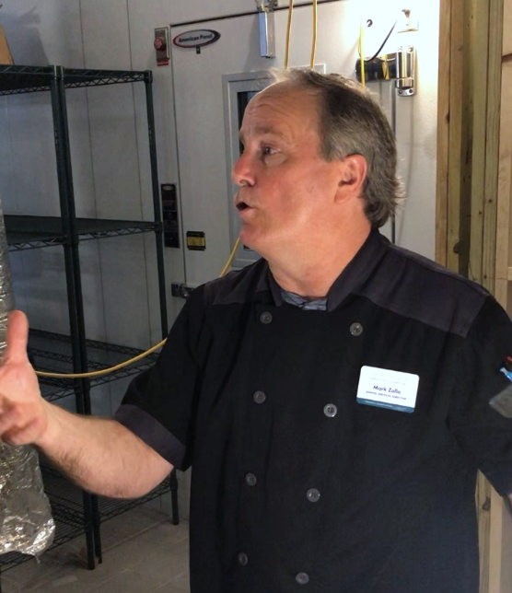
Meridian Assisted Living
BUDGETS ARE VERY FLEXIBLE
Mark spends $7.10 per day for three meals. Breakfast is $1.50, $2.50 for lunch and $3.10 for dinner. (This is for assisted living.) Also includes two snacks.
“What we give them for $7.10 is a miracle. And it’s all based on the price they pay when they walk in the door - $4,000 to $8,000 per people per month.”
“The government gives you nutritional value to follow and we build our budgets based upon that – what you’re supposed to feed the residents each day.
PREPARATION CAN VARY DEPENDING ON STAFF COMPETENCY
Mark’s staff is very teachable and are able to make meals from scratch with craveable visuals.
Directions of RTE foods are not “that important” to Mark or his staff, largely because they are serving from scratch.
NUTRITION AND SODIUM ARE CRITICAL
“It’s non-negotiable if there is too much sodium in a ready-to-eat item.”
Mark indicated there is a daily maximum of sodium for residents. Other nutritional factors – protein, carbohydrates – are up to the resident but not mandated.
LAUNCHING THE PRODUCT IN THE MARKET REQUIRES “PULL THROUGH”
Mark uses a GPO and a major broadline distributor. If it is something he sees as a fit, he will make sure it is added to the preferred list. “It’s the easiest way to avoid distribution if you’re launching a new product or trying to get in.”
MARK ZOLLO, Foodservice Director and Executive Chef for Meridian Assisted Living in Orlando, FL
ABOUT MERIDIAN ORLANDO
Meals served 3-times per day
87 residents
7 residents are on pureed and mechanical diet
Does not use RTE shaped foods

Slide 57
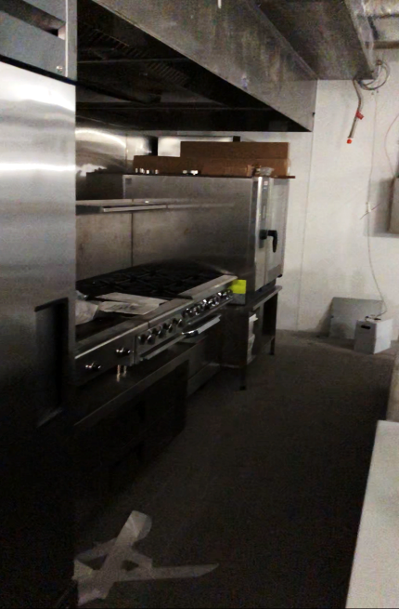
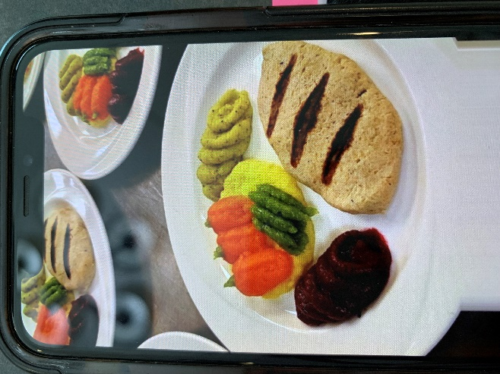
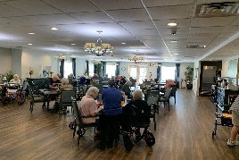
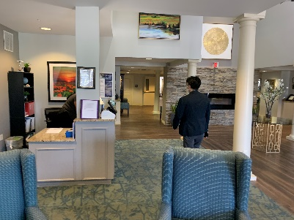
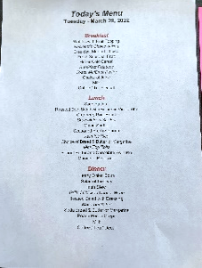
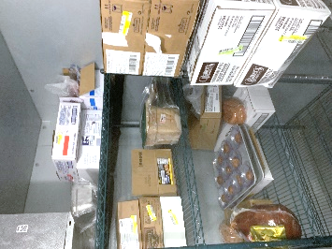

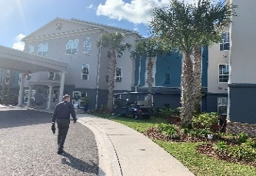
Meridian Assisted Living
Continued
NUTRITION AND SODIUM ARE CRITICAL
“It’s non-negotiable if there is too much sodium in a ready-to-eat item.”
Mark indicated there is a daily maximum of sodium for residents. Other nutritional factors – protein, carbohydrates – are up to the resident but not mandated.
LAUNCHING THE PRODUCT IN THE MARKET REQUIRES “PULL THROUGH”
Mark uses a GPO and a major broadline distributor. He said to call him and the corporate office to send through shipments directly. He would get it added it to his preferred list. “It’s the easiest way to avoid distribution if you’re launching a new product.”

Slide 58
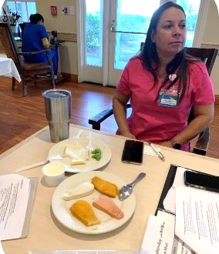
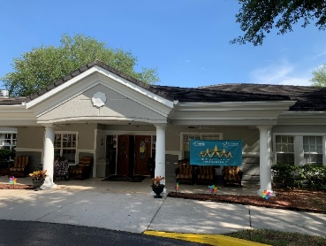
St. Andrews Memory Care
CUSTOMER SETTING
Serve three meals per day. The calories are dependent on the type of patient’s needs. “Only two diners can sit to a table because of the pandemic.”
They have 22 residents in the dining room and the other 23 are room service.
COOKING IS TYPICALLY DONE “NEXT DOOR”
Eliana spends $5 per patient per day – and this includes snacks as well.
The Pacifica site “next door” prepares food for Eliana’s residents, and her side is for memory care. Still, smaller menu items are prepared in their limited kitchen.
“If we have meat loaf for lunch and we have some leftovers, we will make a meatloaf sandwich. We can also reuse vegetables for soups too.”
Sysco does Eliana’s menu and it is a five-week schedule.
Today, they use a food processor to create mechanical foods.
BUDGETS AND SUPPLY ISSUES ABOUND
“For seven months we couldn’t get a big can of apply sauce,” due to Covid, said Eliana. “Meats are very expensive.” Eliana said her company is not allowed to buy from other suppliers – they have to use what they have.
Eliana said that although input prices are on the rise, they do not raise their patient meals costs per day.
STAFFING AND KITCHEN LABOR
Eliana worked 60 hours per week to cover during Covid-19. But, many of her staffers have left after the pandemic. “I still need to hire two people.”
Eliana thinks that ready-to-eat or speed scratch may be a good option now, but she said regulations mean the foods have to be fortified. “For example we’ll add brown sugar to oat meal for fortification.”
ELIANA LONDONE,
Head Nutritionist, St. Andrew’s Skilled Nursing Care
ABOUT ST. ANDREWS
Meals served 3-times per day
45 residents
Skilled nursing

Slide 59

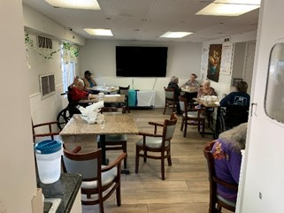
Allmar Assisted Living
CUSTOMER SETTING
Alllmar assisted living has 56 residents. Most are on government programs and are minorities. Meredith said several residents are in hospice right now.
Allmar has a long waiting list for residents.
COOKING AND PREPARATION
Allmar is sill using paper plates from the pandemic.
“We hired a dietician to go over our meals. She writes up a menu at the beginning of the year. It’s a 4-week menu.” Meredith said it stays the same all year.
“We have a lot of Latin food. We use a lot of rice and yucca.”
Allmar serves three meals per day plus three snacks. Snacks include mini ice-creams and other single-serve items.
“Our head chef works from 6a to 130p and she gets everything set up for dinner too.”
BUDGETS AND SUPPLY ISSUES
“We order from Gordon Foods but we are short of milk.” Meredith said she drives to Winn Dixie to get milk herself.
“We get paid a room and board cost and then we get paid from a long-term care program – this is Medicaid. On average, residents pay about $1,250 out of their own pocket.” The rate without insurance is about $2,500 per month.
“We spend about $1,800 per week on food for 56 patients.”
ELIANA LONDONE,
Head Nutritionist, St. Andrew’s Skilled Nursing Care
Residents having lunch in the communal dining area. Four patients still only receive room service.
Most of our residents are Latino so we have a heavy focus on rice in our dishes. I meet with our dietician annually to come up with a 12-month menu that changes every four weeks.
Meredith – Tampa, Florida
© Foodservice IP

Slide 60
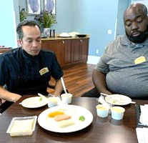
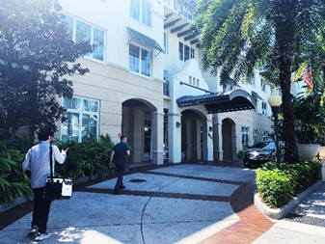
Allegro Independent Living
CUSTOMER SETTING
There are 137 residents right now and they serve 400 meals per day.
During Easter, they are going to reopen the buffet for the first time since the pandemic shut it down.
Residents come in on a contract and get two meals – breakfast, lunch OR dinner. Assisted gets three meals.
PRICES AND COSTS
The price varies from $5 to $8k per month, depending on how much a resident wants to pay.
The per-plate cost is about $8 per resident. Two dollars for breakfast, two dollars for lunch, four dollars for dinner.
COOKING AND PREPARATION
If the calorie count is too high, Marcus said their menu system will kick out the recipe or products.
In order to cut down on waste, they try to reuse products or run products. “We had a lamb gyro for lunch to take advantage of getting the protein.” Other meats are very hard to come by.
“We have 70% refrigerator versus 30% freezer,” so we are focused on fresh.
BUDGETS AND SUPPLY ISSUES
Inflation has hit them – prices are upward to 15%, according to Marcus. “We make estimates every quarter to determine how to keep within a budget.”
“We have to be more creative with the menu – a bit more starches and fewer meats.”
STAFFING AND KITCHEN LABOR
Staffing and labor have not at all been impacted by Covid. Marcus said employees have been dedicated and they have a lot of veterans working for them.
CHEF JOHN & CHEF MARCUS testing items:
RTE is not used often
ABOUT ALLEGRO
Allegro has both an independent and assisted living arm.
137 residents in Independent Living
Serves 400 meals per day
Located in Tampa, Florida

Slide 61

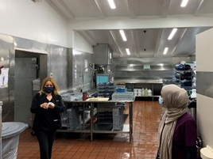
Fountain Care Center Assisted Living
CUSTOMER SETTING
They have 165 beds and currently house 140 beds.
Most patients receive their meals in their rooms, but only about 15 do come into the dining area.
PRICES AND COSTS
Price per patient day is $5.85 for three meals per day and two snacks.
Snack tray is peanut butter and jelly, apple sauce, ice cream.
MENU PLANNING AND PREPARATION
“We outsource our menu and change our menus every four weeks. There are like 10-12 options, but the four-week cycle is fixed,” Hajra said.
“We separate 20 portions of our regular menu to give to dysphagia patients. We use an ice cream scoop – and they have different colors to determine the ounces.”
They started to use a garnish to make the blended foods look “prettier,” because the residents do not like the look.
Hajra said they used to have a steamer to prepare foods, but the “hard water” in Orange County prevented acceptable results.
INNOVATION
If Hajra approves a product, then the head of kitchen operations can purchase it. “We used to have Sysco but now we use Newport Farms because they have the ability to break boxes.”
“We stick to our four-week cycle – they have seasonal menus,” Hajra said, referring to the company they use for menu development.
HAJRA ASHRAF,
Senior Dietician, with her head of kitchen operations.
Tour of kitchen operations. Facility no longer has a steam table because hard water in Orange County negatively impacts flavor and quality.

Slide 62

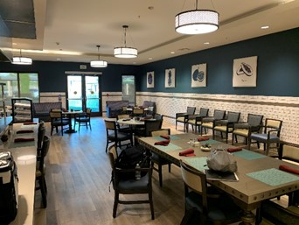

Emerald Court (Kisco Senior Living)
CUSTOMER SETTING
Nancy said they have independent living, assisted living and memory care.
There are 109 in assisted living, 15 in memory care and the 134 in independent living.
Breakfast, lunch and dinner is fed to both independent and assisted living residents.
“We have an all-day menu too.”
PRICES AND COSTS
Nancy was not sure of her patient costs per day, but Foodservice IP estimates it is between $6-$9 per day.
MENU PLANNING AND PREPARATION
Nancy said in order to come up with new ideas, they ask for resident feedback on the menu. Those who are most critical as asked to join a panel to help develop new items. “They will still complain, but at least we can say ‘well this is what you told us.’”
Salmon, codfish and catfish are popular menu items. “We usually bake or use a skillet.”
STAFFING AND KITCHEN LABOR
Most staffers have culinary skills.
Turnover has not been a problem.
NANCY ROMERO,
Assistant Dining Director
Anaheim, California
One of two “restaurants” within the assisted and independent living facility.

Slide 63


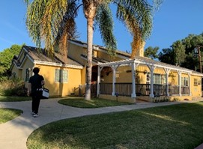
Carmel Oaks Assisted Living (Legacy Care)
CUSTOMER SETTING
Capacity of six residents. It’s a boarding assisted living facility.
The cost to live in a location is about $5,000 to $8,000 per month.
PRICES AND COSTS
Food cost is about 15%-20%.
Her budget is $6.50 per patient day. “I’m trying to keep it at $6.50 but inflation will impact that.” Dinner is the most expensive daypart.
Larger distributors give her 60-day credit. Smaller companies you pay buy credit card.
MENU PLANNING , PREPARATION AND LOGISTICS
She uses Costco and smaller distributors, but her larger rehab facility uses a broadliner.
The facility uses Crandall menu services, which designs personalized recommendations based on community size and budget (www.tfrecipies.com).
SPECIAL DIETS AND CONSUMER NEEDS
They use the same menu items for special diets as they do for regular residents.
No patients have a sodium-free or reduced diet. Just sugar.
SHARI
Head of dining at Legacy Care

Slide 64



Report prepared by:
Tim Powell Managing Principal/Head Analyst
tpowell@foodserviceIP.com
312.602.9899
JOYCE BAIRD Business Development Director
jbaird@foodserviceIP.com
312.305.0532
Let’s build a better strategy together!
www.foodserviceip.com
64

