Slide 1
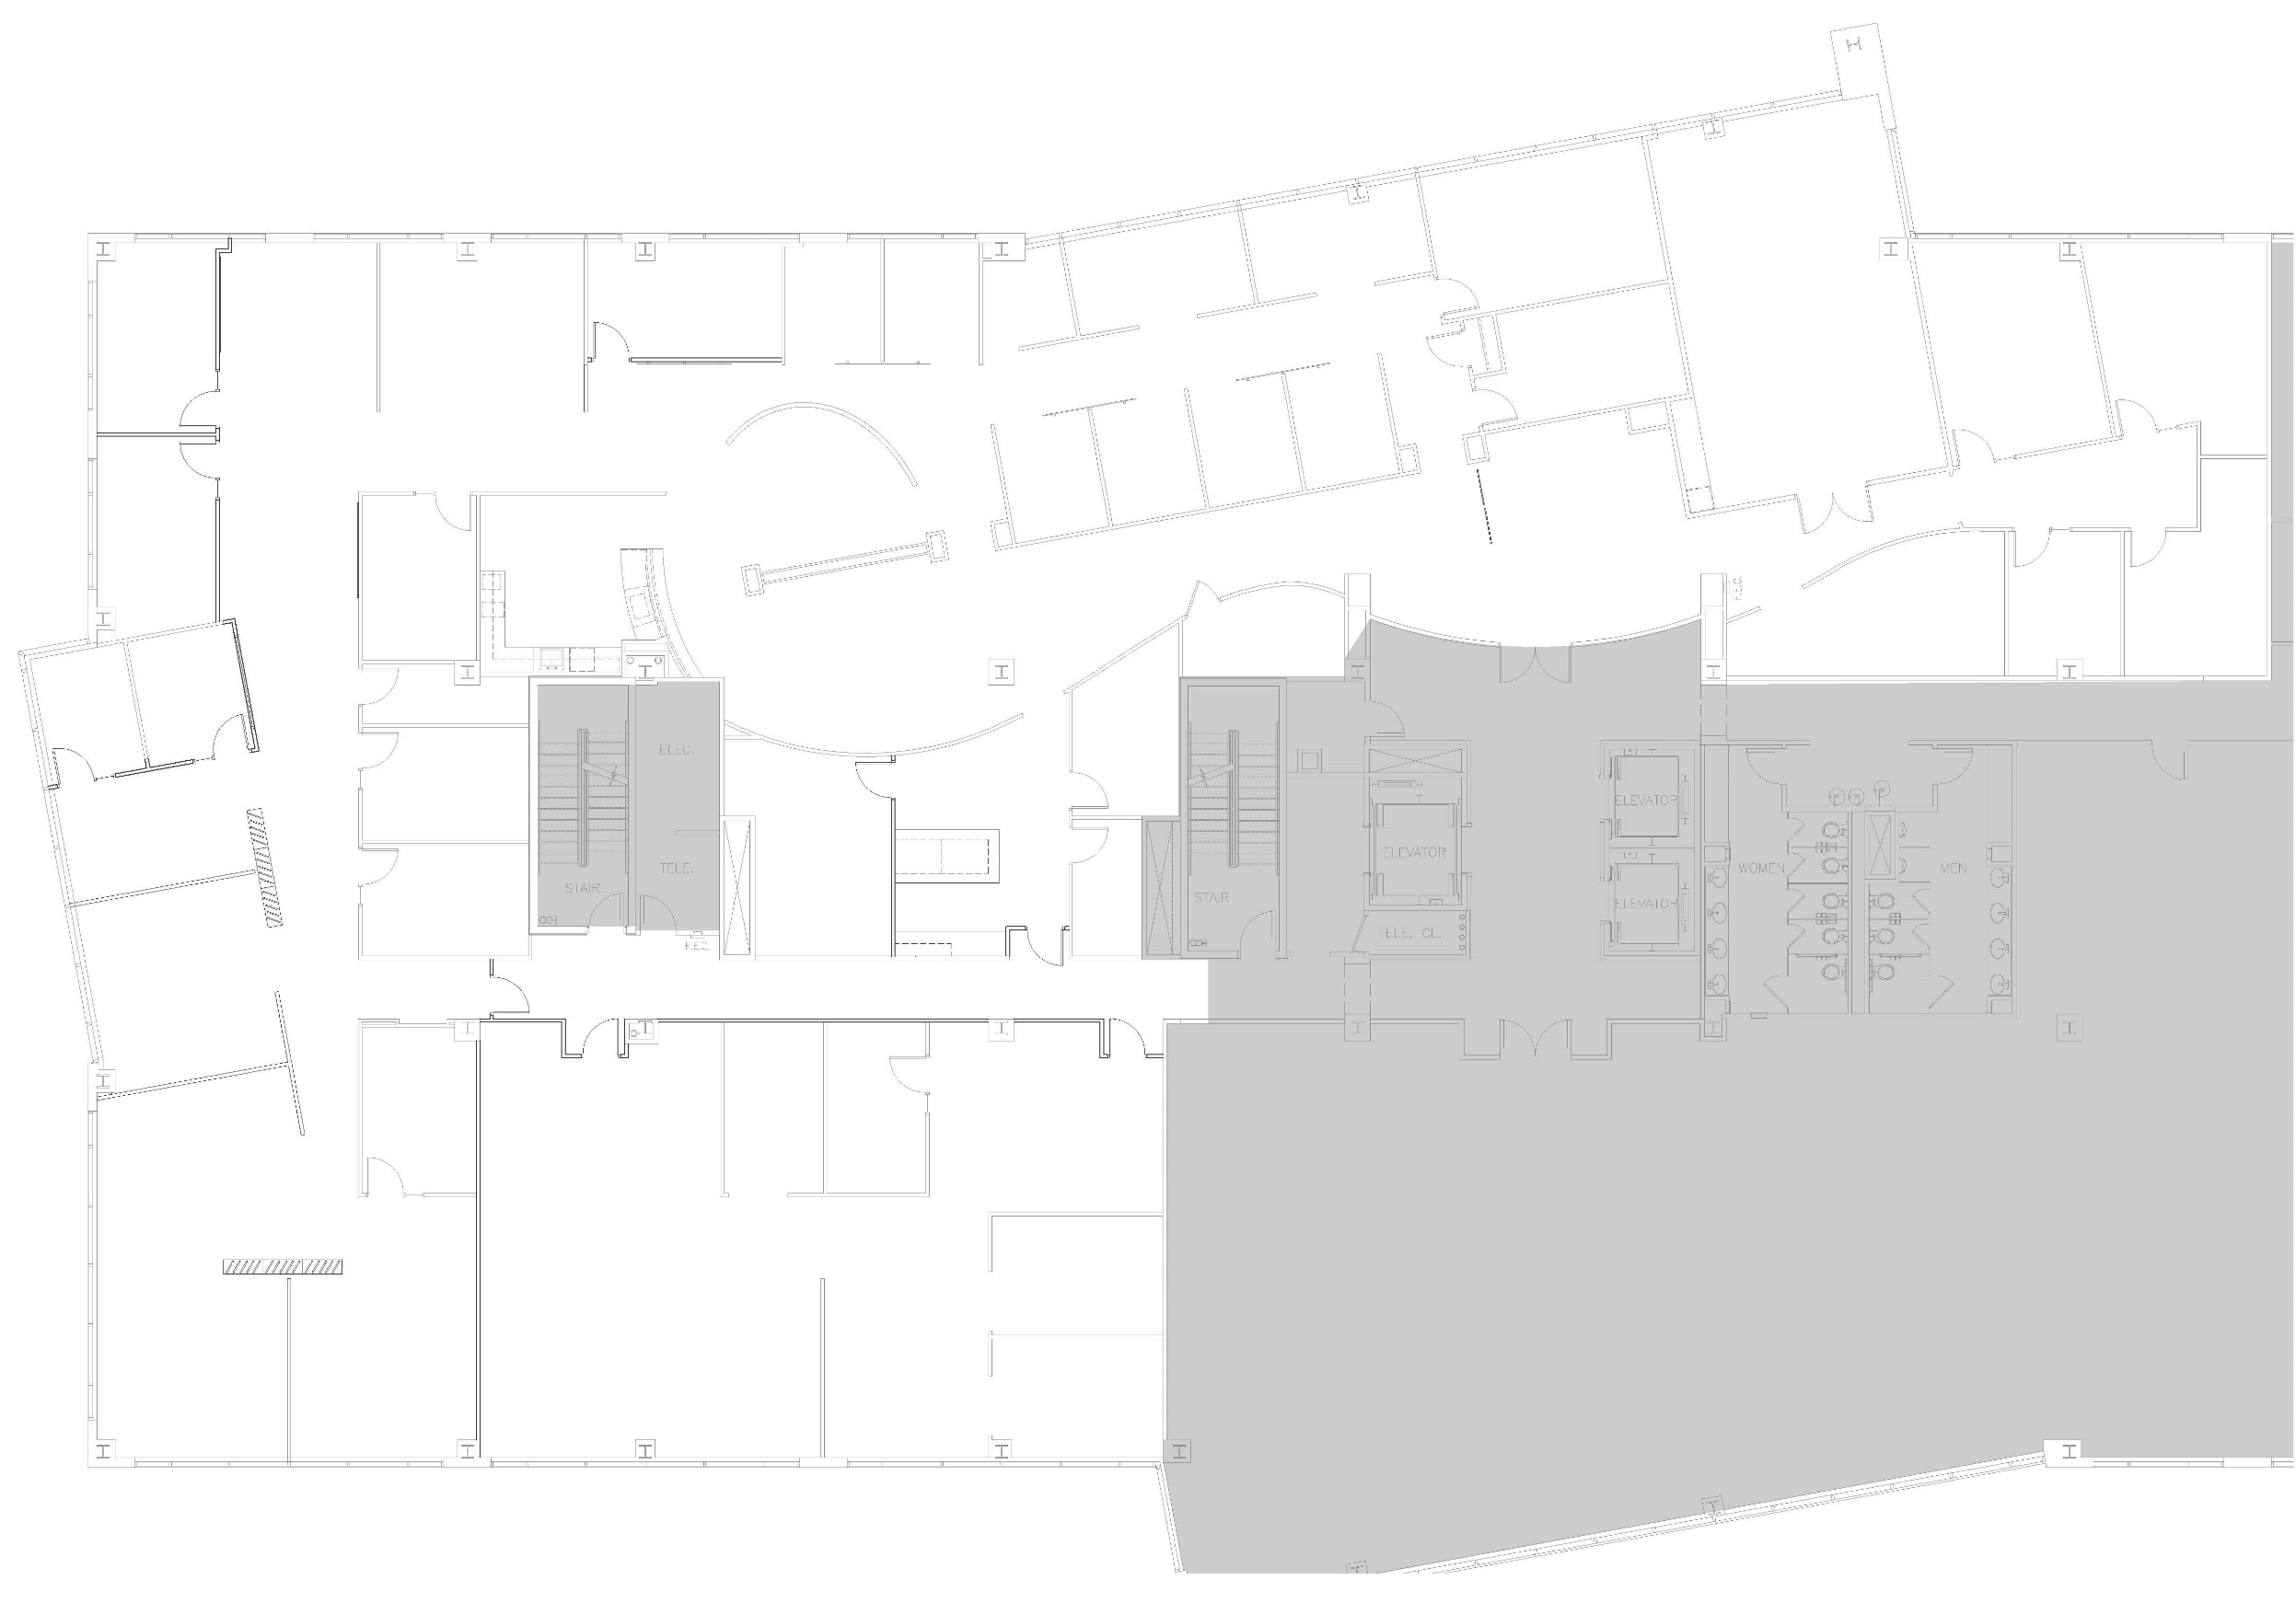

Office Layout (10.2023)
The Crab Pot
(small conference room)
x162
(poly x170)
TBD
x137
Floating Office 2
.
JoAnn
x118
Floating Office 1
x142
Copy
Room
Ashley
x153
Leah
x155
Bordeaux
(large conference room
x160
(poly x168)
Tighe/
Senior Team Mtg Space
x103
(poly x169)
FirePit
(open space
collab area)
x166
TBD
x150
Ann S.
x152
Rob
x119
Printer:
Kyocera
CS 5550ci
Anne T.
x112
Nikki
x105
Connor
x134
Jon N.
Sara F.
x113
Jess G.
x122
Mixing Bowl
(open space
collab area)
x163
x145
Mei
x139
The Sky Lounge
(open space
collab area)
x100
David
x120
High Top
(open space
collab area)
x136
Kitchen
Nursing Moms & Storage Room
x104
Nicole
x140
The Clarity Room
(medium conference room)
x102
Dawn
x127
Brew & Brew
(open space
collab area)
Liquor Closet
Jess P.
Danielle
Copy Room
Printer: Kyocera CS 6052ci
Server
Room
Trey
x149
Back of House
(closed
collab area)
x130
Front of
House
(semi-closed
collab area)
x167
Jake
Juliana
Anna
x156
TBD
x129
Storage Room
Adrian
Anthony
TBD
Kara
Patrick
x107
Wendy
x115
TBD
Erica
Melanie
x117
TBD
Dan
x125
Kate
x121
Upasana
Leah L

