Slide 1



Slide 2
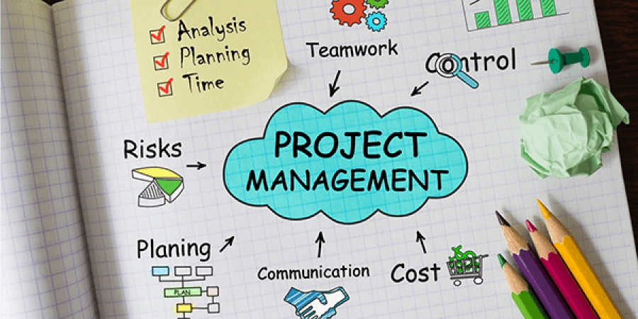
Project Management Boot Camp
October 2019

Slide 3
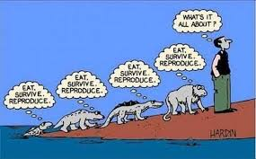
why are we here?
GOAL Align on processes for purposes of consistency across
teams to ensure agency efficiency, as well as collaborative communication to always look for room for improvement.
‹#› | MARRINER MARKETING ©2019 MMC Project Management Boot Camp | October 2019

Slide 4
agenda
Project Set-Up & Status – Set-up, team assignments, reviewing budget against allocated hours, task assignments (Project task vs. Ongoing Tasks).
Project Monitoring – Overall project monitoring/project health/project meetings.
Q&A
‹#› | MARRINER MARKETING ©2019 MMC Project Management Boot Camp | October 2019

Slide 5
project set-up

Slide 6

project set-up
Ensure understanding of type of job (Landing Page, Banner Ads, Email, Sell Sheet)
Confirm timing to launch/deliver and assess if feasible (i.e. are resources available?)
How to review project budget and assign resources based on approved hours
Project Set-up; project tasks vs. ongoing tasks
‹#› | MARRINER MARKETING ©2019 MMC Project Management Boot Camp | October 2019
Notes:
Prior to setting up, review and ask yourself some questions, get comfortable and understand what the work is we are tasked to do.

Slide 7
what type of job is this?
Setting up the Kickoff
Ensure K/O task is created once K/O is scheduled and correct people are assigned to the task.
Prep for K/O
Review hours allocation to ensure correct resources are included on the invite
Review Brief, ensure it is attached to invite, or follow-up with account lead to GET IT DONE. Upload under FILES once Brief is written
If questions before K/O, talk to team members about the project and what the job entails
Ensure Job is moved from DEFINITION to PRODUCTION once invite has been sent
Update Start/End Dates (Start date, at the very least should be Date of K/O, end date adjusted based on K/O)
Put in a K/O task; assign resources who will be in attendance
Put in a conversation that K/O is scheduled and schedule will be put in after the K/O
COMMUNICATION IS KEY
‹#› | MARRINER MARKETING ©2019 MMC Project Management Boot Camp | October 2019
Notes:
There may be rush jobs which means less time to prep, but you should still prep to ensure you understand the ask, as the resource to go to with questions about the job itself.

Slide 8
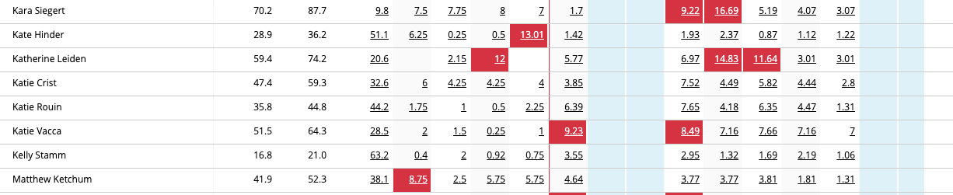
kickoff
Ask the right questions at the Kickoff
What is driving to this landing page? Do we need a separate thank you page? Who should get email notifications (if applicable)? Do we have all the assets? Do they need to be sized? How many resizes are needed and what are the specs for these banner ads? Do we even have specs?
Ask about Timing
When is this needed? Why? What’s the reason for the rush?
Do we have resources available?
Always review staff assignments to ensure the correct people have time to do the work; reallocate as/if needed
Review hours; anyone is red should be a warning they are busy. KEEP COMMUNICATION OPEN WITH TEAM!
‹#› | MARRINER MARKETING ©2019 MMC Project Management Boot Camp | October 2019

Slide 9
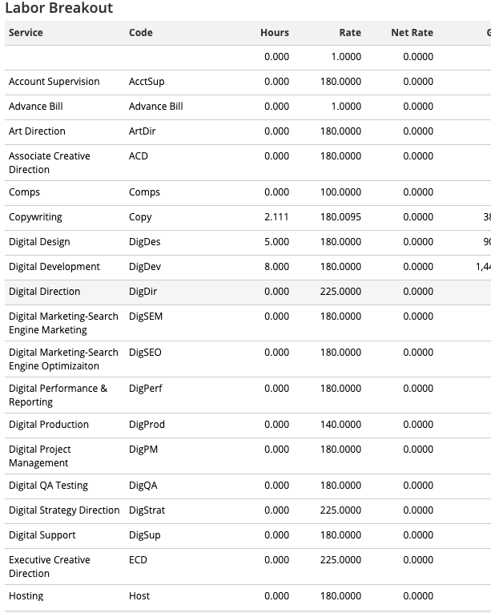
budget & allocation assignments
View estimate/budget by going to ESTIMATE → Click in to Hours → View Labor Breakout
- NO Account Supervision Time
- 2.11 = Copywriting
- 5 = Digital Design
- 8 = Digital Development
This will help determine how tasks are set up and the hours allocation of those tasks based on the job.
‹#› | MARRINER MARKETING ©2019 MMC Project Management Boot Camp | October 2019

Slide 10
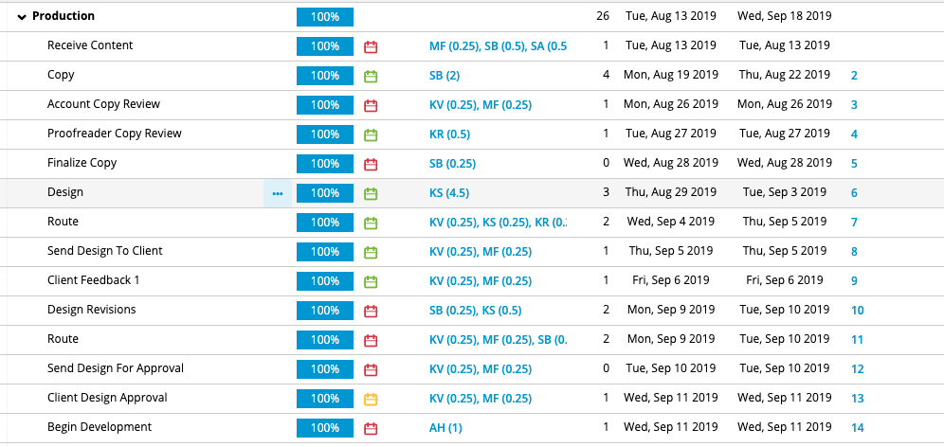
budget & allocation assignments continued
What’s wrong with the task allocation on this job?
‹#› | MARRINER MARKETING ©2019 MMC Project Management Boot Camp | October 2019

Slide 11
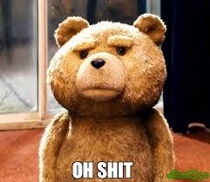
budget & allocation assignments continued
Account Supervision time is assigned; it should not be.
On jobs with no AS time, Account Team can be assigned task but should be kept at 0 hours
Copy will be over-budget because 2 hours was assigned to write, but time for internal review/route/edits was not accounted for
Development time (to build email) was only 1 hour when 8 hours was scoped
Time on Dev route was 4.5 for development. That makes no sense
There are too many routes in general, so QA will be over
Tasks are not action oriented; tasks should be action oriented so it’s obvious who needs to do what
i.e. Client Feedback 1 should be Collect Client Feedback_R1
‹#› | MARRINER MARKETING ©2019 MMC Project Management Boot Camp | October 2019

Slide 12
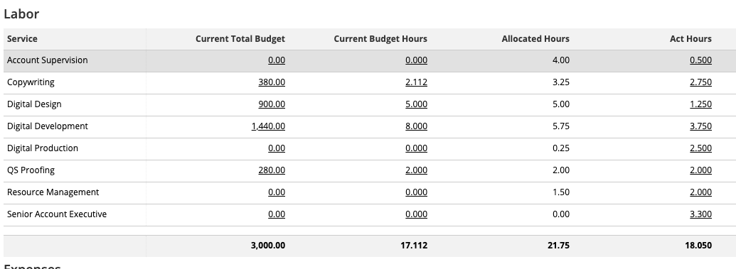
budget & allocation assignments continued
Once all tasks and team members are assigned, you can review resource allocation by completing the following:
Go to BUDGET → Review by Item, Type, Task, Person (I typically review by Item and then navigate from there based on where we are with the budget).
Constantly check back as tasks are completed and talk to Manager to help understand where we are over and why. This *may* change the schedule (i.e. too many routes, etc).
‹#› | MARRINER MARKETING ©2019 MMC Project Management Boot Camp | October 2019

Slide 13
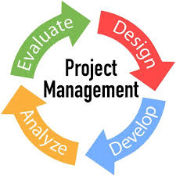
project set-up
Project Tasks vs. Ongoing Tasks (Maintenance, Account Support)
A task is a scheduled item that has specific people assigned and a certain amount of hours to get it done. It is the main driving element to tell people what they need to do, how long they have and when it is due. Tasks can be as detailed as you want, but at the very least, should be action oriented.
Ongoing tasks serve the same purpose, but are worked on over a longer period of time.
Based on the job & allocations, time should be added to the task card, AS THE TASK IS BEING WORKED ON.
WHY?
It shows management how much TRUE time a task takes.
It will display the card at the end of each month for more accurate tracking.
It allows for a true view of utilization rates.
It helps avoid dumping in hours at the end vs. as tasks are worked on (see next slide).
‹#› | MARRINER MARKETING ©2019 REGAL SPRINGS | eCommerce Recommendations | June 2019

Slide 14
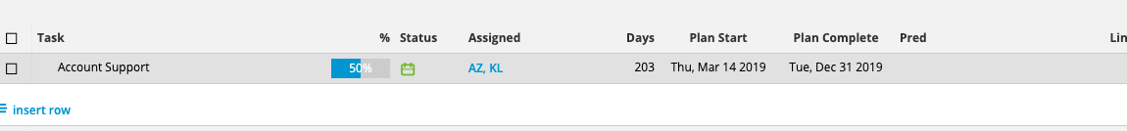

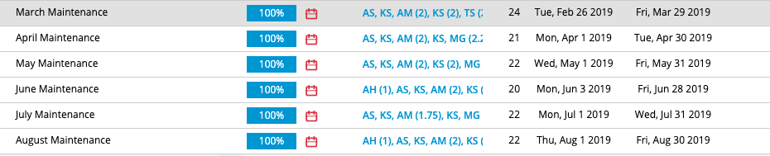
project set-up
‹#› | MARRINER MARKETING ©2019 MMC Project Management Boot Camp | October 2019

Slide 15

project set-up
When setting up recurring tasks, you need to determine:
# of months
Total # of hours by service
Divide total # of hours/month to determine # of allocated hours per month per service
Always have 2 days on a route; design and dev
This gives proofreader time to review (and prioritize based on other items on their list)
Ensure the person who did the work (design, dev, creative) is on the route to make the changes.
IF THERE IS A RUSH, ensure you talk to EVERYONE involved so everyone can keep their eyes peeled that a rush job is coming and prioritize over other work!
‹#› | MARRINER MARKETING ©2019 MMC Project Management Boot Camp | October 2019

Slide 16
project monitoring

Slide 17
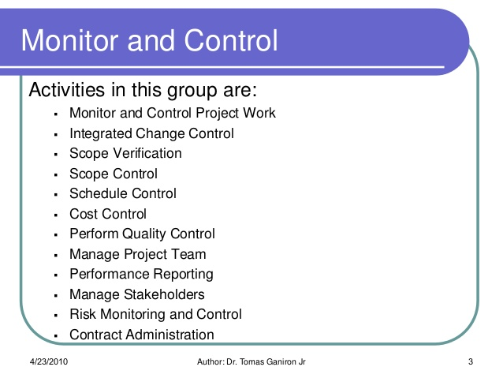
project monitoring
‹#› | MARRINER MARKETING ©2019 MMC Project Management Boot Camp | October 2019

Slide 18
project monitoring
As managers on projects, we are responsible for project health from conception to completion.
This requires constantly checking all active projects, tasks, due dates and making schedule adjustments all. the. time.
If tasks are late and schedule needs to be updated, ALWAYS put in a conversation and include all those involved on the job. This will mean a lot of schedule adjustments to be made daily.
WHY?
Account Team/Client “accountability”; the account team can’t say they didn’t know the date changed when they were late on something. It also helps ignite some fire so people know “oh we have to get s*&t done”.
Holds the team accountable for why a task was late. If you feel like something will be late, make a note and stalk whoever you need to.
The due dates on the job will shift to show where the hold-up is ( 1 day now = 7 days).
‹#› | MARRINER MARKETING ©2019 REGAL SPRINGS | eCommerce Recommendations | June 2019

Slide 19
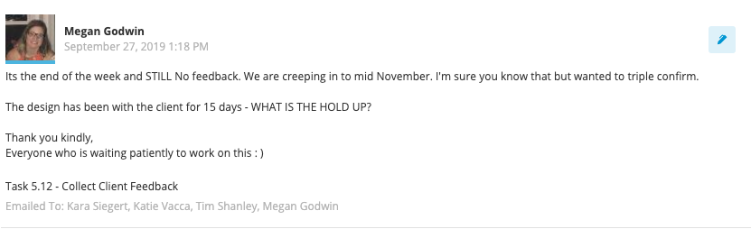
project monitoring
Look at all active jobs every morning and every evening (as time allows) and make adjustments.
Put in the necessary conversations when schedule is adjusted.
This means if we have a hard date, people will need to start having hard conversations with client/vendors as things are held up.
Routes/Rounds may need to be adjusted based on this.
KEEP COMMUNICATION OPEN
‹#› | MARRINER MARKETING ©2019 MMC Project Management Boot Camp | October 2019
Notes:
In person conversations!!!!!!!!

Slide 20
project status
AT RISK, WHATS LATE?
KEEP YOUR EYES PEELED, A TASK IS AT RISK
ON TIME, NO RISKS OR DELAYS
‹#› | MARRINER MARKETING ©2019 MMC Project Management Boot Camp | October 2019

Slide 21
always be monitoring
Always put in a conversation once schedule is in and ready to be reviewed. Essentially have team “sign off” on due dates/deliverables
Project Dates
Look at Task Due Dates
Always Communicate
Continue to monitor. Chase people down, put in conversations as tasks get closer to AT RISK
Retrospective
Face to face, pick up the phone, slack
For projects that are way over budget, set up a retrospective once job is done to figure out lessons learned for next time.
1
2
3
4
‹#› | MARRINER MARKETING ©2019 MMC Project Management Boot Camp | October 2019
Notes:
Just because you drop in a schedule, task etc does not mean the job is off your plate. You need to ALWAYS be checking in, looking back, adjusting as needed.

Slide 22
q & a

Slide 23

q & a
‹#› | MARRINER MARKETING ©2019 MMC Project Management Boot Camp | October 2019

Slide 24
follow-up | October 2019

Slide 25
follow-up items from Part 1
Thinking about how to handle DPM v. RM moving forward (Digital v. Creative Jobs) – note, I’m thinking we should start thinking of all jobs the same, in terms of management. I’m not super clear on what Katie fully meant by this but I think this can be solved for.
Potential Solve: Think of all projects as the same; completing from start to finish, under budget, even if their are hard deadlines. Put in schedules and make the account team review and provide feedback if needed.
Using PENDING status for project; once estimates are approved but the job is not yet kicked off.
Potential Solve: I have never used PENDING and I just think it’s an unnecessary thing to keep track of. 10/14 UPDATE: Keep it in Definition, move to ON HOLD if K/O not scheduled within 2 weeks.
Accounting for account time
Potential Solve: Susan T to talk to Tighe further about this?
Handling of media jobs and tight turn around; including Kate or Oscar in necessary kick-offs (why wouldn’t they always be?)
Potential Solve: Why wouldn’t Media team be included in these kick-offs to confirm all assets, sizes etc? UPDATE: Ensure every media plan includes a NEED APPROVAL BY date.
Take Kick-off/Meeting notes and include everyone on the job for reference.
‹#› | MARRINER MARKETING ©2019 MMC Project Management Boot Camp | October 2019
Notes:
In person conversations!!!!!!!!

