Slide 1

Distribution Marketplaces
CONFIDENTIAL

Slide 2
Distribution Marketplaces
Digital “one-stop shops” that allow operators to order from all of their distributors/suppliers through one ecommerce-based interface
The companies behind these marketplaces can develop a full ecommerce catalog for a distributor in just a few weeks, at no cost to the distributor, eliminating the need for the distributor to build their own system from scratch, as many larger broadliners have done
Allows manufacturers to reach customers from multiple distributors at one time, increasing the breadth of their marketing approach
CONFIDENTIAL

Slide 3
Cut + Dry

Slide 4


Distributor Marketplace: Cut + Dry
Created by a team of foodservice professionals with decades of experience in hospitality and financial technology, restaurant operations, wholesale food distribution, and food analytics and data science
Cut+Dry was born to provide distributors, their customers, and their suppliers with a single digital platform to make food commerce a more enjoyable, more profitable, and less wasteful experience
CONFIDENTIAL

Slide 5
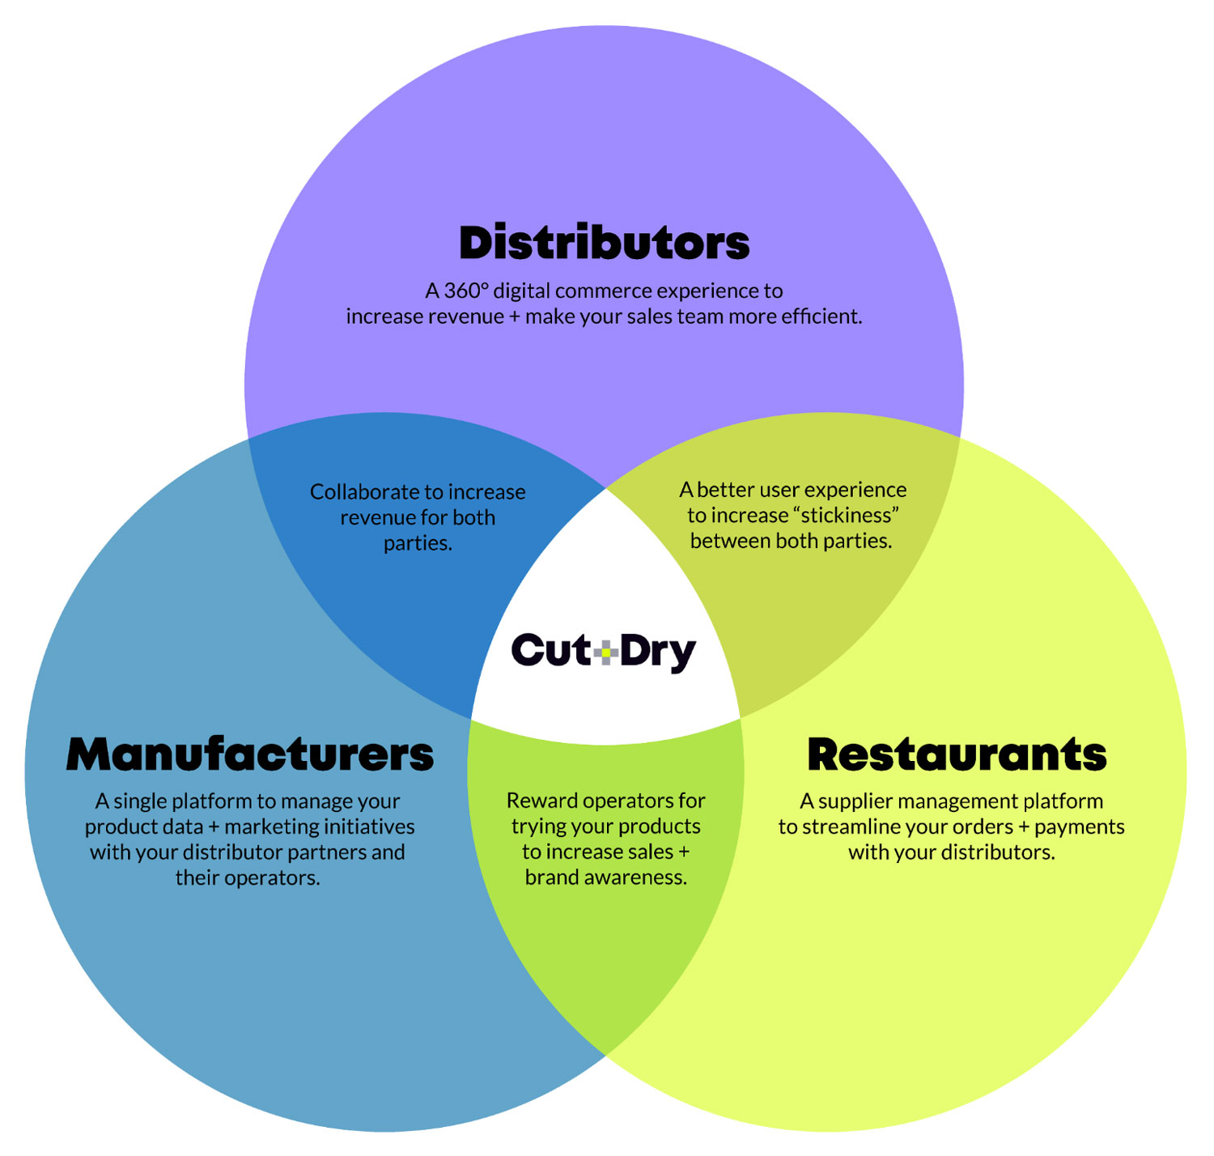
Distributor Marketplace: Cut + Dry
CONFIDENTIAL

Slide 6

Distributor Marketplace: Cut + Dry
For manufacturers…
Own Data
Enhanced Data
C+D structures and enhances product data to make it e-commerce ready.
Syndicate Everywhere
C+D syndicates and refreshes data to help reach the 12,000+ SMB distributors not on GS1.
Control Customer’s Experience
C+D offers full control over the evolution of content and how customers see it.
Increase Sales
Dynamic Website
C+D makes it easier for operators to buy product directly from manufacturers or local distributors.
eConnect to Distributors
C+D directs customers to distributors that sell a manufacturers products.
Seamless Samples
C+D expands and supplements sampling programs.
Influence Purchasing Decisions
Rebate Marketing
C+D allows direct connection with foodservice purchasers and attracts new customers via Cashback rebates.
Targeted Ads
X+D offers ability to run targeted campaigns to the right people.
Endless Aisle
C+D makes it easy for distributors to browse and supplement their catalogs with manufacturer products.
CONFIDENTIAL

Slide 7

Distributor Marketplace: Cut + Dry
For distributors…
Your Own Branded Digital Experience
Configurable content
Custom welcome messages
In-app branding
Amazon-like shopping experience
24/7 virtual food show
Rapid catalog search
Easy product discovery
Integrated marketing to increase share of wallet
Schedule broadcast announcements
Display recommended items at checkout
In-app chat to upsell and confirm subs
Never take a ‘Where’s my truck?’ call again
Automated delivery ETAs for customers
Integrate with existing fleet management software
Dispatch and monitor routes via Track+ Driver App
Automate your collections process
Digital bill pay done right
Automatic ‘set and forget’ payments
Let tech handle the hard stuff
CONFIDENTIAL

Slide 8

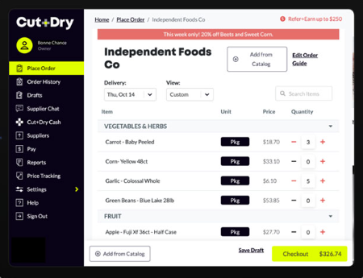
Distributor Marketplace: Cut + Dry
For operators…
Manage all distributor orders from one app
Streamline order management and cut labor requirements by 50%
Streamline communication
Chat directly with sales reps
Get delivery ETAs and real-time tracking
Check-in deliveries, manage credits, scan invoices and share directly with accounting
Pay any invoice via bank transfer or credit card
Cards now accepted everywhere, plus batch payments means less time paying bills
Get paid
Earn cash rewards directly from major foodservice brands
CONFIDENTIAL

Slide 9
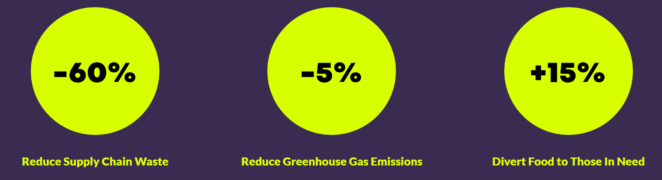
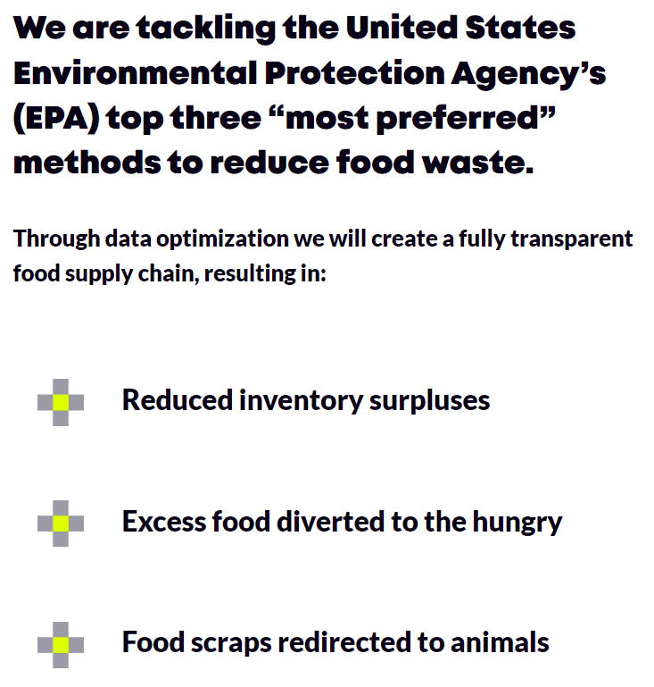
Distributor Marketplace: Cut + Dry
Goal is to transform the global foodservice industry by achieving the following results over the next 5 years
CONFIDENTIAL

Slide 10
Choco.com

Slide 11




Distributor Marketplace: Choco.com
Choco discovered that the food supply chain is massively broken. It produces a lot of waste, it’s a major driver for climate change, it’s intransparent, it puts farmers and food producers under existential price pressure, and massively reduces the world’s biodiversity.
A key flaw is how restaurants order their ingredients, so Choco decided to build a software that would make the process better for both parties – digitizing the whole supply chain from there.
Choco's namesake is the Chocó district of Colombia – one of the most biodiverse and rich ecosystems on our planet. It's places like Chocó that they are fighting to preserve.
CONFIDENTIAL

Slide 12
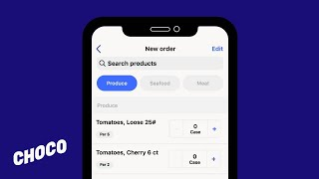
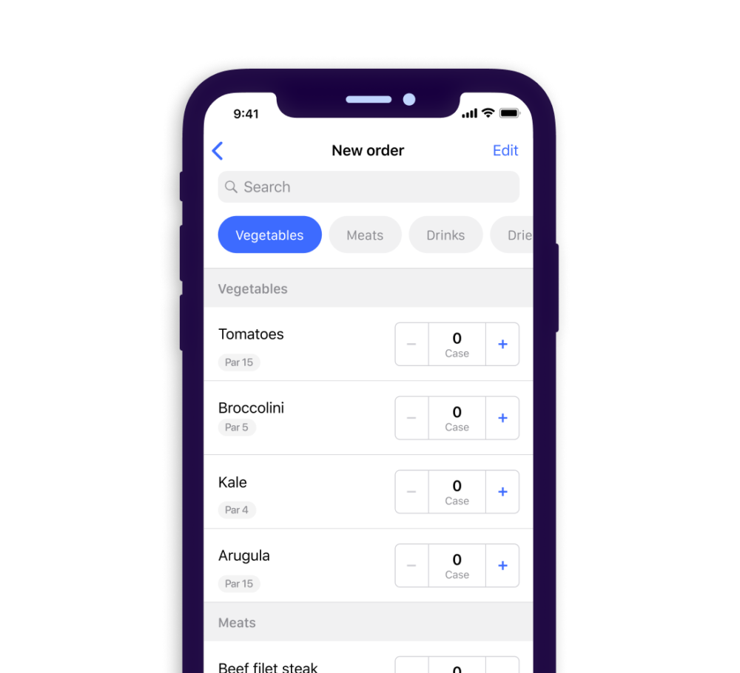
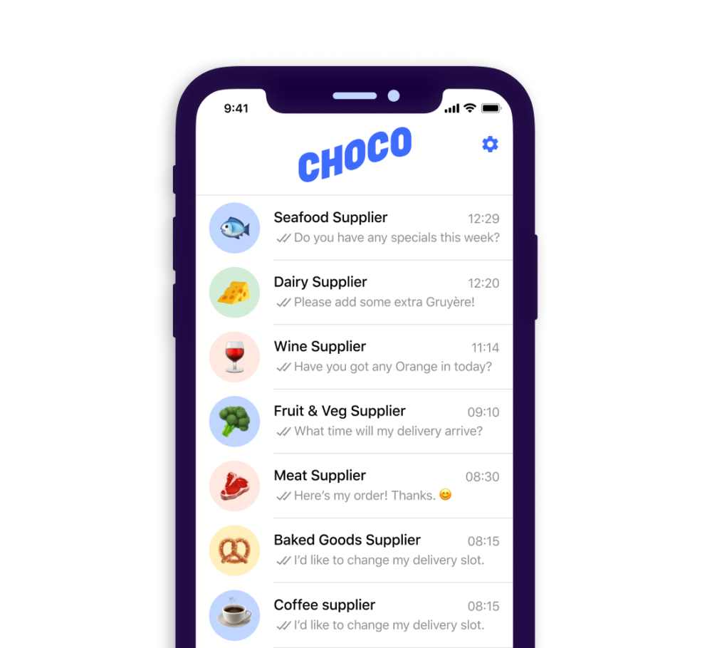
Distributor Marketplace: Choco.com
For restaurants…
Order from suppliers
Place orders and chat with all suppliers in one app.
Save 2 hr+ per week
24/7 in-app support
Organize order guides
View and edit all order sheets online.
Cut mistakes by 85%
Manage multiple locations
Keep track of orders across all restaurants from the palm of your hand.
CONFIDENTIAL

Slide 13



Distributor Marketplace: Choco.com
For suppliers…
Increase basket size and order frequency
Display your full catalog assortment with up-to-date product availability.
Effectively promote your products
Reach customers directly where they place orders. Send targeted, in-app promotions to all or select customers.
Cut costs with ERP integration
Choco integrates with ERPs, including Quickbooks and 200+ other custom integrations.
CONFIDENTIAL

