Slide 1
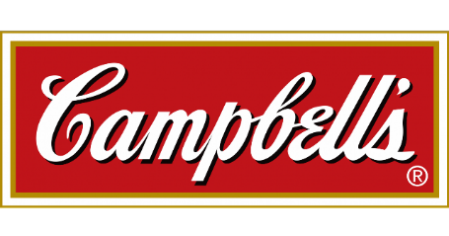
Brand Equity Tracker and Overview of Key Category Insights
Revised January 2020
#18509

Slide 2
In This Report
Table of contents
Background | 3
Introduction
Objectives
Methodology and scope
Executive Summary | 7
Brand awareness and usage
Category trends and innovations
Category summaries
Recommendations
Detailed Findings: Packaged Snacks | 59
Brand awareness and usage
Critical purchase attributes
Brand performance
Best in class brands
Detailed Findings: Soup | 77
Brand awareness
Usage by format
Critical purchase attributes by format
Brand performance by format
Best in class brands
Detailed Findings: Salsa | 121
Brand awareness and usage
Critical purchase attributes
Brand performance
Best in class brands
Detailed Findings: Beverages | 133
Brand awareness and usage
Critical purchase attributes
Brand performance
Best in class brands
Detailed Findings: Manufacturers | 148
Brand awareness and usage
Critical purchase attributes
Brand performance
Best in class brands
Appendix | 160
Operator demographics
Additional detailed findings

Slide 3
Background

Slide 4
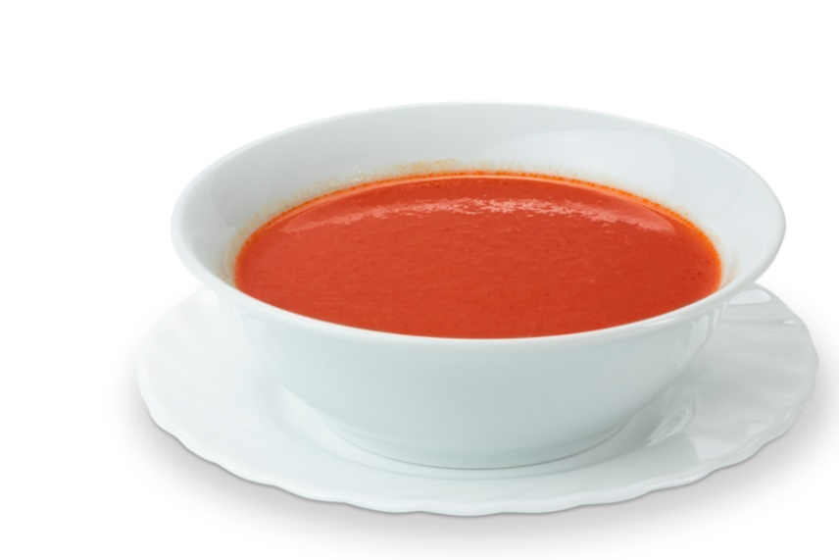
Introduction
The Situation
For branded manufacturers, nothing is more important than protecting their brand power. However, today’s flat foodservice environment has provided a situation that poses significant challenges to manufacturer brands and their prospects.
Campbell’s Foodservice competes in a variety of categories in the food away from home space, including soup (frozen and canned), snacks, salsa and beverages.
In 2017, the Campbell’s Foodservice portfolio was positioned under the “Made to Serve” tagline, which emphasizes the company’s commitment to real food and its alignment with operator values and needs.
But, importantly, over the past several years there have been a variety of portfolio, product level and segment initiatives, which have been evaluated via communication metrics and sales results.
The Solution
To position the organization for future growth in the wake of the evolution of the brand (and the industry), Campbell’s asked Technomic for intelligence and guidance to better understand its current and evolving brand equity among foodservice operators.
Given this need for insights, Technomic developed this report to address areas of critical importance to Campbell’s Foodservice.

Slide 5
Project Objectives and Scope
Engagement Objectives
Tracking and monitoring operator awareness, usage and perception of the Campbell’s Foodservice portfolio as well as key competitor portfolios.
Tracking and monitoring operator awareness, usage and perception of the priority brands within the Campbell’s Foodservice portfolio as well as key competitor brands.
Measure the success and effectiveness of Campbell’s marketing communications.
Develop and provide key conclusions, implications and recommendations to Campbell's Foodservice regarding relevant brands.
Develop a fixed set of measures to be collected annually.
Develop and adjust a variable set of measures to gather category-level insights designed to inform annual planning.
Key Category Issues Addressed
Category specific usage, including Campbell’s and leading competitor brands
Brand awareness (unaided and aided)
Brand usage
Critical purchasing considerations
Brand performance across key factors and reasons to believe
Net promotor scores (NPS) for portfolios as well as individual brands
Advertising awareness and association
Operator expectations of manufacturer support
Category Scope:
Soup (includes scratch, frozen, refrigerated and canned)
Vegetable and/or fruit beverages and coconut water
Packaged snacks
Salsa
Manufacturer portfolios
Segment Scope:
K-12
Healthcare
College and university
Limited-service restaurants (independent restaurants as well as chains)
Full-service restaurants (independent restaurants as well as chains)
C-stores
Lodging

Slide 6
Project Phase and Methodology
Phase One: Program Initiation
Technomic team members spent time with various Campbell’s Foodservice and marriner marketing personnel to review the proposal, anticipated deliverables and timeline.
Phase Two: Secondary Research
Technomic gathered and analyzed all relevant published materials, including manufacturer product literature, trade publications, available market research and Technomic nonproprietary studies.
The purpose of this phase was to inform the study team on current competitor and category details.
Phase Three: Quantitative Operator Surveys
Technomic conducted 700 quantitative surveys (segment detail below). The primary purpose of these surveys was to obtain operator insights on the various Campbell’s Foodservice brands and competitor brands.
Respondents were reminded throughout the survey that all questions were in relation to awareness, usage and behavior as it relates to brands and companies in terms of foodservice, not retail.
Phase Four: Reporting
Technomic analyzed all study findings and addressed each of the stated research objectives. Technomic has prepared the following report, which includes an executive summary and more in-depth coverage of category- and brand-specific findings.
Segment | Operator Completes
Limited-service restaurants | 110
Full-service restaurants | 165
K-12 | 150
College & University | 50
Healthcare | 125
Convenience store | 125
Hotel | 50
Total | 700

Slide 7
Executive Summary

Slide 8
Summary
Operator brand awareness and usage
Brand Awareness in Category (Number of Brands in Category). | Packaged Snacks (11) | Soup (10) | Prepared Salsa (10) | Beverages (11)
Highest level of awareness (percent familiar with brand) | Goldfish 52% | Campbell’s 71% | Pace 48% | Vita Coco 58%
Second-highest level of awareness (percent familiar with brand) | Ritz 49% | Heinz 56% | Herdez 32% | V8 44%
Campbell’s brand awareness/rank | 52%/1st | 71%/1st | 48%/1st | 44%/2nd
Brand Usage in Category (Number of Brands in Category) | Packaged Snacks (11) | Prepared Salsa (10) | Beverages (11)
Highest level of usage (Percent purchasing brand) | Goldfish 40% | Pace 27% | Vita Coco 46%
Second-highest level of usage (Percent purchasing brand) | Nabisco 35% | Herdez 19% | V8 31%
Campbell’s brand usage/rank | 40%/1st | 27%/1st | 31%/2nd

Slide 9
Summary
Operator soup brand usage
Brand Usage in Category (Number of Brands in Category) | Canned (2) | Frozen (10) | Refrigerated (2) | Homemade (5)
Highest level of usage (Percent purchasing brand) | Campbell’s 70% | Campbell’s 46% | Kettle Cuisine 39% | Homemade base 48%
Second-highest level of usage (Percent purchasing brand) | Heinz 40% | Heinz 35% | Blount Fine Foods 21% | Nestle 47%
Campbell’s brand usage/rank | 70%/1st | 46%/1st | NA | NA

Slide 10
Summary – Total Sample
Top eight purchase drivers for all categories
Packaged Snacks | Canned Soup | Frozen Soup | Refrigerated Soup | Homemade Soup | Prepared Salsa | Beverages
Price | Price | Requires less labor | Requires less labor | Taste/flavor | Price | Price
Taste/flavor | Shelf life | Wide range of flavor options | Price | Overall product quality | Overall product quality | Taste/flavor
Overall product quality | Distributor availability | Taste/flavor | Works well in recipes | Flexibility for flavor options | Taste/flavor | 100% juice products
Distributor availability | Requires less labor | Ready to eat (only requires heating) | Taste/flavor | Price | Distributor availability | Shelf life
Shelf life | Overall product quality | Overall product quality | Appropriate packaging size | Reduce food waste | Shelf life | Distributor availability
Strong consumer-known brand name | Appropriate packaging size | Price | Product packaging and format | Offer of LTOs | Requires less labor | Health and wellness benefits
Appropriate packaging size | Works well in recipes | Shelf life | Wide range of flavor options | Health and wellness benefits | Easily incorporated into recipes | Appropriate packaging size
Nutrition claims | Taste/flavor & Reputation | Distributor availability | Shelf life | Low-sodium options | Dietary claims | Overall product quality

Slide 11
Restaurants
Top eight purchase drivers for all categories
Packaged Snacks | Canned Soup | Frozen Soup | Refrigerated Soup | Homemade Soup | Prepared Salsa | Beverages
Price | Price | Requires less labor | Requires less labor | Overall product quality | Price | Price
Taste/flavor | Shelf life | Taste/flavor | Works well in recipes | Taste/flavor | Taste/flavor | Availability of 100% juice
Overall product quality | Requires less labor | Overall product quality | Price | Flexibility for flavor options | Shelf life | Taste/flavor
Nutrition claims | Distributor availability | Shelf life | Taste/flavor | Ability to reduce food waste | Overall product quality | Shelf life
Appropriate packaging size | Taste/flavor | Price | Overall product quality | Ability to offer seasonal or LTOs | Requires less labor | Overall product quality
Strong consumer-known brand name | Overall product quality | Wide range of flavors | Reputation of supplier | Signature soup of the operation | Distributor availability | Health and wellness benefits
Shelf life | Reputation of supplier | Distributor availability | Product packaging and format | Price | Homemade appearance | Reputation of supplier
Easy to display product | Health and wellness benefits | Is ready to eat (only requires heating) | Product claims | Health and wellness benefits | Easily incorporated into recipes | Broad customer appeal

Slide 12
Commercial Chains - Priority Segment for Packaged Snacks, Soup and Salsa
Top eight purchase drivers for all categories
Packaged Snacks | Canned Soup | Frozen Soup | Refrigerated Soup | Homemade Soup | Prepared Salsa | Beverages
Overall product quality | Distributor Availability | Requires less labor | Reputation of supplier | Overall product quality | Taste/flavor | Taste/flavor
Nutrition claims | Price | Taste/flavor | Health and wellness benefits | Taste/flavor | Price | Availability of 100% juice
Strong consumer-known brand name | Overall product quality | Distributor availability | Product packaging and format | Health and wellness benefits | DSR recommendation | Price
Taste/flavor | Shelf life | Price | Strong consumer-known brand name | Ability to reduce food waste | Product packaging and format | Product claims
Price | Taste/flavor | Frozen is my preferred format | Price | Price | Requires less labor | Distributor availability
Product claims | Requires less labor | Shelf life | Works well in recipes | Ability to offer seasonal or LTOs | Shelf life | Shelf life
Easy to display product | Reputation of supplier | DSR recommendation | Refrigerated is my preferred format | Flexibility for flavor options | Low-sodium options | Reputation of supplier
Appropriate for kids menu | Appropriate packaging size | Appropriate packaging size | Requires less labor | Signature soup of the operation | Easily incorporated into recipes | Appropriate packaging size

Slide 13
Noncommercial
Top eight purchase drivers for all categories
Packaged Snacks | Canned Soup | Frozen Soup | Refrigerated Soup | Homemade Soup | Prepared Salsa | Beverages
Taste/flavor | Price | Requires less labor | Requires less labor | Taste/flavor | Overall product quality | Price
Price | Distributor availability | Wide range of flavors | Taste/flavor | Flexibility for flavor options | Price | Distributor availability
Overall product quality | Shelf life | Is ready to eat (only requires heating) | Overall product quality | Overall product quality | Distributor availability | Taste/flavor
Distributor availability | Appropriate packaging size | Overall product quality | Appropriate packaging size | Price | Taste/flavor | Availability of 100% juice
Shelf life | Overall product quality | Taste/flavor | Product packaging and format | Health and wellness benefits | Easily incorporated into recipes | Shelf life
Strong consumer-known brand name | Requires less labor | Price | Wide range of flavors | Ability to reduce food waste | Dietary claims | Appropriate packaging size
DSR recommendation | Works well in recipes | Shelf life | Price | Ability to offer seasonal or LTOs | Low-sodium options | Health and wellness benefits
Product packaging and format | Dietary claims | Distributor availability | Works well in recipes | Low-sodium options | Requires less labor | Broad customer appeal

Slide 14
K-12 – Priority Segment for Packaged Snacks and Soup
Top eight purchase drivers for all categories
Packaged Snacks | Canned Soup | Frozen Soup | Refrigerated Soup | Homemade Soup | Prepared Salsa | Beverages
Taste/flavor | Distributor Availability | Requires less labor | Appropriate packaging size | Taste/flavor | Student interest | Student interest
Overall product quality | Price | Ready to eat (only requires heating) | Product packaging and format | Student interest | Overall product quality | Distributor availability
Meets USDA requirements | Dietary claims | Price | Works well in recipes | Overall product quality | Meets USDA requirements | Price
Distributor availability | Meets USDA requirements | Wide range of flavors | Overall product quality | Health and wellness benefits | Dietary claims | Availability of 100% juice
Price | Overall product quality | Taste/flavor | Meets USDA requirements | Flexibility for flavor options | Low-sodium options | Taste/flavor
Brand uses a licensed character | Appropriate packaging size | Overall product quality | Requires less labor | Low-sodium options | Distributor availability | Is Smart Snack compliant
Nutrition claims | Student interest | Distributor availability | Taste/flavor | Ability to reduce food waste | Taste/flavor | Shelf life
Is Smart Snack compliant | Shelf life | Reputation of supplier | Price | Meets USDA requirements | Product packaging and format | Health and wellness benefits

Slide 15
Healthcare - Priority Segment for Soup
Top eight purchase drivers for all categories
Packaged Snacks | Canned Soup | Frozen Soup | Refrigerated Soup | Homemade Soup | Prepared Salsa | Beverages
Taste/flavor | Price | Requires less labor | Taste/flavor | Overall product quality | Easily incorporated into recipes | Price
Price | Appropriate packaging size | Wide range of flavors | Overall product quality | Flexibility for flavor options | Overall product quality | Taste/flavor
Shelf life | Shelf life | Is ready to eat (only requires heating) | Price | Taste/flavor | Price | Availability of 100% juice
Overall product quality | Distributor availability | Taste/flavor | Requires less labor | Price | Distributor availability | Broad customer appeal
Easy to display product | Overall product quality | Shelf life | Unique product | Health and wellness benefits | Taste/flavor | Distributor availability
Product packaging and format | Works well in recipes | Overall product quality | Wide range of flavors | Ability to reduce food waste | Requires less labor | Shelf life
Reputation of supplier | Availability of organic/non-GMO | Strong consumer-known brand name | Works well in recipes | Low-sodium options | Shelf life | Appropriate packaging size
Distributor availability | Requires less labor | Distributor availability | Health and wellness benefits | Ability to offer seasonal or LTOs | Dietary claims | Product claims

Slide 16
Hotels
Top eight purchase drivers for all categories
Packaged Snacks | Canned Soup | Frozen Soup | Refrigerated Soup | Homemade Soup | Prepared Salsa | Beverages
Strong consumer-known brand name | Price | Taste/flavor | Price | Taste/flavor | Appropriate for kids menu | Taste/flavor
Shelf life | Availability of organic/non-GMO | Appropriate packaging size | Requires less labor | Flexibility for flavor options | Price | Price
Availability of organic/non-GMO | Appropriate packaging size | Is ready to eat (only requires heating) | Works well in recipes | Overall product quality | Appropriate packaging size | Strong consumer-known brand name
Overall product quality | Shelf life | Price | Availability of organic/non-GMO | Ability to reduce food waste | Dietary claims | Availability of 100% juice
Taste/flavor | Health and wellness benefits | Health and wellness benefits | Overall product quality | Price | Homemade appearance | Shelf life
Distributor availability | Overall product quality | Dietary claims | Appropriate packaging size | Health and wellness benefits | Taste/flavor | Availability of clean label products
Appropriate packaging size | Reputation of supplier | Low-sodium options | Health and wellness benefits | Back of house space/storage requirements | Shelf life | Availability of organic/non-GMO
DSR recommendation | Strong consumer-known brand name | Works well in recipes | Wide range of flavors | Ability to offer seasonal or LTOs | Availability of organic/non-GMO | Appropriate for kids menu

Slide 17
C-store
Top eight purchase drivers for all categories
Packaged Snacks | Canned Soup | Frozen Soup | Refrigerated Soup | Homemade Soup | Prepared Salsa | Beverages
Price | Price | Ability to offer seasonal or LTOs | Price | Taste/flavor | Price | Price
Strong consumer-known brand name | Appropriate packaging size | Product packaging and format | Taste/flavor | Promotes sustainability | Shelf life | Shelf life
Overall product quality | Requires less labor | Is ready to eat (only requires heating) | Refrigerated is my preferred format | Overall product quality | Distributor availability | DSR recommendation
Reputation of supplier | Overall product quality | Overall product quality | Works well in recipes | Price | Requires less labor | Appropriate packaging size
Distributor availability | Shelf life | Availability of organic/non-GMO | Overall product quality | Health and wellness benefits | Appropriate packaging size | Health and wellness benefits
Shelf life | Works well in recipes | Corporate contract | Distributor availability | Ability to offer seasonal or LTOs | Easily incorporated into recipes | Availability of organic/non-GMO
Availability of organic/non-GMO | Taste/flavor | Works well in recipes | Appropriate packaging size | Low-sodium options | Taste/flavor | Taste/flavor
Brand uses a licensed character | Ability to offer seasonal or LTOs | Price | Availability of organic/non-GMO | Signature soup of the operation | Dietary claims | Distributor availability

Slide 18

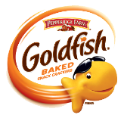
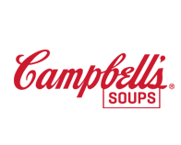
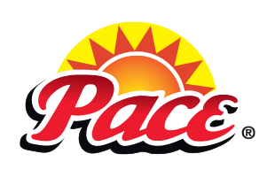


Net Promoter Scores
Campbell’s foodservice brands
39
48
53
0
34
50
70
-100
0
50
70
+100
Poor
Good
Excellent
World Class

Slide 19
Packaged Snacks
Executive Summary

Slide 20






Goldfish Brand Usage Funnel
Major segments
Total Sample
Restaurants
Non Comm
Hotel
C-Store
Unaided Awareness
18%
23%
17%
18%
13%
Aided Awareness
52%
66%
47%
52%
33%
29%
21%
Currently Purchasing
40%
49%
37%
39%
28%

Slide 21



Goldfish Brand Usage Funnel
Priority segments
Total Sample
Commercial Chains
K-12
Unaided Awareness
18%
29%
19%
Aided Awareness
52%
67%
40%
32%
21%
Currently Purchasing
40%
50%
33%

Slide 22
Packaged Snacks Category Performance Summary
In top eight purchase drivers
Percent of Operators Who Believe Statement Describes Brand | Leader | Goldfish Performance Among Operators
Products give you value for the money | Cheez-It (66%) | 53%
Tastes great and flavor resonates with consumers | Honey Maid (68%) | 62%
Offers products that are high-quality and perform consistently | Teddy Grahams (75%) | 63%
Is available from my distributor | Honey Maid (77%) | 63%
Has a good shelf life | Goldfish (70%) | 70%
Is a brand that pleases my patrons | Honey Maid (77%) | 59%
Offers appropriate packaging sizes | Teddy Grahams/Keebler (67%) | 62%
Has desired nutrition claims (i.e., whole grain) | Nabisco (67%) | 50%

Slide 23
Consumer Snacking Occasions
Snack Composition
Consumption
Appealing Nutritional Attributes
Percent of occasions
3+ between-meal
snacks per day

Slide 24
Category and Brand Assessment
Packaged snacks
Category Summary
Goldfish leads aided awareness and operator usage, while Nabisco tops unaided awareness.
There is a large amount of variation in the types of snacks and, therefore, the brands, reported by operators. Some focus on salty snacks while others focus on sweet snacks. There is also variation in the specificity of brand—some operators recognize Campbell’s by name, some by its family of brands, like Pepperidge Farm or Lance, and some list both.
Performance-wise, Honey Maid and Teddy Grahams lead the competitive set on five of the eight most critical purchase drivers including taste, quality, packaging, availability and pleasing consumers.
Nabisco leads category NPS performance, followed closely by Goldfish. Cheez-It and Ritz round out the top four, performing similarly to the NPS leaders.
In terms of snack category support, operators are looking to manufacturers for help with innovation.
Goldfish Operator Summary
Operators are very familiar with Goldfish as a brand in the packaged snacks category, leading to high usage. Two in five operators currently purchase Goldfish for their establishment. Limited-service restaurants drive usage of Goldfish across restaurants, including commercial chains.
The brand outperforms its closest competitors when it comes to shelf life but underperforms on price and nutrition claims.
Among operators familiar with Goldfish, the highest performing brand statement, in terms of agreement and motivation, was “Goldfish delights our guests—even the little ones.”
Overall, Goldfish has an NPS of 48, which indicates good performance. But, NPS rises to world class and excellent in priority segments, chains (86) and K-12 (52), respectively.

Slide 25
Recommendations
Goldfish—packaged snacks
Recommendations
Price tops operator criteria when purchasing packaged snacks yet only 53% of operators strongly agree that Goldfish are a good value. Campbell’s should work with operators on pricing solutions or consider rebates that allow foodservice operators to stay competitive with retailers who dominate the snacking space.
Goldfish slightly underperforms when it comes to nutrition claims, something that is more important to restaurants and noncommercial operators like healthcare and K-12. Additionally, only 48% of operators strongly agree with the statement that “Goldfish is a wholesome snack baked with real cheese,” indicating a need for additional messaging around this reason to believe. Campbell’s should drive home the nutritional claims inherent to Goldfish that resonate with the noncommercial audience, such as made with real cheese and low in saturated fat.
Since nearly half of consumers consume a food and beverage item for a snack, Campbell’s should educate operators on potential snack-beverage pairings that are on trend and appeal to consumers, ultimately increasing traffic to their operation.
Operators expect suppliers of packaged snacks to provide them with support in their efforts to be innovative. Materials on fun menu ideas and consumer trends are most valuable to operators, especially restaurants. This is not surprising as operators are tasked with keeping up with constantly evolving consumer expectations. Campbell’s should educate operators on consumer trends related to packaged snacks, such as their increasing desire for high-protein snacks and help them deliver on these trends while incorporating Goldfish.
Operators are most motivated by the brand statement “Goldfish delights our guests—even the littlest ones.” Campbell’s should consider incorporating this reason to believe into materials targeted toward foodservice operations with younger audiences.

Slide 26
Prepared Soup
Executive Summary

Slide 27
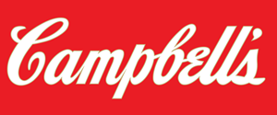





Campbell’s Brand Usage Funnel
Major segments
Total Sample
Restaurants
Non Comm
Hotel
C-Store
Unaided Awareness
57%
62%
55%
59%
44%
Aided Awareness
71%
78%
71%
66%
49%
Frozen
Frozen
Frozen
29%
Frozen
Frozen
Currently Purchasing
Canned
Canned
Canned
Canned
Canned
70%
46%
77%
36%
70%
60%
66%
30%
57%
36%
36%

Slide 28



Campbell’s Brand Usage Funnel
Priority segments
Total Sample
Commercial Chains
Healthcare
K-12
Unaided awareness
57%
60%
52%
53%
Aided awareness
71%
75%
73%
66%
21%
29%
57%
Frozen
Frozen
Frozen
Frozen
Currently Purchasing
Canned
Canned
Canned
Canned
70%
46%
74%
38%
72%
66%
65%
65%
36%

Slide 29
Soup Decision Tree
Top Four Format Purchase Drivers
84% Menu Canned
Price
Requires less labor
60% Menu Frozen
Requires less labor
Range of flavors
44% Menu Homemade
Taste
27% Menu Refrigerated
Requires less labor
Shelf Life
Availability
Taste
Ready to eat
Price
Works in recipes
Taste
Quality
Flexibility
Price
66% of Operators Offer Soup on the Menu

Slide 30
Canned Soup Category Performance Summary
On top nine purchase drivers
Percent of Operators Who Believe Statement Describes Brand | Leader | Campbell’s Performance Among Operators
Products give you value for the money | Campbell’s (52%) | 52%
Has a good shelf life | Campbell’s (76%) | 76%
Is available from my distributor | Campbell’s (67%) | 67%
Requires less labor | Campbell’s (68%) | 68%
Offers products that are high-quality and perform consistently | Campbell’s (58%) | 58%
Offers appropriate packaging sizes | Campbell’s (54%) | 54%
Works well in recipes | Campbell’s (71%) | 71%
Tastes great and flavor resonates with consumers | Heinz (67%) | 62%
Has a reputable reputation in foodservice | Campbell’s (62%) | 62%

Slide 31
Frozen Soup Category Performance Summary
On top eight purchase drivers
Percent of Operators Who Believe Statement Describes Brand | Leader | Campbell’s Performance Among Operators
Requires less labor | Campbell’s (58%) | 58%
Is a brand that offers a wide range of flavor options | Sysco (67%) | 59%
Tastes great and flavor resonates with consumers | Sysco (71%) | 67%
Is ready to eat (only requires heating) | Campbell’s (68%) | 68%
Offers products that are high-quality and perform consistently | Sysco (86%) | 77%
Products give you value for the money | Campbell’s (44%) | 44%
Has a good shelf life | Campbell’s (89%) | 89%
Is available from my distributor | Campbell’s (90%) | 90%

Slide 32

Soup Lifecycle
Flavors
Introduction
Chive | 5.4 %
Truffles | 4.7 %
Apple | 4.7 %
Pumpkin | 3.9 %
Tarragon | 3.1 %
Growth
Miso | 10.2 %
Gruyere | 5.5 %
Asian | 5.5 %
Lemongrass | 3.2 %
Coconut | 2.4 %
Mainstream
Carrots | 14.3 %
Pepper | 13.6 %
Sour Cream | 11.8 %
Bacon | 10.4 %
Spicy | 10.4 %
Mature
Chili | 47.9 %
Onion | 33.5 %
Tomatoes | 30.6 %
Mexican | 22.9 %
Cheddar | 22.5 %
Source: Technomic Ignite menu data, Q2 2019
User: 14 Bernadette

Slide 33
Soup
Fastest-growing ingredients
Midwest
Spinach
Rice Noodles
Cabbage
Udon Noodles
Northeast
Ramen Noodles
Soybean
Red Onion
Lettuce
West
Soybean
Steak
Butter
Peanut
South
Gruyere
Spinach
Egg Noodles
Steak
Source: Technomic Ignite menu data, 19,096 menu Items across 4,159 operators with five-year historical menus, Q2 2018-Q2 2019

Slide 34
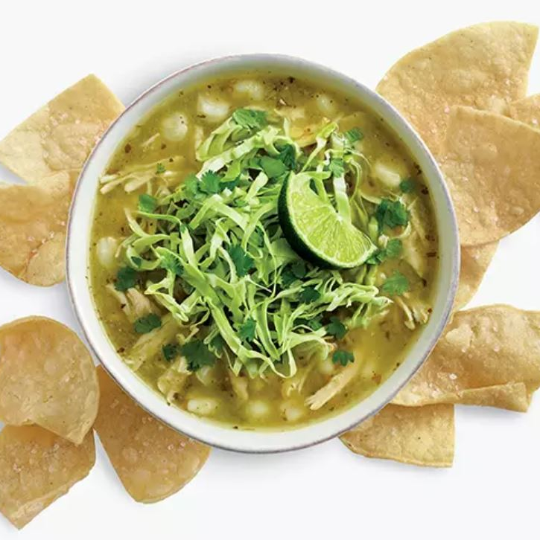
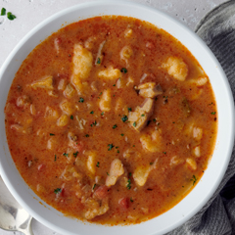
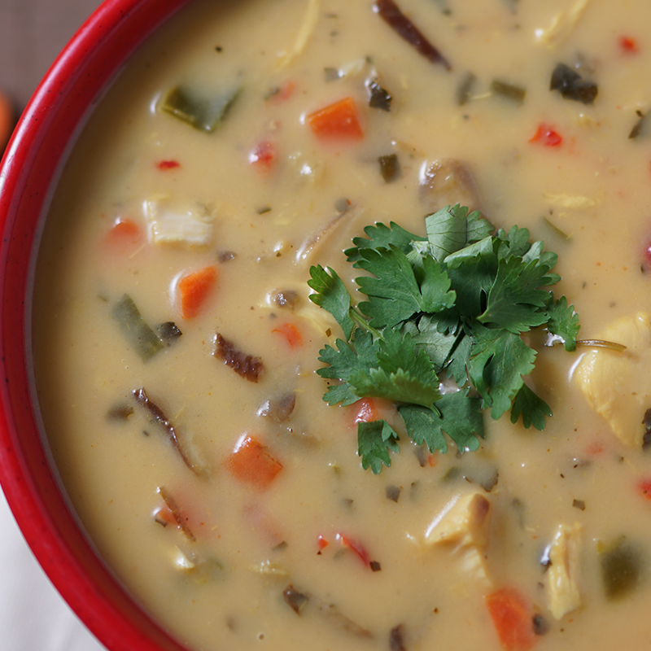
Innovations in Soup
Fastest-Growing Soup Menu Items | Dishes | Menu Items | Growth % Over the Last Year
1 | RAMEN | 107 | 10.3%
2 | CHOWDER | 525 | 1.9%
3 | TOM YUM SOUP | 707 | 1.6%
4 | BEAN/LENTIL SOUP | 751 | 1.5%
Featured LTOs
El Pollo Loco’s Chicken Pozole
Made with fire-grilled chicken, hominy, tomatillo, cilantro, garlic, onion, serrano chile and Anaheim chile, all topped with cabbage, lime and cilantro.
Au Bon Pain’s Chicken Paprikash
A rich, creamy stew with sweet and smoky paprika, red peppers and chicken with spaetzle.
Newk’s Eatery Thai Chicken Soup
With sliced mushrooms, chopped carrots, diced red and green bell peppers, chicken, coconut milk and lemon grass with a touch of garlic, Sriracha chile sauce, turmeric and curry powder, all garnished with fresh cilantro.
Source: Technomic Ignite menu data, 19,096 menu Items across 4,159 operators with five-year historical menus, Q2 2018-Q2 2019

Slide 35
Category and Brand Assessment
Prepared soup
Category Summary
In the prepared soup category, Campbell’s is the leader in terms of awareness, followed by Heinz. Campbell’s is also the most used brand for the two formats offered, frozen and canned.
Operator usage of soup is dominated by the canned format. Drivers leading operators to choose canned over other formats include price, shelf life and wide availability.
Homemade soup accounts for one-fifth of soup menued, followed by frozen and refrigerated. Taste, quality and flexibility drive homemade soup decisions; labor and flavor variety drive frozen soup usage; and labor and price drive refrigerated soup usage.
Performance-wise, Campbell’s outperforms Heinz on nearly all critical purchasing attributes when it comes to canned soup. Sysco and Campbell’s drive performance in the frozen soup category.
Brand loyalty within the prepared soup category is high; only one in 10 operators have switched brands in the past two years.
Campbell’s significantly outperforms competitors in terms of NPS for the category. Heinz, the second-most used brand has the second-highest NPS (38) in the category.
In terms of the prepared soup category, operators expect a variety of supplier support from innovative menu ideas to samples to flavor and consumer trends to promotions.
Campbell’s Operator Summary
Operators are extremely familiar with Campbell’s as a soup brand, leading to high usage.
While the brand outperforms Heinz on nearly all canned soup purchase drivers, there is room for improvement in the frozen soup category. In general, Campbell’s underperforms against a number of purchase drivers when compared to Sysco.
Operators familiar with Campbell’s were most likely to strongly agree with the statement “With Campbell’s, there is a soup for every season.” But motivation is slightly stronger for the statement “Seasons change. Your menu should too. Give guests seasonal flavor with Campbell’s soup.”
Overall, Campbell’s has an NPS of 53, which indicates excellent performance in the foodservice soup category. This is the highest NPS across all Campbell’s category brands studied (i.e., Campbell’s Soup, Goldfish, V8 and Pace).

Slide 36
Recommendations
Campbell’s—prepared soup
Recommendations
Price is a top driver for both canned and frozen soup, yet only 52% of canned users and 44% of frozen users strongly agree that Campbell’s is a good value in the category. Operators are also expecting their soup suppliers to provide promotions and deals, especially restaurant and c-store operators. Campbell’s should work with operators on pricing solutions and promotions that position the brand as a good value in the category.
In the canned and frozen soup categories, Campbell’s underperforms competitors on taste and flavor, a critical purchase driver. Campbell’s should conduct further research to better understand what could be adjusted to improve flavor perceptions among foodservice operators.
Operators opting for frozen soup cite the variety of flavors as a key driver to this format. Campbell’s should boost their suite of flavor options but also consider conducting research to identify what flavor varieties are missing that could potentially expand reach across the industry.
According to Technomic’s Starters, Small Plates and Sides Consumer Trend Report, 30% of consumers strongly agree that they prefer well-known brand names for soups they order at restaurants. Campbell’s should work with operators to demonstrate the appeal and potential to drive purchases by including the Campbell’s name or logo on menus.
According to Technomic Ignite menu data, the percentage of operators who menu soup has declined from 73% in 2014 to 69% in 2019. To combat further decline in soup menuing, Campbell’s should provide operators with the support they are looking for, including innovative menu ideas (ethnic-focused), as well as consumer and flavor trends that have the potential to drive sales and customer traffic.
Operators are most motivated by the brand statement “Seasons change. Your menu should too. Give guests seasonal flavors with Campbell’s soup.” Not only should Campbell’s incorporate this reason to believe into their materials, they should also ensure seasonal soup offerings align with operator and consumer preference.

Slide 37
Prepared Salsa
Executive Summary

Slide 38





Pace Brand Usage Funnel
Major segments
Total Sample
Restaurants
Non Comm
Hotel
C-Store
Unaided Awareness
26%
35%
22%
18%
17%
Aided Awareness
48%
55%
44%
41%
50%
29%
21%
Currently Purchasing
27%
32%
24%
26%
23%

Slide 39


Pace Brand Usage Funnel
Priority segments
Total Sample
Commercial Chains
Unaided Awareness
26%
36%
Aided Awareness
48%
51%
32%
21%
Currently Purchasing
27%
26%

Slide 40
Prepared Salsa Category Performance Summary
In top eight purchase drivers
Percent of Operators Who Believe Statement Describes Brand | Leader | Pace Performance Among Operators
Products give you value for the money | Embasa (69%) | 60%
Offers products that are high quality and perform consistently | Embasa (69%) | 54%
Tastes great and flavor resonates with consumers | Pace (66%) | 66%
Is available from my distributor | Pace (55%) | 55%
Has a good shelf life | Pace (67%) | 67%
Requires less labor | Pace (73%) | 73%
Can be easily incorporated into recipes | Pace (64%) | 64%
Has desirable dietary claims (i.e., vegan, vegetarian, etc.) | Pace (53%) | 53%

Slide 41
Salsa Lifecycle
Ingredients
Introduction
Octopus | 6.0 %
King Crab | 4.8 %
Catfish | 4.8 %
Lobster Ginger Sauce | 3.6 %
Vietnamese | 3.6 %
Growth
Tuna | 12.8 %
Ahi | 9.3 %
Coconut | 7.0 %
Almond | 7.0 %
Lobster | 7.0 %
Mainstream
Roasted Corn Salsa | 22.3 %
Tomatillos | 14.1 %
Mango | 12.3 %
Mustard | 12.3 %
Salmon | 12.3 %
Mature
Salsa | 88.0 %
Cheese | 81.8 %
Tortilla | 73.8 %
Chicken | 69.8 %
Sour Cream | 65.3 %
Source: Technomic Ignite menu data, Q2 2019
User: 14 Bernadette

Slide 42
Salsa
Fastest-growing flavors
Midwest
Salt
Sriracha
Thai
Adobo
Ginger
Northeast
Salt
Mole
Oaxacan
Thai
Adobo
West
Salt
Sriracha
Adobo
Jalapeno Cheddar
Feta
South
Salt
Goat Cheese
Cotija
Thai
Adobo
Source: Technomic Ignite menu data, 11,222 menu Items across 1,912 operators with five-year historical menus, Q2 2018-Q2 2019

Slide 43
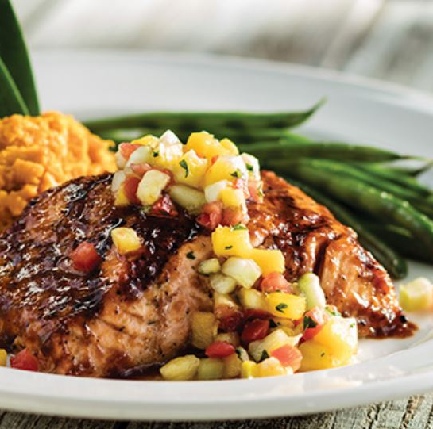
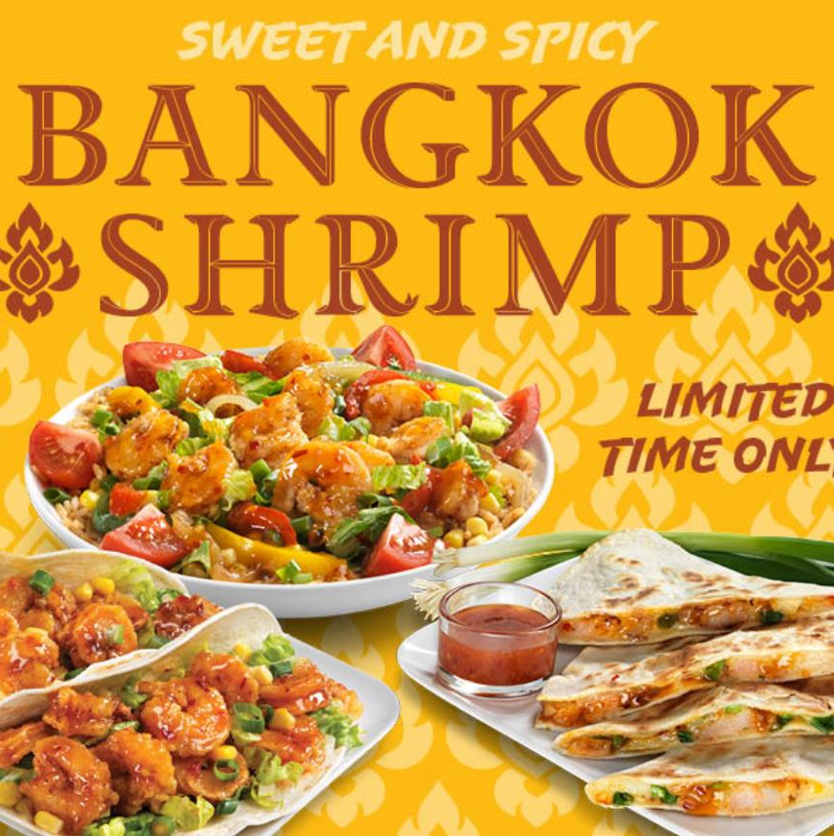
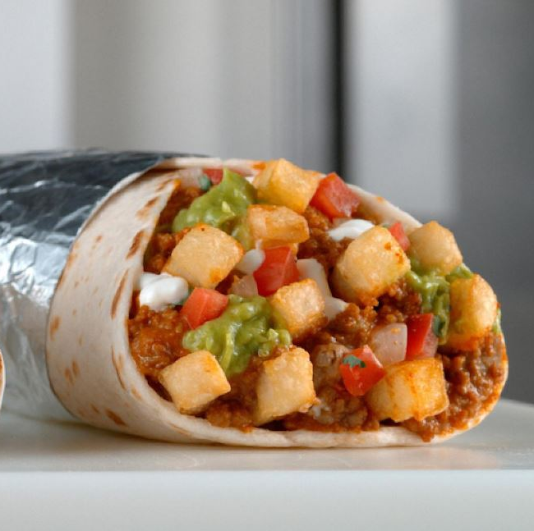
Innovations in Salsa
Featured LTOs
Bahama Breeze Island Grill’s Tequila Sunburn Salmon
Grilled salmon basted with new Tequila Sunburn glaze, topped with pineapple-mango salsa, and served with cinnamon mashed sweet potatoes and green beans.
California Tortilla’s Bangkok Shrimp Tacos
Shrimp with sweet red chile sauce, shredded romaine, fire-roasted corn salsa and green onions, wrapped in a warm, soft tortilla.
Epic Beyond Cali Burrito
Del Taco's seasoned Beyond Meat plant-based crumbles combined with its crinkle-cut fries, cool sour cream, tangy guacamole and handmade pico de gallo salsa in a warm, oversized flour tortilla.
Fastest Growing Salsa Menu Items | Dishes | Menu Items | Growth % Over the Last Year
1 | MEXICAN BOWL | 178 | 8.5%
2 | MIXED MEXICAN DISH | 161 | 4.5%
3 | SPECIALTY MEXICAN DISH | 207 | 4.0%
4 | BURRITO/CHIMICHANGA | 1,213 | 2.0%
5 | QUESADILLA | 893 | 1.7%

Slide 44
Category and Brand Assessment
Prepared salsa
Category Summary
In the prepared salsa category, Pace is the leader in terms of both aided and unaided awareness, as well as operator usage.
When it comes to performance on the primary purchase drivers, Pace leads on half of the critical drivers, including taste and ease of recipe use. Embasa, however, leads on the two most important purchase drivers: price and quality.
Utilizing prepared salsa as an ingredient in a dish is the most popular use across operators.
Despite low familiarity and purchasing behavior, Naturally Fresh has the highest NPS in the category, likely due to its performance on quality, taste and labor requirements.
Pace Operator Summary
Operators are very familiar with Pace as a brand in the prepared salsa category, leading to high usage. One-quarter of salsa purchasers currently purchase Pace for their establishment.
The brand outperforms its closest competitors on taste, shelf life, labor requirements and ease of incorporating into recipes, but underperforms on overall product quality—a critical purchase driver for operators.
Pace falls to sixth place in NPS performance, with a score of 34. In fact, Pace received the lowest NPS of all Campbell’s brands included in the study. Performance is slightly higher among chains—a priority segment for the brand.
Recommendations
Pace underperforms on overall quality compared to top competitors in the category. Campbell’s should speak with operators to better understand how they could improve quality to better compete with top performing brands like LaVictoria and Embasa.
While Pace’s NPS is considered good, it is much lower than the competitors in the salsa category and falls to the bottom of all Campbell’s brands in the study. Campbell’s needs to address the factors forcing their NPS down, which could include quality concerns.
To help operators keep up with consumer and flavor trends, Campbell’s should provide innovative menu ideas that feature salsa and expand flavor combinations beyond Mexican-inspired cuisine. A great example of this is the Bangkok Shrimp Taco LTO at California Tortilla, which fuses Indian and Mexican flavors to offer a unique experience for consumers and a traffic driver for operators.

Slide 45
Beverages
Executive Summary

Slide 46
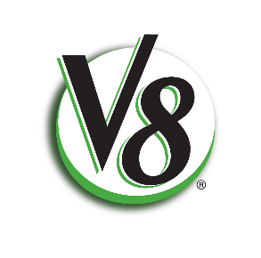
V8 Brand Usage Funnel
Major segments
Total Sample
Restaurants
Non Comm
Hotel
C-Store
Unaided Awareness
25%
33%
21%
18%
21%
Aided Awareness
44%
58%
39%
27%
33%
29%
21%
Currently Purchasing
31%
43%
27%
18%
24%

Slide 47
Beverages Category Performance Summary
In top eight purchase drivers
Percent of Operators Who Believe Statement Describes Brand | Leader | V8 Performance Among Operators
Products give you value for the money | Vita Coco & Ocean Spray (48%) | 43%
Tastes great and flavor resonates with consumers | Ocean Spray (70%) | 64%
Offers 100% juice products | Ocean Spray (65%) | 64%
Has a good shelf life | V8 (68%) | 68%
Is available from my distributor | Ocean Spray (77%) | 61%
Offers health and wellness benefits | V8 (67%) | 67%
Offers appropriate packaging sizes | Naked (56%) | 41%
Offers products that are high-quality and perform consistently | V8 (65%) | 65%

Slide 48
Juice Lifecycle
Ingredients
Introduction
Pinot Noir | 2.3 %
Raspberry | 2.3 %
Fennel | 2.3 %
Growth
Pomegranate | 6.0 %
Kale | 6.0 %
Parsley | 4.5 %
Blackberry | 3.0 %
Spinach | 3.0 %
Mainstream
Coconut | 11.2 %
Coconut Water | 8.5 %
Celery | 5.9 %
Carrots | 5.9 %
Mango | 5.9 %
Mature
Orange | 62.9 %
Apple | 49.5 %
Cranberry | 28.0 %
Source: Technomic Ignite menu data, Q2 2019
User: 14 Bernadette

Slide 49
Juice
Fastest-growing flavors
Midwest
Beets
Ginger
Celery
Grape
Salt
Northeast
Blueberry
Passion Fruit
Grape
Strawberry Banana
Lemon Ginger
West
Lemon
Parsley
Strawberry
Celery
Carrots
South
Grape
Lemon
Fruit Punch
Celery
Beets

Slide 50
Category and Brand Assessment
Beverages
Category Summary
In the fruit and/or vegetable juice and coconut water category, V8 is the leader in terms of unaided awareness, but second to Vita Coco in aided awareness and operator usage.
On the primary purchase drivers of price, taste and 100% juice products, Ocean Spray leads the competitive set.
Fruit juice is the most popular beverage format across all major segments, with noncommercial operators offering the largest proportion of fruit juice only compared to competitors. Coconut water is the second-most purchased format of beverages included in the study, followed by vegetable juice only and vegetable fruit juice blends. Restaurants account for the largest proportion of fruit vegetable juice blends.
Vita Coco commands the highest NPS of brands included in the study, followed by Sacramento.
V8 Operator Summary
Operators are very familiar with V8 as a brand in the beverage category, leading to high usage. One in three operators menuing juice or coconut water currently purchase V8 for their establishment.
The brand slightly underperforms competitors when it comes to the most important purchase driver for operators: price. But, V8 outperforms competitors in terms of shelf life, health benefits and quality.
V8 is ranked third in NPS performance. With an NPS of 39, the brand is considered to be performing “good” but there is room for improvement.
Only one-third of operators are very motivated by the statement “V8 delivers plant-based goodness.”

Slide 51
Recommendations
V8—beverages
V8 Recommendations
Because V8 slightly underperforms on the most critical purchase driver—price—Campbell’s should consider promotions or rebates that encourage operators to purchase and menu V8 over competitors.
According to Technomic’s Beverage Consumer Trend Report, consumers are increasingly expecting health and nutrition benefits from their beverages. Campbell’s should take advantage of V8’s nutrition claims to position the brand as a driver of purchases among consumers who are increasingly seeking out these benefits. Campbell’s should also work with operators to ensure they are in tune with the increasing consumer demand for better-for-you beverages—something V8 can offer compared to options like sugar-sweetened beverages.
According to Technomic Ignite menu data, the percentage of operators who menu juice has declined slightly from 43% in 2014 to 42% in 2019. To combat decline, Campbell’s should identify the threats impacting operators when it comes to juice and help them overcome these concerns. For example, the explosion of third-party delivery has led to a decline in beverage purchases. Campbell’s can work with operators on a strategy that encourages consumers to opt for a beverage purchase when selecting delivery.
The proportion of operators who find the reason to believe “V8 delivers plant-based goodness” is low compared to other category reasons to believe. Campbell’s should consider adjusting the statement to enhance appeal and motivation across segments.

Slide 52
Manufacturers
Executive Summary

Slide 53
Summary
Operators’ familiarity with manufacturer brands
Manufacturer | Brand Familiarity
Campbell’s | 89%
Nestle | 82%
PepsiCo (Frito-Lay) | 81%
Kellogg’s | 81%
Kraft-Heinz | 78%
Unilever | 31%
Mondelez | 29%

Slide 54







Net Promoter Scores
Foodservice manufacturing companies
46
49
54
47
70
0
50
-100
0
50
70
+100
Poor
Good
Excellent
World Class

Slide 55
Manufacturer Category Performance Summary
In statement agreement
Percent of Operators Who Believe Statement Describes Brand | Leader | Campbell’s Performance Among Operators
Offers products that are high-quality and perform consistently | Campbell’s (46%) | 46%
Offers products that give you value for the money | Campbell’s (40%) | 40%
Offers products carried by my distributor | Campbell’s (47%) | 47%
Is a company that pleases my patrons | Nestle & Kellogg’s (44%) | 42%
Offers products with health and wellness benefits | Campbell’s (44%) | 44%
Offers products that taste great | Campbell’s (46%) | 46%
Offers the product variety I need or value | PepsiCo (45%) | 44%
Is a company that helps grow your business | Nestle (43%) | 41%
Is a company my distributor sales rep prefers over others | Campbell’s & Kellogg’s (38%) | 38%
Is a company that promotes sustainability | Campbell’s (41%) | 41%
Is an innovative brand company | Campbell’s (42%) | 42%
Is a company that provides useful recipe, menu and merchandising support | Campbell’s & PepsiCo (45%) | 45%
Is founded on a mission to bring good, nutritious food to many | Campbell’s (47%) | 47%
Is a company that has a wide portfolio of products that meet my needs | Campbell’s & Kellogg’s (43%) | 43%

Slide 56
Summary
Manufacturer marketing and advertising
Manufacturer | Percent of Operators Seeing Marketing Materials Over Past Three Months
Campbell’s | 24%
PepsiCo | 21%
Kellogg’s | 18%
Nestle | 14%
Cheez-It | 13%
Kraft-Heinz | 11%
Keebler | 9%
Naked | 7%
Unilever | 7%
Kettle Cuisine | 6%
Mondelez | 5%
Apple and Eve | 4%
Blount Fine Foods | 3%
None of the above manufacturers | 44%
Campbell’s Advertising Format Seen
Magazine/industry publication | 38%
Social media | 36%
Food-themed television show | 30%
Advertisement on a website | 29%
Company website | 25%
News | 25%
Company sales rep | 23%
Tradeshow/live event | 23%
Email | 9%
Peers | 8%

Slide 57
Category and Brand Assessment
Manufacturing companies
Category Summary
Campbell’s was rated as the most familiar manufacturing company, followed closely by Nestle, PepsiCo and Kellogg’s.
Performance-wise, Campbell’s leads in agreement statements, but its top competitors are not far behind.
Campbell’s also tops competitors in terms of NPS performance. Overall, manufacturer NPS performance mimics their level of familiarity—the more familiar a brand, the higher the NPS.
Nearly half of operators have not seen or heard advertising or marketing communications from any of the listed brands. Campbell’s led as the brand from which the most operators had recently experienced marketing communications. Magazines or industry publications were the most likely platform of marketing communications.
Campbell’s Operator Summary
Operators are very familiar with Campbell’s as a manufacturing company. This translates into high levels of agreements with company attributes.
When asked what came to mind when thinking about Campbell’s, operators reported thinking of a trusted company that they associate with family and tradition.
Over 80% of operators agreed with and found Campbell’s reasons to believe motivating. About half of those operators strongly agreed and found them very motivating. Operators felt particularly positive about the statement that “Campbell’s offers brands their patrons trust,” reporting the highest levels of agreement and motivation.
Recommendations
Campbell’s history in the foodservice channel resonates with operators—they associate the company with trust and tradition. T0 further improve their reputation, Campbell’s should work to improve ratings on price and DSR preference, where Campbell’s is rated lowest compared to other attributes.
While Campbell’s advertising can be found across a number of channels, very few operators have seen it via email. Operators were more likely to mention email for PepsiCo and Kellogg’s. To enhance operator reach and to ensure they are competitive, Campbell’s should consider enhancing their email communication to operators.
“Campbell’s Foodservice offers brands your patrons trust” is most likely to resonate with operators. Trust in a brand and company is critical to today’s consumer, Campbell’s should reiterate the trust their brands invoke among operators and consumers alike.

Slide 58
Detailed Findings

Slide 59
Detailed Findings
Packaged Snacks

Slide 60
Cast a Wide Net
Brand | % of Operators Mentioning Brand
Nabisco | 25%
Goldfish | 18%
Ritz | 16%
Lay’s | 13%
Cheez-it | 11%
Keebler Grahams | 10%
Crunchmania | 9%
Annie’s | 8%
MJM Grahams | 8%
Honey Maid Grahams | 6%
Teddy Grahams | 5%
General Mills | 3%
Belly Bears | 3%
Dorito’s | 2%
Kellogg’s | 2%
Kraft | 2%
Campbell’s | 2%
Lance | 2%
Pepperidge Farm | 2%
Unaided brand familiarity
When asked to list all packaged snack brands that come to mind, the largest portion of Campbell’s branded-products belonged to Goldfish, with 18% of respondents mentioning this brand.
Respondents also listed a multitude of brands that belong to the Campbell’s family, such as Pepperidge Farm, Lance, Snyder’s, Milano, Late July, Kettle and even Campbell’s itself.
One of Campbell’s largest competitors, Nabisco, shows a similar pattern. A large number of respondents remember them by the Nabisco name as well as by their large portfolio of products, including Ritz, Honey Maid, Chips Ahoy, Oreo and Triscuit.

Slide 61
Snack Brand Familiarity
Aided
Despite trailing behind Nabisco in unaided brand familiarity, when respondents were presented with a list of packaged snack brands, Goldfish overtook Nabisco to claim the top spot with over half (52%) of respondents recognizing the Goldfish name.
With the exception of Crunchmania and Annie’s, the restaurant segment generally showed higher levels of brand familiarity across all brands.

Slide 62
Critical Purchase Drivers
Total sample
Across segments, price and taste were rated as the strongest drivers of purchasing behavior. It’s not surprising that the first things most operators look for in their packaged snacks is something that tastes great but won’t break the bank.

Slide 63
Different Drivers
Significant purchase driver differentiators by segment
This chart illustrates purchase drivers that are statistically significant against other segments. This is intended to show which drivers stand out more in specific segments.
C-store and hotel segments place significantly more importance on reputations and availability of organic products. It is important to keep in mind the differing sample sizes as you interpret results.

Slide 64
Different Drivers: Segment Specific
Option only presented to restaurant and hotel operators
Only one quarter of restaurant and hotel operators reported that whether or not an item was appropriate for their kids menu was a primary driver of their purchase behavior when it comes to packaged snacks.

Slide 65
Snack Purchase Drivers
Priority segments
Looking specifically at the primary purchase drivers in the K-12 segment, taste remains at the top of the list, but price was surpassed by product quality, alignment with USDA requirements and distributor availability. Children can be picky eaters, requiring K-12 operators to prioritize taste over everything.
Among the options that were only presented to K-12 respondents, meeting USDA program requirements leads in driving purchase behavior. These stringent requirements can be very limiting and providing products that easily, and clearly, abide by such requirements could increase purchasing in the K-12 segment.
Chain restaurants were strongly driven by whether the brand was well-known among their consumers.

Slide 66
Goldfish is the Big Fish
Brand purchasing by segment
Across segments, Goldfish is the most purchased packaged snack brand. Exceptions to this pattern come from hotels, where Nabisco dominates (55% versus 39%), and c-store, where Ritz has a slight edge (31% versus 28%).
Restaurants, echoing their high levels of brand familiarity (slide 54), show some of the highest levels of brand purchasing behavior among the major segments.

Slide 67
Snack Brand Performance
Goldfish against top snack competitor brands on top eight purchase drivers
At least half of operators purchasing Goldfish strongly agree that the brand performs well on the top eight purchase drivers.
Despite the high agreement, there is still room for improvement compared to competitors when it comes to price and nutrition claims.

Slide 68
Net Promoter Scores
Packaged snacks
NPS = 50
NPS = 48
In general, the top four brands in the category perform very similarly in terms of NPS with Nabisco just slightly outperforming the other three brands (Campbell’s, Cheez-it and Ritz).
NPS = 45
NPS = 44

Slide 69
Net Promoter Scores
Packaged snacks
NPS = 44
NPS = 34
As brand familiarity and usage decline, so does performance on NPS.
NPS = 29
NPS = 28

Slide 70
Net Promoter Scores
Packaged snacks
NPS = 27
NPS = 24
Belly Bears, the least used brand in the category also carries the lowest NPS with a total of 16.
NPS = 16

Slide 71
Goldfish Net Promoter Scores
Among the priority segments, chain operators are most likely to recommend Goldfish, with 88% reporting they were extremely likely to recommend. This pushes their NPS to 86, a full 38 points higher than the total segment NPS for Goldfish and the highest NPS among the brands.
K-12 operators are closer to the overall Goldfish NPS at 52.
Priority segments
NPS = 86
NPS = 52

Slide 72
Critical Claims
Total sample
Across segments, operators ranked claims such as low sugar, low fat and low sodium as some of the most important when making their purchasing decisions for packaged snacks.
K-12 operators found such claims as particularly important, 42% sought low sugar, 39% looked for low fat, and 37% searched for low sodium. This isn’t surprising as K-12 operators prioritize nutritional claims when making their purchasing decisions.

Slide 73
Changed Claims
By segment
Among purchase drivers, the c-store and hotel segments showed a greater emphasis on the value of organic and non-GMO products (slide 56). This is reiterated in both segments’ placement of greater importance on non-GMO claims.
Restaurants showed a differential focus on the importance of real over artificial ingredients. They are willing to make sacrifices when it comes to health, showing a decreased focus on low sugar and low calorie, to have products that are less synthetic.

Slide 74
Brand Agreement
Among operators familiar with the Goldfish brand, over three-fourths agreed with all the Goldfish brand statements, and such agreement was similar across the major segments.
Top 2 Box 86%
Top 2 Box 93%
Top 2 Box 90%
Top 2 Box 75%
Top 2 Box 87%

Slide 75
Brand Motivation
Among all operators, about 90% found all the Goldfish brand statements as motivating when it came to their packaged snack purchases, and these levels were similar across the major segments.
This, alongside the high levels of brand agreement, shows that the priorities of the Goldfish brand resonate and align with the priorities of operators.
Top 2 Box 89%
Top 2 Box 95%
Top 2 Box 92%
Top 2 Box 90%
Top 2 Box 91%

Slide 76
Supplier Support Expectations
By segment
Innovation is a major area in which operators are looking to their manufacturer partners for support in terms of packaged snacks.
Operators struggle to keep up with the constantly changing demands of consumers and they are turning to manufacturers to help them keep up with trends and translate those trends into new and exciting menu items.
With price being a major purchase driver, operators are also looking to suppliers for special deals and promotions in order to lower costs.

Slide 77
Detailed Findings
Soup

Slide 78
Campbell’s Rings a Bell
Brand | % of Operators Mentioning Brand
Campbell’s | 57%
Heinz | 24%
Progresso | 8%
Kettle Cuisine | 8%
CTI Foods | 7%
Whitey’s | 6%
Meritage Soups | 6%
Sysco | 5%
Blount Foods | 5%
Molly’s Kitchen | 5%
NORPAC | 4%
Knorr | 4%
Chef Francisco | 2%
Amy’s | 2%
Pacific Foods | 1%
Healthy Choice | 1%
LeGout | 1%
GFS | 1%
Unaided brand familiarity
Unaided, 72 brands of prepared soup come to mind for operators.
Campbell’s is by far the most mentioned prepared soup brand with 57% of operators mentioning the brand.
Heinz is the second most mentioned brand, but trails significantly behind Campbell’s.

Slide 79
Soup Brand Familiarity
Total sample
Across all major segments, Campbell’s is the most familiar prepared soup brand among operators. The only exception is in the retail space—c-store operators are slightly more likely to be familiar with Heinz than Campbell’s (54% versus 49%).
Awareness beyond Campbell’s and Heinz drops significantly across segments.
Restaurant operators are more likely to be familiar with distributor brands. Awareness is much higher for Sysco among restaurant operators, especially family (54%) and casual dining (54%) operators. Awareness is also higher for Molly’s Kitchen (US Foods) among restaurant operators.

Slide 80
Soup Brand Familiarity
Priority segments
With the exception of Campbell’s, Heinz and Meritage soup, K-12 brand awareness lags the total sample as well as other priority segments. This isn’t surprising as K-12 operator purchasing decisions are generally driven by nutrition criteria and pricing rather than brand name.

Slide 81
Soup Format Usage
Regardless of segment, canned soup dominates operators’ prepared soup usage. Hotels, and noncommercial operations, especially K-12 (83%) and healthcare (62%), use a higher percentage of canned soup than other segments.
Restaurants, especially casual dining operators (23%), utilize a lower proportion of canned soup than other segments. This isn’t surprising as restaurants are the most likely segment to prepare and offer homemade soup. Homemade soup is more common among independent restaurants—48% of soup served in independent restaurants is homemade.
Total sample

Slide 82
Critical Claims
Most important claims by segment
Overall, natural, non-GMO and low in sodium are the top three most important claims when it comes to purchasing prepared soup. But, claim importance varies by segment
While half of restaurants feel natural is very important, only one quarter of c-store operators and one third of noncommercial operators consider natural very important.
Noncommercial operators are most likely to value soups carrying the heart healthy and low sodium claims, which is not surprising as hospitals and K-12 seek out items that meet their nutrition criteria.

Slide 83
Critical Claims
Not surprisingly, K-12 operators place low sodium, low saturated fat and low calorie at the top of their list for soup claims. This aligns closely with USDA school lunch requirements for nutrition criteria.
Healthcare operators place low sodium and heart healthy at the top of their list, two attributes that are critical for both hospital patients and residents in senior living communities.
Priority segments

Slide 84
Changing the Lineup
With the exception of restaurants and c-stores operators, all other segments are most likely to rotate their soup menu annually.
Restaurants generally rotate more frequently, with one third rotating as often as once a month or more. This is driven by casual dining (43%) and family dining (41%) operators.
Two thirds of c-stores never rotate their soup flavors, higher than any other segment.
Total sample
% of Operators Changing Soup Lineup

Slide 85
Supplier Support Expectations
By segment
In general, supplier support expectations vary by segment.
Innovative menu ideas, deals and marketing materials seem to have the most universal appeal across all major segments.

Slide 86
Supplier Support Expectations
Two out of five K-12 operators expect consumer trend info from their soup supplier partners. K-12 operators are competing with other outlets for student participation and understanding consumer trends can help them better compete.
For healthcare operators, industry flavor trends and deals are most important.
Restaurants are more likely than other segments to value marketing materials, which ultimately helps drive traffic.
Priority segments

Slide 87
Change in Soup Brands
Regardless of segment, fewer than one in six operators have switched soup brands used over the past two years.
Restaurants, especially family (20%), fine (17%) and chain (16%), as well as healthcare (15%) operators are the most likely to have switched in the past two years.
K-12 (5%) and c-store (2%) operators have been the most loyal to their current brand of soup.
Total sample
% Changing Soup Brands in Past Two Years

Slide 88
Brands Operators Began Purchasing
By segment
Among operators who said they have switched or added brands in the past two years, Campbell’s is the most commonly added brand, primarily driven by K-12 (83%) and college and university (75%) operators.
Heinz and Kettle Cuisine are two other brands commonly added by operators who have switched.

Slide 89
Brands Operators Stopped Purchasing
78% dropped for better pricing
By segment
Among operators who said they have switched or added brands in the past two years, one in three have simply added a new brand to their lineup.
Heinz and Campbell’s are the two brands operators are the most likely to have moved away from over the past two years.
Among operators who switched away from Campbell’s, pricing (78%) and distributor availability (55%) were the most common drivers for changing.

Slide 90
Net Promoter Scores
Of the prepared soup brands included in the study, Campbell’s has the highest net promotor score, indicating a stronger customer loyalty than any other brands.
Heinz, Campbell’s biggest competitor in the prepared soup category, has the second highest NPS but it lags Campbell’s by 15 points.
Prepared soup
NPS = 53
NPS = 38
NPS = 20
NPS = 17
NPS = 13

Slide 91
Net Promoter Scores
Sysco, another prominent brand in the category, especially for frozen prepared soup, has an NPS of only eight, indicating an opportunity for Campbell’s to convert current Sysco users who are unhappy with the brand.
Prepared soup
NPS = 10
NPS = 10
NPS = 8
NPS = 8
NPS = 6

Slide 92
Campbell’s Net Promoter Scores
Among the priority segments, K-12 operators are most likely to recommend Campbell’s, which pushes their NPS to 70, which is 17 points higher than the total sample average for Campbell’s.
Healthcare operators are on par with the sample average while chain operators are slightly lower with an NPS of 49.
Priority segments
NPS = 70
NPS = 53
NPS = 49

Slide 93
Brand Agreement
Operators familiar with the Campbell’s soup brand in foodservice generally agree with all brand statements although there is a slightly higher level of agreement with the statement “with Campbell’s, there is a soup for every season” compared to the other three.
Top 2 Box 89%
Top 2 Box 91%
Top 2 Box 80%
Top 2 Box 84%

Slide 94
Brand Motivation
While the majority of operators find all statements motivating, there is a slightly preference for the statement about seasons changing.
Top 2 Box 88%
Top 2 Box 88%
Top 2 Box 83%
Top 2 Box 86%

Slide 95
Decision Tree
Canned Soup

Slide 96
Canned Soup Purchase Drivers
Among all operators currently purchasing canned soup, price, shelf life and distributor availability are the top three drivers of purchasing canned soup.
The ongoing labor challenges facing the industry are also leading more than one quarter of operators to purchase canned soup as it requires less labor than alternatives like homemade.
Unlike many other product categories, taste is not a top five driver leading operators to purchase canned soup, signaling that operators appreciate the more pragmatic characteristics associated with the format such as shelf life, price and easy to store packaging.
Total sample

Slide 97
Canned Soup Purchase Drivers
Of the priority segments, K-12 operators tend to have the most unique drivers when it comes to purchasing canned soup while healthcare and chain operators are more in line with the total sample.
K-12 operators are much more driven by dietary claims compared to other segments. USDA requirements and student interest, both unique to the K-12 segment, fall within the top eight purchase drivers.
Priority segments

Slide 98
Unique Purchase Drivers by Segment
Significant purchase driver differentiators by segment
This chart illustrates purchase drivers that are statistically significant against other segments. This is intended to show which drivers stand out more in specific segments.
For example, while important to restaurants, noncommercial and c-store operators, the availability of seasonal items is considered a purchase driver by only 3% of hotel operators.

Slide 99
A Souper Brand
Operators across segments who purchase canned soup are most likely to currently be purchasing Campbell’s.
Restaurants are the most likely to purchase Campbell’s—this is driven by quick service (87%), family dining (85%) and casual dining (85%) operators.
C-store operators are slightly less likely to purchase Campbell’s compared to other segments, but Campbell’s is still more commonly purchased than Heinz in this segment.
Other brands mentioned include Progresso, College Inn and Juanita’s.
Canned soup brand usage by segment

Slide 100
Campbell’s Canned Soup Brand Performance
Among operators purchasing Campbell’s canned soup, between half and three quarters agree that Campbell’s performs well on key purchase drivers, like price, shelf life and product quality.
Campbell’s purchasers rate Campbell’s as higher performing across all purchase drivers compared to Heinz canned soup purchasers.
Against top canned competitor brand on top eight purchase drivers

Slide 101
Size Preference for Canned Soup
By segment
Operator preference for canned soup size is split between 48-52-ounce cans and 10-20-ounce cans. Restaurant operators, especially casual (80%), family (74%) and quick service (67%) are most likely to prefer the 48-52-ounce cans.
Noncommercial operators are the most likely to prefer 7.25-ounce cans—this is driven primarily by healthcare operators (49%).

Slide 102
Decision Tree
Frozen Soup

Slide 103
Frozen Soup Purchase Drivers
The limited labor required to prepare frozen soup is the top driver among operators currently purchasing soup.
Frozen soup purchasers also cite the variety of flavors (33%) and the fact that it is ready to heat, only requiring reheating (32%) as two other primary drivers leading them to purchase frozen soup.
The taste and flavor appeal is more likely to resonate among frozen soup purchasers (32%) compared to canned soup purchasers (21%).
Total sample

Slide 104
Frozen Soup Purchase Drivers
In general, priority segment purchase drivers for frozen soup are similar to the total sample. Across all three priority segments, the limited labor requirements of frozen soup are most appealing to operators.
Priority segments

Slide 105
Unique Purchase Drivers by Segment
Significant purchase driver differentiators by segment
This chart illustrates purchase drivers that are statistically significant against other segments. This is intended to show which drivers stand out more in specific segments.
Noncommercial operators are much more likely than other segments to purchase frozen soup because it requires less labor and offers a wide range of flavors. This is not surprising as noncommercial operators tend to have a more difficult time finding and retaining skilled labor for their operation.

Slide 106
Frozen Soup Brands Purchased
By segment
Overall, Campbell’s rises to the top in the frozen soup category but this is driven primary by noncommercial operators, specifically healthcare operators (66%).
Heinz is the second most purchased frozen soup brand, driven by c-store and hotel operators.
Sysco and Molly’s Kitchen, both distributor brands, are the third and fourth most purchased brands in the frozen soup category.

Slide 107
Campbell’s Frozen Soup Brand Performance
Against top frozen competitor brand on top eight purchase drivers
When it comes to Campbell’s frozen soup performance, there is more variation across critical purchase drivers. Campbell’s performs very well in terms of shelf life, distributor availability and product quality, but there is room for improvement when it comes to price.

Slide 108
Package Preference for Frozen Soup
By segment
With the exception of noncommercial operators, all segments slightly prefer the pouch/bag format when purchasing frozen soups. Healthcare (80%) and K-12 (65%) operators are more likely to prefer the tub over the pouch/bag, making the tub most preferred in the noncommercial segment.

Slide 109
Are You Ready?
Across major segments and priority segments, with the exception of c-stores, frozen soup format usage is split between ready-to-cook and ready-to-eat.
C-store operators are slightly more likely to purchase a ready-to-cook format of frozen soup compared to other segments.*
Frozen soup format usage by segment

Slide 110
Decision Tree
Refrigerated Soup

Slide 111
Refrigerated Soup Purchase Drivers
Similar to frozen soup, operators place the limited labor requirements at the top of their purchase drivers list when it comes to refrigerated soup.
Compared to canned and frozen soup, operators are more likely to say they purchase refrigerated soup because of the product packaging and format (24% for refrigerated versus 15% for canned and 13% for frozen).
Total sample

Slide 112
Refrigerated Soup Purchase Drivers
Among K-12 operators purchasing refrigerated soup, most do for the packaging format or size while healthcare operators are overwhelmingly driven by the taste and flavor of refrigerated.
Chain operators, who are the most likely segment to purchase refrigerated soup, are driven to this format due to the reputation of refrigerated soup suppliers.
Priority segments

Slide 113
Unique Purchase Drivers by Segment
Significant purchase driver differentiators by segment
This chart illustrates purchase drivers that are statistically significant against other segments. This is intended to show which drivers stand out more in specific segments.
Noncommercial operators are much more likely than other segments to purchase refrigerated soup for the packaging and format—this is driven almost primarily by K-12 operators.

Slide 114
Refrigerated Soup Brands Purchased
By segment
Among the two brands included in the survey, Kettle Cuisine rises to the top of usage for refrigerated soup. But, across segments, operators are more likely to say they use a brand other than Kettle Cuisine and Blount Foods.
Panera, Sysco and US are the most commonly mentioned other brands.

Slide 115
Prefer the Pouch
By segment
When it comes to format preference of refrigerated soup, nearly all segments (excluding hotels) are slightly more likely to prefer the pouch or bag format to the tub format.

Slide 116
Decision Tree
Homemade Soup

Slide 117
Homemade Soup Drivers
Unlike all of the prepared soup formats, taste and quality rise to the top for operators opting for homemade soup.
Operators also appreciate the enhanced flexibility they have when making soup rather than using a prepared format like canned.
Total sample

Slide 118
Homemade Soup Drivers
Similar to the total sample, taste and quality fall in the top three drivers for offering homemade soup.
Half of K-12 operators offer homemade due to student interest—this is significantly higher than prepared soup formats.
Health and wellness benefits are also significant drivers of offering homemade soup, something unique to homemade.
One third of restaurant operators offer homemade because it allows them to offer LTOs, which is critical to driving traffic in todays environment.
Priority segments

Slide 119
Unique Purchase Drivers By Segment
Significant purchase driver differentiators by segment
This chart illustrates purchase drivers that are statistically significant against other segments. This is intended to show which drivers stand out more in specific segments.
While quality is the lead driver of preparing homemade soup across segments, it is even more important to restaurant operators, specifically casual dining (80%) and fine dining (73%) and independent (71%) operators.
Restaurant operators are also much more likely to offer homemade as their signature soup item is a homemade recipe. This is driven primarily by family dining operators (54%).

Slide 120
Home is Where the Heart is
Soup base brands used for homemade preparation
Among operators offering homemade soup, nearly half use a homemade soup base. Of the prepared soup bases used, Nestle is the most popular.

Slide 121
Detailed Findings
Prepared Salsa

Slide 122
Set the Pace
Brand | % of Operators Mentioning Brand
Pace | 26%
Herdez | 14%
Embasa | 13%
Contigo | 11%
Del Real | 9%
Naturally Fresh | 9%
LaVictoria | 7%
Tostitos | 7%
Ortega | 6%
Del Pasado | 5%
Casa Solana | 3%
SYSCO | 3%
Old El Paso | 3%
Red Gold | 2%
San Antonio Farms | 2%
Heinz | 2%
Newman’s Own | 1%
Rosarita | 1%
Unaided brand familiarity
Unaided, about 65 different prepared salsa brands were listed by operators.
Pace was the most frequently reported brand, with a quarter of respondents mentioning the brand.
Herdez was the second most reported brand, but familiarity dropped significantly from Campbell’s.

Slide 123
Salsa Brand Familiarity
Aided
Across all major segments, Pace was rated as the most familiar brand by operators.
Among the priority segment, chain restaurants, Pace was much more familiar than the other brands, with 51% of operators rating it as familiar, compared to only 34% for the second most familiar brand, Herdez.
While Pace is consistently familiar across the segments, other brands showed differential popularity depending on the segment. For example, Embasa was more familiar among non-commercial and hotel segments, Casa Solana in restaurants and San Antonio Farms in c-stores.

Slide 124
Critical Purchase Drivers
Total sample
Across segments, price was rated as the strongest driver of purchasing behavior, followed by product quality. Operators are looking for well-made salsa that is seen as a value when making their purchasing decisions.

Slide 125
Different Drivers
Significant purchase driver differentiators by segment
This chart illustrates purchase drivers that are statistically significant against other segments. This is intended to show which drivers stand out more in specific segments.
C-stores and hotel segments continue to place significantly more importance on the availability of organic and non-GMO products as well as being more focused on appropriate package sizing and their greater storage limitations.

Slide 126
Different Drivers: Segment Specific
Options only presented to restaurant and hotel operators
Whether or not an item was appropriate for a kids menu was twice as important in purchasing decisions for prepared salsa among hotel operators compared to restaurant operators.

Slide 127
Salsa Purchase Drivers
Priority segment
Looking specifically at the primary purchase drivers in chain restaurants, taste jumped above price to become the most important driver. Price is still important, as the second most important driver, indicating that chain restaurants may be more willing than other segments to pay more for a better taste, but they too have their limits when it comes to cost.

Slide 128
Salsa Brands Purchased
By segment
With the exception of hotels, Pace is the most purchased prepared salsa brand across the major segments. Similar to brand familiarity patterns, Embasa was preferred among hotel operators.
Chain restaurants reported Pace as the most purchased salsa brand with 26% of operators.

Slide 129
Salsa Brand Performance
Against top salsa competitor brands on top eight purchase drivers
Pace, for the most part, can hold its own against its top competitors on the most significant prepared salsa purchase drivers.
Pace tops out in areas like distributor availability, ease of incorporating into recipes, dietary claims and labor requirements. However, it falls below its competitors when it comes to shelf life and quality.

Slide 130
Net Promoter Scores
NPS = 51
NPS = 42
Prepared salsa
Unlike many other product categories included in the study, NPS performance in salsa does not align with brand familiarity and purchasing behaviors.
Naturally Fresh, while receiving the highest NPS, is ninth in brand familiarity and fourth in brand purchasing and Pace, while first in both brand familiarity and brand purchasing, is rated sixth in NPS.
NPS = 41
NPS = 41
NPS = 37

Slide 131
Net Promoter Scores
Prepared salsa
NPS = 34
NPS = 30
Overall, Pace is ranked sixth in NPS with a score of 34. Chain restaurants rate Pace higher than the average with an NPS of 41.
NPS = 25
NPS = 16
NPS = 2

Slide 132
Prepared Salsa Formats and Usage
Utilizing prepared salsa as an ingredient in a dish is the most popular usage across the major segments.
Restaurants show the lowest rates of using prepared salsa as an ingredient, with a higher focus on topping and condiment usage.
By segment

Slide 133
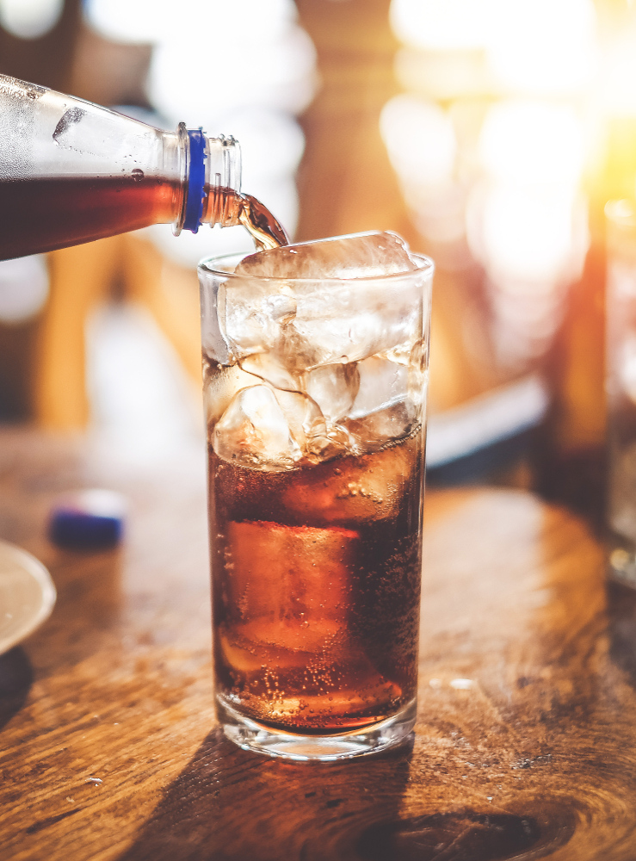
Detailed Findings
Beverages

Slide 134
Beverage Brand Familiarity
Brand | % of Operators Mentioning Brand
V8 | 25%
Naked | 12%
Vita Coco | 12%
Ocean Spray | 12%
Motts | 11%
Thirster | 9%
Sacramento | 9%
Odwalla | 8%
Tropicana | 7%
Red Gold | 6%
ZICO | 6%
Dole | 6%
Apple and Eve | 5%
Minute Maid | 3%
Campbell’s | 2%
Welch’s | 2%
Del Monte | 2%
SYSCO | 2%
Unaided
Unaided, approximately 70 brands of fruit and/or vegetable juice and coconut water come to mind with foodservice operators.
V8 was mentioned by one quarter of the sample, making it the most mentioned brand in the category.
Two percent of operators also mention Campbell’s as a brand in juice, likely referring to Campbell’s Tomato Juice.

Slide 135
Beverage Brand Familiarity
Aided
Vita Coco was the only brand rated as more familiar than V8 within most of the major segments. The exception is restaurants, where V8 was rated as the most familiar.
Within restaurants, V8 was the most familiar among quick service (69%) and casual dining operations (64%).

Slide 136
Fruitful Format
Beverage formats by segment
Across all major segments, fruit juice represents the highest proportion of drink formats.
Hotels report the highest proportion of coconut water purchases. This aligns with the segment’s significantly higher familiarity with Vita Coco, a brand that sells exclusively coconut water products.

Slide 137
Critical Purchase Drivers
Total sample
Consistent with other product categories in the study, price is the most influential driver of purchasing decisions for beverages, with taste not far behind.
A unique driver to beverage purchasing decisions is the claim of 100% juice. Authenticity, and a lack of artificial flavoring, is clearly an important consideration for beverage products.

Slide 138
Unique Purchase Drivers by Segment
Significant purchase driver differentiators by segment
Similar to many other product categories in the study, c-store and hotel segments stand apart in their purchase drivers. They continue to prioritize organic and non-GMO products as well as an even stronger focus on taste than the other segments.
It is important to keep in mind the differing sample sizes as you interpret results.

Slide 139
Different Drivers: Segment Specific
Options only presented to restaurant and hotel operators
Only about one quarter of restaurant and hotel operators reported that whether or not a beverage item was appropriate for their kids menu was a primary driver of their purchase behavior when it comes to drinks.

Slide 140
Brand Usage
Purchasing behavior by segment
Echoing brand familiarity behavior (slide 128), Vita Coco tops V8 in all segments except for restaurants, and most strongly among hotels and c-stores.
V8 was again most popular among quick service (53%) and casual dining (47%) restaurants.

Slide 141
Brand Performance
Against top beverage competitor brands on top eight purchase drivers
V8 brand performance varies across purchase drivers.
V8 underperforms competitors on price, which was rated as the most important purchase driver for operator, as well appropriate packaging size.
V8 does beat out its competitors in shelf life, health benefits and quality.

Slide 142
Net Promoter Scores
NPS = 42
NPS = 40
Beverages
Of the top three brands with the highest NPS, Vita Coco and V8 were both rated high in terms of familiarity and purchasing. Sacramento, however, was only ninth in brand familiarity and seventh in brand purchasing.
NPS = 39
NPS = 35

Slide 143
Net Promoter Scores
Beverages
NPS = 35
NPS = 34
Brands like Motts and Ocean Spray underperform on NPS compared to their brand familiarity and purchasing.
NPS = 25
NPS = 22

Slide 144
Net Promoter Scores
Beverages
NPS = 20
NPS = 16
The bottom brands in NPS performance are more closely aligned with the brands that are reported as the least familiar to operators.
NPS = 16

Slide 145
Critical Claims
Most important claims by segment
The most important claims to operators in their beverage products center around all-natural assertions. This reiterates the importance of 100% real juice, a major purchase driver (slide 130).
C-stores and hotels continue to flock toward organic and non-GMO products.

Slide 146
Brand Agreement
Among operators familiar with the V8 brand, 90% agreed with the V8 brand statement that V8 delivers plant-based goodness.
Agreement was highest among c-stores (100%) and lowest among non-commercial operations (82%).
V8 delivers plant-based goodness
Top 2 Box 90%
Top 2 Box 98%
Top 2 Box 82%
Top 2 Box 83%
Top 2 Box 100%

Slide 147
Brand Motivation
Restaurant operators are most likely to find the statement, “V8 delivers plant-based goodness” very motivating while noncommercial operators are least likely to find it very motivating (26%).
V8 delivers plant-based goodness
Top 2 Box 90%
Top 2 Box 92%
Top 2 Box 87%
Top 2 Box 91%
Top 2 Box 100%

Slide 148
Detailed Findings
Manufacturers

Slide 149
Manufacturing Familiarity
Aided
Overall, operators are most familiar with Campbell’s as a company in foodservice. This high level of familiarity is driven by noncommercial operators (95%).
Nestle, PepsiCo, Kellogg’s and Kraft-Heinz have a similar level of familiarity with operators. In general, restaurants have a slightly lower familiarity while noncommercial, hotel and c-store have a slightly higher level.
Unilever and Mondelez trail other major brands in familiarity among operators.

Slide 150
Manufacturer Brand Performance
Against top three competitor manufacturers
Operators generally have a high level of agreement across all statements when it comes to the leading four foodservice manufacturing companies.
While there is not significant variation in ratings, Campbell’s very slightly leads in most of the statements.

Slide 151
Campbell’s Manufacturer Brand Performance
Against top three competitor manufacturers
Operators are slightly less likely to agree that PepsiCo products offer health and wellness benefits, likely because the company corresponds directly with their core sugar-sweetened beverage, rather than their portfolio of offerings.

Slide 152
Net Promoter Scores
Manufacturing companies
NPS = 54
NPS = 49
Operator net promoter scores for foodservice manufacturing brands generally aligns with operator familiarity; the more familiar the brand, the higher the NPS.
Of the brands included in the study, Campbell’s has the highest NPS at 54.
NPS = 49
NPS = 47

Slide 153
Net Promoter Scores
Manufacturing companies
NPS = 46
NPS = 34
Mondelez and Unilever, the two least familiar foodservice brands also carry the lowest NPS among operators.
NPS = 16

Slide 154
Marketing Awareness
% of Operators Who Have Seen/Heard Marketing From Each Company Over Past Three Months
Against top three competitor manufacturers
Nearly half of operators (44%) have not seen any advertising or marketing communications from any of the included companies or brands.
Of those operators who have, they are most likely to have seen communications from Campbell’s, PepsiCo or Kellogg’s.
Restaurants, specifically casual (40%) and fast casual (37%) dining, are more likely to have seen Campbell’s advertising over the past three months.
Hotel and c-store operators are the least likely to have seen Campbell’s marketing over the past three months. Both segments are more likely to have seen PepsiCo and Kellogg marketing.

Slide 155
Extra! Extra!
Advertising formats of top manufacturers
Operators are most likely to have seen Campbell’s advertising over the past three months in a magazine or trade publication, or on a social media outlet, such as Facebook or Instagram. Compared to leading competitors, Campbell’s drives a much higher advertising awareness via social media.

Slide 156
Campbell’s Brings to Mind…
When people think of Campbell’s, the first product that comes to mind is soup. Whether it be chicken noodle or tomato, operators’ minds immediately jump to those iconic red and white labeled soup cans.
Operators not only think of Campbell’s as a brand in soup, but as the brand in soup.
“The leading brand in soup.”
- Healthcare Operator
While this high level of awareness for soup is beneficial for soup sales, Campbell’s has a wide variety of products outside of soup that are either not being recognized as Campbell’s branded products or not being remembered.
“Soup. Sorry, can’t think of anything else.”
- C&U Operator
The Campbell’s brand brings to mind positive images with memories of home-cooked meals with family and feelings of comfort.
“Campbell’s represents home cooking and family.”
- Healthcare Operator
“The company makes me feel warm, cozy and safe.”
- C&U Operator
Campbell’s is a long-standing company that’s been around for generations. Their traditional family-focused image serves them well with past and current customers but may need to be revamped to bring in new consumers.
“Very blank packaging, doesn’t stand out. Everyone older grew up with Campbell’s soup, today’s crowd needs more reasons to love a product.”
- Healthcare Operator
Operators remember highly positive interactions when thinking about how they deal with Campbell’s as a company. Respondents appreciate the wide selection of products, that don’t sacrifice quality, and the affordable prices. Campbell’s thrives in the exact areas that are most important to operators.
“A company I can trust to provide high quality food products that are recognized by my customer at a price that is a value to me.”
- K-12 Operator
“Lots of choices with great prices.”
- Fast Casual Operator
“Best brand in foodservices.”
- K-12 Operator

Slide 157
Competitors Bring to Mind…
Nestle
PepsiCo
Kellogg’s
The first products that come to mind when operators think of Nestle revolve around chocolate and sweets.
“Chocolate and sugar.”
- Fast Casual Operator
For Nestle, no specific images or messages were reported, indicating their marketing may be lacking.
“Wide variety of products available that they carry but you never hear about. Marketing and advertising needs improvement.”
- Casual Dining Operator
In terms of the company overall, operators view Nestle as dependable, high quality and known for having the best tastes and flavors.
“Very reliable.”
- Quick Service Operator
“Provide good products with superb taste.”
- Family Dining Operator
When thinking of PepsiCo, operators immediately jump straight to beverage products.
“Large variety of products from soda to water and sports drinks.”
- Family Dining Operator
PepsiCo has a very successful and modern marketing presence, with many operators recalling specific commercials, often with celebrity spokespeople like Cardi B or Kendall Jenner.
“Tries to be the ‘cool’ soft drink brand.”
- Healthcare Operator
A large number of operators recalled the large portfolio of PepsiCo products, with some even claiming the size is overwhelming.
“More varieties than you actually need.”
- C&U Operator
For Kellogg’s, operators focus on breakfast items, like cereals and cereal bars.
“I think of cereal and grains.”
- C-store Operator
Kellogg’s, as a brand, has been successfully marketed as family-friendly and kid-focused, with its cereal box characters like Tony the Tiger. Operators also report it is well-recognized by the iconic rooster or red capital K.
“Has been a traditional brand bought by families.”
- Healthcare Operator
“Huge company with characters that appeal to kids.”
- K-12 Operator
As a company, operators respond most to the high quality, good taste, and healthy nature of Kellogg’s products.
“Quality is a cornerstone of this brand.”
- C&U Operator

Slide 158
Campbell’s Reasons to Believe Agreement
Operators familiar with Campbell’s are most likely to agree that Campbell’s Foodservice offers brands their patrons trust—nearly half (46%) of operators strongly agree with this statement.
There is a slight drop in agreement for the statements presenting Campbell’s as a partner.
Top 2 Box 85%
Top 2 Box 83%
Top 2 Box 82%
Top 2 Box 86%
Notes:
complete

Slide 159
Campbell’s Reasons To Believe Motivation
About two out of five operators, including those familiar with Campbell’s and those who are unfamiliar, find each of the statements to be very motivating.
Top 2 Box 85%
Top 2 Box 85%
Top 2 Box 84%
Top 2 Box 87%

Slide 160
Appendix Slides

Slide 161
Operator Demographics

Slide 162
Operation Type
Quick Service—18%
Fast Casual—22%
Casual—20%
Midscale—22%
Polished Casual—18%

Slide 163
Cuisine Type
Among Restaurant Operators

Slide 164
Healthcare Details

Slide 165
Hotel & Lodging Type

Slide 166
K-12 Details

Slide 167
Chain vs. Independent
Six units or more

Slide 168
Operator Role

Slide 169
Operator Role
All respondents have responsibility over decision making on foods and beverages

Slide 170
Operation Location

Slide 171
Annual Purchases
Food, ingredients, and non-alcohol beverages

Slide 172
Foodservice Manager Membership

Slide 173
Group Purchasing Organization Membership

Slide 174
Primary Distributor

Slide 175
Additional Category Detailed Findings

Slide 176
Packaged Snacks

Slide 177
Snack Purchase Drivers
By Segment

Slide 178
Snack Purchase Drivers
By Segment

Slide 179
Snack Purchase Important Claims
By Segment

Slide 180
Goldfish Agreement by Segment
“Goldfish makes our guests smile”
Top 2 Box 86%
Top 2 Box 88%
Top 2 Box 81%
Top 2 Box 94%
Top 2 Box 100%

Slide 181
Goldfish Agreement By Segment
“Goldfish adds smiles to our kids menu”
Top 2 Box 93%
Top 2 Box 94%
Top 2 Box 88%

Slide 182
Goldfish Agreement By Segment
“Goldfish delights our guests—even the littlest ones”
Top 2 Box 90%
Top 2 Box 89%
Top 2 Box 88%
Top 2 Box 100%
Top 2 Box 100%

Slide 183
Goldfish Agreement By Segment
“Goldfish is a wholesome snack baked with real cheese”
Top 2 Box 87%
Top 2 Box 88%
Top 2 Box 85%
Top 2 Box 94%
Top 2 Box 100%

Slide 184
K-12 Goldfish Agreement
All statements presented to K-12 operators
Top 2 Box 86%
Top 2 Box 86%
Top 2 Box 89%
Top 2 Box 75%

Slide 185
Goldfish Motivation by Segment
“Goldfish makes our guests smile”
Top 2 Box 89%
Top 2 Box 87%
Top 2 Box 89%
Top 2 Box 94%
Top 2 Box 92%

Slide 186
Goldfish Motivation by Segment
“Goldfish adds smiles to our kids menu”
Top 2 Box 95%
Top 2 Box 94%
Top 2 Box 97%

Slide 187
Goldfish Motivation
“Goldfish delights our guests—even the littlest ones”
Top 2 Box 92%
Top 2 Box 91%
Top 2 Box 92%
Top 2 Box 91%
Top 2 Box 100%

Slide 188
Goldfish Motivation
“Goldfish is a wholesome snack baked with real cheese”
Top 2 Box 91%
Top 2 Box 91%
Top 2 Box 91%
Top 2 Box 100%
Top 2 Box 90%

Slide 189
K-12 Goldfish Motivation
All statements presented to K-12 operators
Top 2 Box 94%
Top 2 Box 91%
Top 2 Box 94%
Top 2 Box 90%

Slide 190
Soup

Slide 191
Critical Soup Claims
By Segment
Beyond top eight most important claims.

Slide 192
Canned Soup Purchase Drivers
By Segment

Slide 193
Canned Soup Purchase Drivers
By Segment

Slide 194
Frozen Soup Purchase Drivers
By Segment

Slide 195
Frozen Soup Purchase Drivers
By Segment

Slide 196
Refrigerated Soup Purchase Drivers
By Segment

Slide 197
Refrigerated Soup Purchase Drivers
By Segment

Slide 198
Brand Agreement
Seasons change. Your menu should too. Give guests seasonal flavor with Campbell’s soup.
Top 2 Box 89%
Top 2 Box 88%
Top 2 Box 89%
Top 2 Box 89%
Top 2 Box 95%

Slide 199
Brand Agreement
With Campbell’s, there is a soup for every season.
Top 2 Box 91%
Top 2 Box 89%
Top 2 Box 91%
Top 2 Box 85%
Top 2 Box 95%

Slide 200
Brand Agreement
Every kitchen has a secret ingredient. Let yours be Campbell’s soup.
Top 2 Box 80%
Top 2 Box 77%
Top 2 Box 81%
Top 2 Box 78%
Top 2 Box 100%

Slide 201
Brand Agreement
Campbell’s Soup means more quality in the can, less effort in the kitchen.
Top 2 Box 84%
Top 2 Box 82%
Top 2 Box 85%
Top 2 Box 89%
Top 2 Box 90%

Slide 202
Brand Motivation
Seasons change. Your menu should too. Give guests seasonal flavor with Campbell’s soup.
Top 2 Box 88%
Top 2 Box 86%
Top 2 Box 91%
Top 2 Box 80%
Top 2 Box 95%

Slide 203
Brand Motivation
With Campbell’s, there is a soup for every season.
Top 2 Box 88%
Top 2 Box 87%
Top 2 Box 87%
Top 2 Box 85%
Top 2 Box 95%

Slide 204
Brand Motivation
Every kitchen has a secret ingredient. Let yours be Campbell’s soup.
Top 2 Box 83%
Top 2 Box 80%
Top 2 Box 84%
Top 2 Box 85%
Top 2 Box 91%

Slide 205
Brand Motivation
Campbell’s Soup means more quality in the can, less effort in the kitchen.
Top 2 Box 86%
Top 2 Box 85%
Top 2 Box 87%
Top 2 Box 83%
Top 2 Box 98%

Slide 206
Prepared Salsa

Slide 207
Prepared Salsa Purchase Drivers
By Segment

Slide 208
Prepared Salsa Purchase Drivers
By Segment

Slide 209
Beverages

Slide 210
Drink Purchase Drivers
By Segment

Slide 211
Drink Purchase Drivers
By Segment

Slide 212
Manufacturers

Slide 213
Campbell’s Agreement by Segment
To caring operators who want the best for their patrons, Campbell's Foodservice is the partner working to make delicious, carefully crafted foods accessible to all
Top 2 Box 85%
Top 2 Box 88%
Top 2 Box 81%
Top 2 Box 86%
Top 2 Box 89%

Slide 214
Campbell’s Agreement by Segment
Campbell's Foodservice believes in carefully selected ingredients. Our philosophy of building recipes from scratch, with carefully selected ingredients and no additives, reflects our heritage of evolving products to meet the demands of patrons.
Top 2 Box 83%
Top 2 Box 84%
Top 2 Box 82%
Top 2 Box 77%
Top 2 Box 93%

Slide 215
Campbell’s Agreement by Segment
Campbell's Foodservice believes in partnership. We partner with and listen to customers in order to offer the best operator assistance through attentive customer service, category expertise, culinary support and more.
Top 2 Box 82%
Top 2 Box 84%
Top 2 Box 80%
Top 2 Box 84%
Top 2 Box 91%

Slide 216
Campbell’s Agreement by Segment
Campbell's Foodservice offers brands your patrons trust. We have more than 500 soups, beverages, broths, sauces and entrees from brands your patrons trust, like Campbell's, V8, Pepperidge Farms, Prego, Pace, and Swanson.
Top 2 Box 86%
Top 2 Box 90%
Top 2 Box 84%
Top 2 Box 80%
Top 2 Box 93%

Slide 217
Campbell’s Motivation by Segment
To caring operators who want the best for their patrons, Campbell's Foodservice is the partner working to make delicious, carefully crafted foods accessible to all
Top 2 Box 85%
Top 2 Box 85%
Top 2 Box 86%
Top 2 Box 86%
Top 2 Box 84%

Slide 218
Campbell’s Motivation by Segment
Campbell's Foodservice believes in carefully selected ingredients. Our philosophy of building recipes from scratch, with carefully selected ingredients and no additives, reflects our heritage of evolving products to meet the demands of patrons.
Top 2 Box 85%
Top 2 Box 86%
Top 2 Box 83%
Top 2 Box 82%
Top 2 Box 86%

Slide 219
Campbell’s Motivation by Segment
Campbell's Foodservice believes in partnership. We partner with and listen to customers in order to offer the best operator assistance through attentive customer service, category expertise, culinary support and more.
Top 2 Box 84%
Top 2 Box 86%
Top 2 Box 82%
Top 2 Box 82%
Top 2 Box 92%

Slide 220
Campbell’s Motivation by Segment
Campbell's Foodservice offers brands your patrons trust. We have more than 500 soups, beverages, broths, sauces and entrees from brands your patrons trust, like Campbell's, V8, Pepperidge Farms, Prego, Pace, and Swanson.
Top 2 Box 87%
Top 2 Box 88%
Top 2 Box 87%
Top 2 Box 84%
Top 2 Box 80%

Slide 221



Questions?
Wade Hanson
Principal, Advisory Practice
whanson@technomic.com
Mary Hermann
Research Analyst
mhermann@technomic.com
Erin Moore Ruddy
Senior Manager
eruddy@technomic.com
312-876-0004 | info@technomic.com | technomic.com

