Slide 1
Artificial Intelligence: Musings from Ann
CONFIDENTIAL

Slide 2
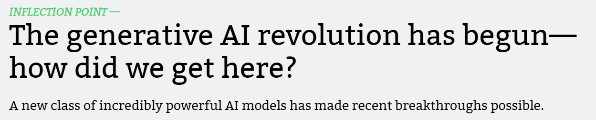


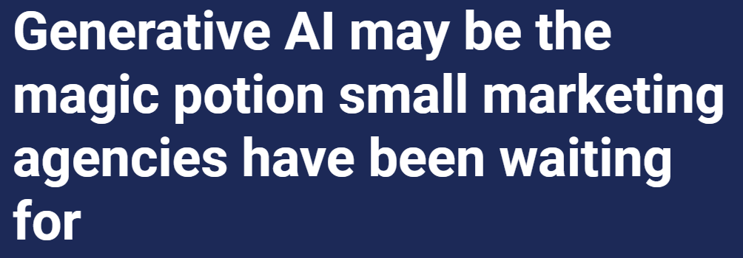
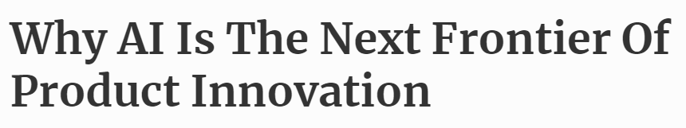
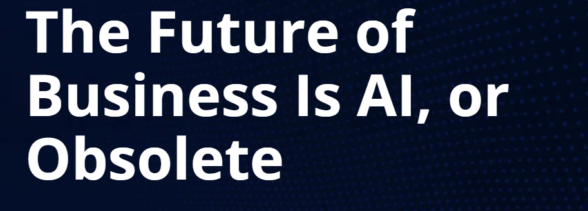
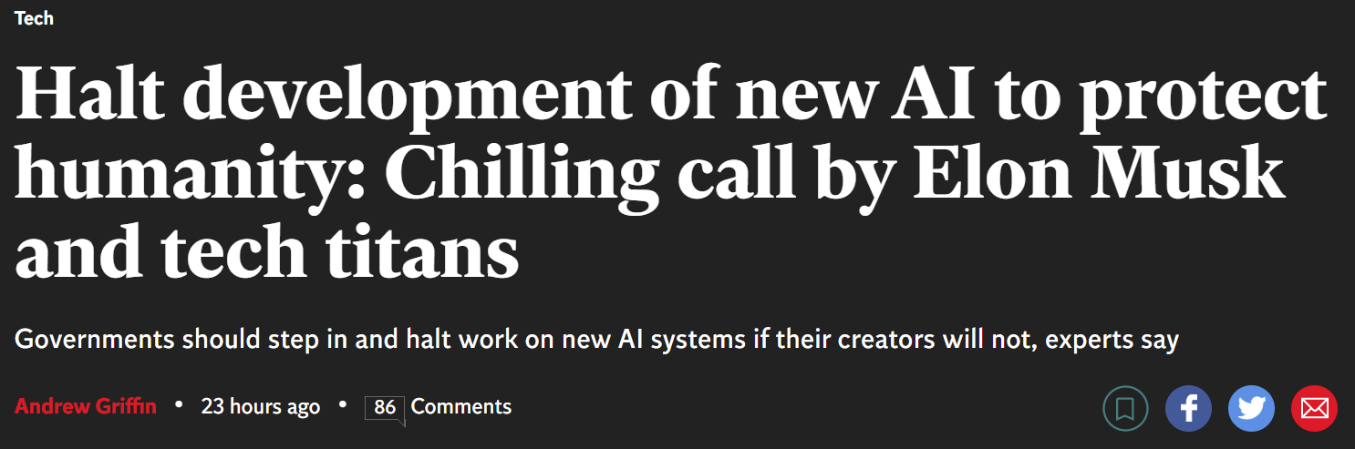
CONFIDENTIAL

Slide 3
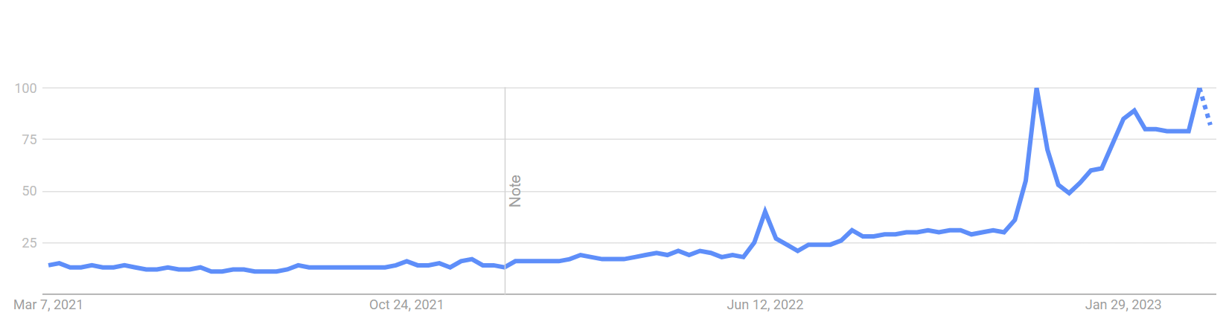

Google Search – Artificial Intelligence
CONFIDENTIAL

Slide 4
What is “artificial intelligence?”
Artificial Intelligence (AI) refers to the ability of machines to perform tasks that typically require human intelligence, such as learning, problem-solving, decision-making, perception, and natural language processing.
CONFIDENTIAL

Slide 5
How is artificial intelligence used in our everyday lives?
Personal assistants: Siri, Alexa, and Google Assistant help us with things like setting reminders, scheduling appointments, or playing music
Image recognition: facial recognition in security systems, object recognition in autonomous vehicles, and product recognition in online shopping
Social media: personalized user experiences, suggested content, and removal of inappropriate content
Online shopping: personalized product recommendations, optimization of pricing and promotions
Healthcare: analyzing medical images, diagnosing diseases, and developing personalized treatment plans
Financial services: fraud detection, credit scoring, and investment analysis
Education: development of personalized learning programs, assessing student performance and improving accessibility for students with disabilities
CONFIDENTIAL

Slide 6
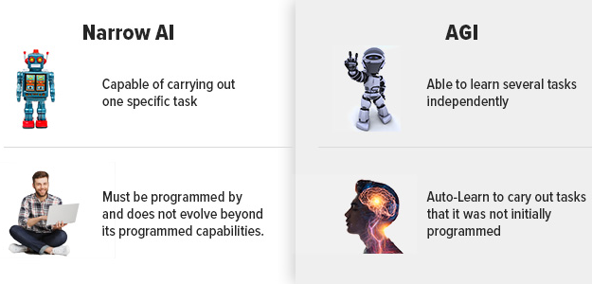
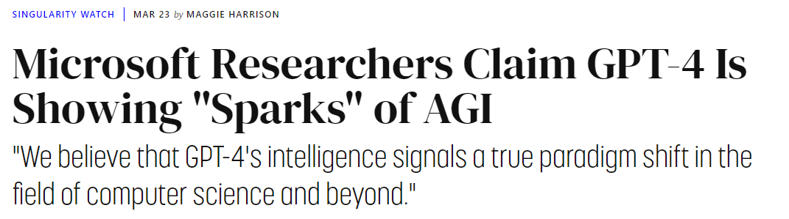
What about “AGI” (Artificial General Intelligence)?
From Microsoft Researchers:
"We demonstrate that, beyond its mastery of language, GPT-4 can solve novel and difficult tasks that span mathematics, coding, vision, medicine, law, psychology and more, without needing any special prompting,"
"Given the breadth and depth of GPT-4's capabilities," they continue, "we believe that it could reasonably be viewed as an early (yet still incomplete) version of an artificial general intelligence (AGI) system."
CONFIDENTIAL

Slide 7
Artificial intelligence in Marketing Agencies
AI will transform agency processes from top to bottom with tools that impact:
Process automation
Website development
AI art generators
Content generators
Data and analytics
Customer experience tools
CONFIDENTIAL

Slide 8












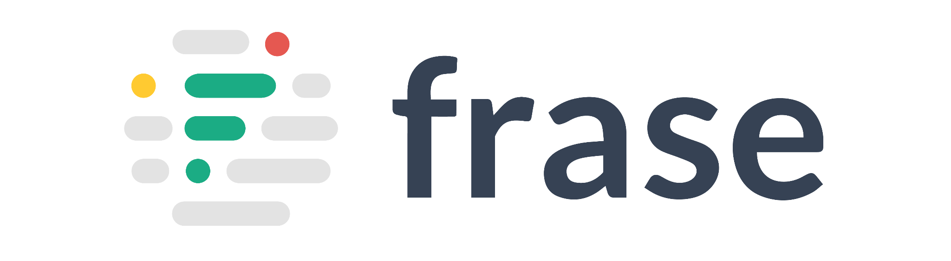






AI Content Generation Tools – Just Copy
Stuff they do…
Generate human-like text
Summarize text
Translate languages
Proofread and edit text
Create product descriptions
Generate video captions
Generate social media posts
Compose emails
Personalize content
Optimize content for SEO
Generate reports and articles
Create chatbot scripts
Organize and classify content
Turn existing content into new formats - like videos!!
CONFIDENTIAL

Slide 9
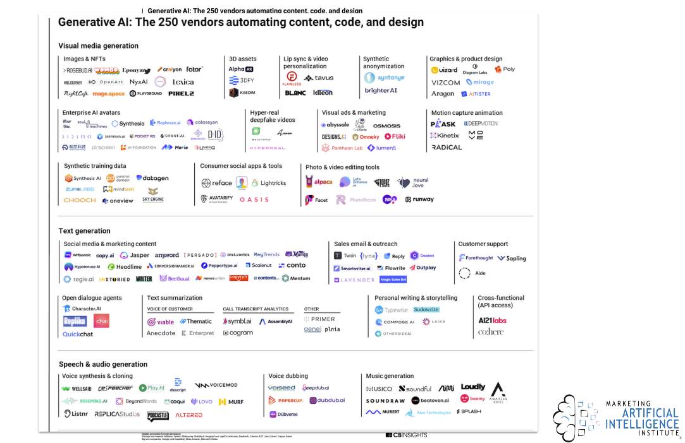
AI Tools
Expect there to be thousands of vendors by the end of 2023!
CONFIDENTIAL

Slide 10
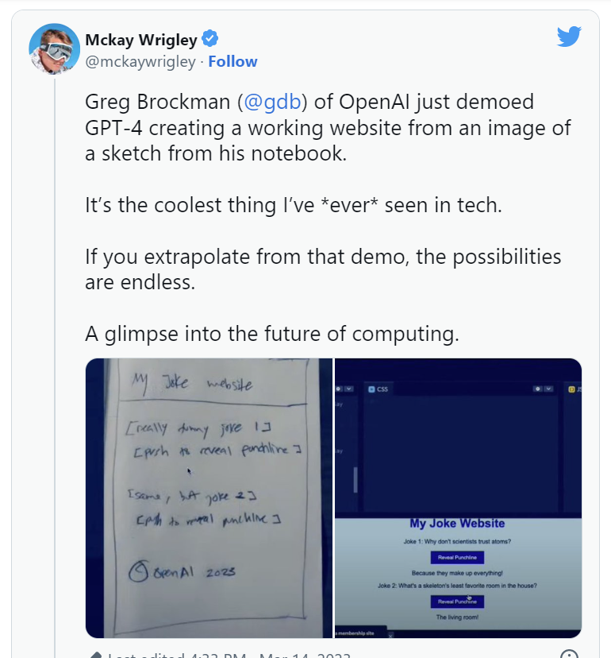
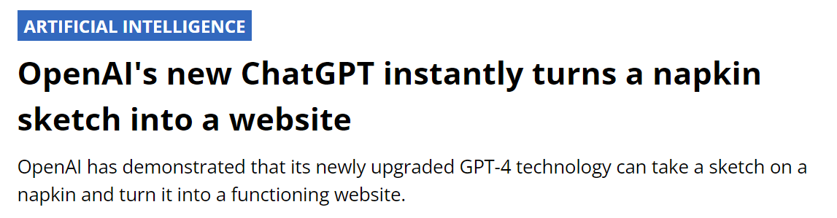
Oh yeah, AI can build websites…
CONFIDENTIAL

Slide 11
AI in Action: Things I asked AI to do
CONFIDENTIAL

Slide 12
Survey Writing
Ann asked…“What are some quantitative questions you could ask chefs and operators to measure brand perception and health”
How likely are you to recommend our brand to a colleague or friend?
On a scale of 1-10, how satisfied are you with our brand's quality?
How often do you use our brand compared to our competitors?
How would you rate our brand's value for the price?
How frequently do you encounter issues or problems with our brand?
How easy is it to work with our brand?
How would you rate the consistency of our brand's products?
How well does our brand meet your specific needs?
How often do you hear positive feedback about our brand from your customers?
How well does our brand support your business goals?
CONFIDENTIAL

Slide 13
Naming
Ann asked…“Please provide a list of potential names for a Commercial braising pan, frequently known as tilt skillet. They are one of the most versatile pieces of equipment you can add to your kitchen. These handy machines can braise, grill, steam, and boil massive quantities of food, enabling you to keep up with crowds of hungry guests.”
Braisemaster
Skillet Pro
Tilt Chef
Griddle Titan
Sizzle King
Steam Supreme
Boil Boss
Pan Power
Cookmaster
Kitchen Maverick
Mega Skillet
Versa Pan
Heavy Duty Skillet
Industrial Chef
Multi Cooker
CONFIDENTIAL

Slide 14
Social Posts
Ann asked…“Please write 4 social posts based on the following article” https://www.butterballfoodservice.com/resources/how-artificial-intelligence-is-advancing-foodservice-operations/
Exciting news! AI is revolutionizing the foodservice industry by increasing efficiency and predicting dining trends. With labor shortages, it's crucial to find innovative solutions to streamline the customer experience. Check out Anthony’s Coal Fired Pizza & Wings and Jet Pizza for some AI success stories!
Innovation is key in the foodservice industry, and AI is leading the way. By synthesizing tons of raw data, AI platforms can provide actionable insights and alert operators to ever-changing consumer preferences. Don't get left behind - check out the latest AI technology solutions for your business.
Running a successful foodservice operation just got easier with AI technology. From minimizing human error to increasing efficiency, AI is a game-changer for the industry. Check out OrderAI, the text message-based ordering system that helped Jet Pizza generate $31.36 million in sales in 2019.
The future of foodservice is here, and it's powered by AI. By anticipating dining trends and responding to customer orders in profitable ways, AI technology is changing the game for operators. Learn how ConverseNow, the leading voice AI technology platform for restaurants, helped Anthony's Coal Fired Pizza & Wings streamline their customer experience.
CONFIDENTIAL

Slide 15
Food safety has always been a top concern for diners, but the COVID-19 pandemic brought it into even sharper focus. In July 2021, research conducted for the International Food Information Council revealed that 66% of those surveyed were comfortable with individually wrapped, pre-packaged foods, whereas only 30% were comfortable with a self-serve buffet. In response, 96% of noncommercial operators stopped at least one self-serve offering or station due to COVID-19 and 46% added more pre-packaged grab-and-go items, according to a report by Technomic in June 2021.
Individually wrapped sandwiches have emerged as a popular solution that meets both consumer needs and operator demands. For diners, pre-packaged sandwiches offer a safe and convenient option that allows them to enjoy healthy, filling sandwiches without spending time in the kitchen. Additionally, they offer the portability that many diners need to accommodate their busy lifestyle. Operators, on the other hand, appreciate that pre-packaged, individually wrapped sandwiches provide scratch-made quality without the labor, ensure consistency, and offer flexibility related to serving environments, such as remote serving locations, grab-and-go, and curbside pick-up.
Butterball, a trusted and respected name in the food industry for generations, offers five delicious options on a variety of breads or biscuits, all featuring quality turkey products inside. The Roasted Turkey & Swiss Cheese on Multigrain Ciabatta (Product # 22655 89584), Turkey Sausage & Cheddar Cheese on Muffin (Product # 22655 89580), Turkey, Mozzarella & Arugula Pesto on Ciabatta (Product # 22655 89581), Turkey Sausage, Egg & Cheddar Cheese on Biscuit (Product # 22655 89583), and Roasted Turkey & Cheddar Cheese on Craft Bun (Product # 22655 89582) all offer something for every taste preference.
What sets Butterball apart is their consistent delivery of quality turkey. In fact, 60% of diners prefer to see Butterball branded turkey on menus, which is 10 times higher than the number two brand at only 6%, according to a 2019 report by Butterball on The Importance of Turkey in Food Away from Home.
Operators can trust that Butterball’s pre-packaged sandwiches will meet their customers’ expectations for quality and safety while also saving them valuable time and labor. With Butterball, operators can offer their diners delicious and satisfying sandwiches that are ready to go whenever and wherever they are needed.
In conclusion, the pandemic has brought about significant changes in the food industry, with the emphasis on food safety and convenience being more important than ever. Pre-packaged, individually wrapped sandwiches have emerged as a popular solution that meets both consumer needs and operator demands. Butterball, a trusted and respected name in the industry, offers a range of high-quality, pre-packaged sandwiches that can help operators meet the changing demands of their customers while also saving them valuable time and labor. With Butterball’s consistent delivery of quality turkey, operators can feel confident that they are offering their customers a safe and satisfying dining experience.
Notes:
I asked it to write a 400-500 word article, using an approachable yet slightly professorial tone, leveraging the following information (outlined I created a few years ago for a Butterball infographic)

Slide 16
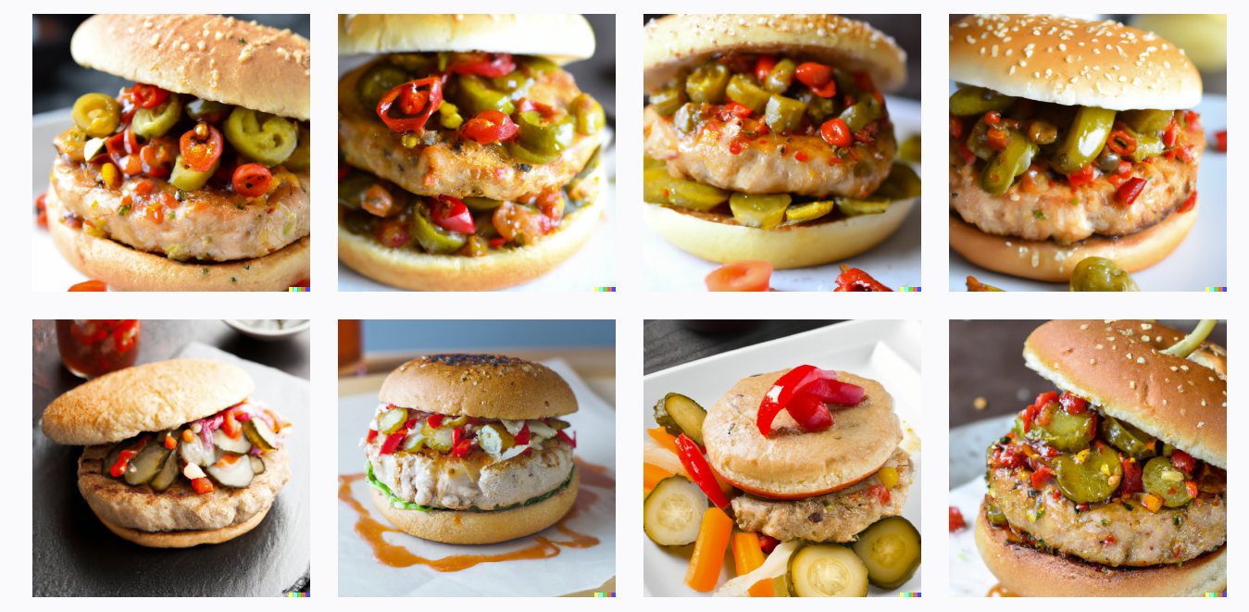
Image Generation
Ann asked…“Please create the image of a juicy turkey burger with pickled vegetables and spicy sauce”

Slide 17

Image Generation
Ann asked…“Please create the image of a Vietnamese roast turkey salad with green papaya, banana blossom salad, loaded with fresh herbs”

Slide 18


Image Generation
Ann asked…“Please create a orange, yellow and black glowing lion logo in an illustrative style”
Context: My son’s soccer team is the “Glowing Lions.” I’m going to make stickers :)

Slide 19
Watch Outs
CONFIDENTIAL

Slide 20
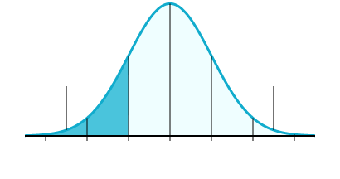
Artificial Intelligence Watch Outs
What chat.gpt returns = average
While AI tools offer numerous benefits, there are also several watch outs that marketing agencies need to consider before using them to create content.
Bias in AI: AI tools rely on algorithms that are trained on data, and if that data is biased (which can’t be avoided when humans are controlling it), the tool will replicate those biases in its output
Quality of the Input Data: The output of AI tools is only as good as the input data it receives (see bell curve)
Lack of Contextual Understanding: AI tools lack the ability to understand the nuances and context of human language, which can lead to errors or misinterpretations
Bad stuff on the web
Good stuff on the web
CONFIDENTIAL

Slide 21
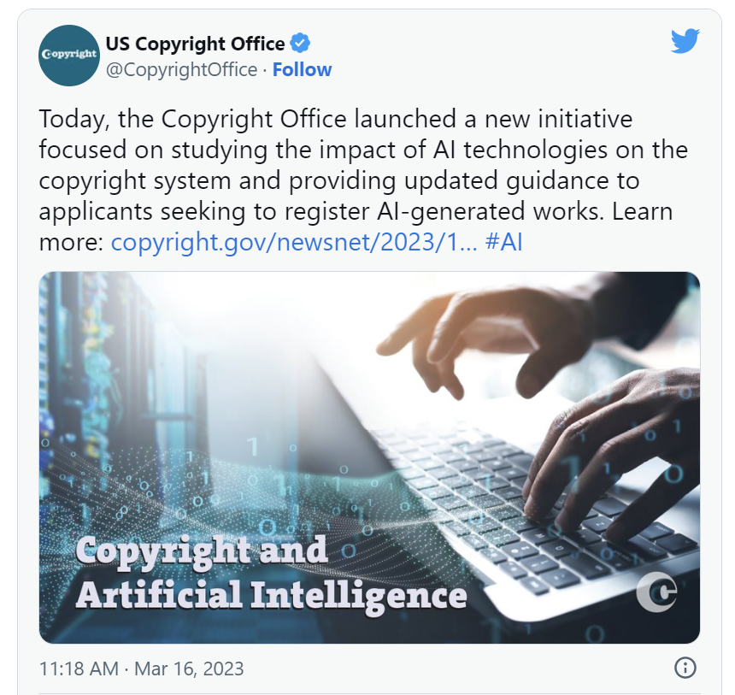
Artificial Intelligence Watch Outs
Customer Experience: While AI tools can automate content creation, it's important to consider how the content will be received by the target audience. Marketing agencies need to ensure that the content generated by AI tools aligns with their clients' brand and voice and resonates with their target audience
Human Element: AI tools can automate content creation, but they cannot replace the creativity and emotional intelligence of humans
Legal Compliance: AI-generated content needs to comply with legal requirements, such as advertising standards, data privacy regulations, and disclosure requirements
Intellectual Property: AI-generated content can raise intellectual property concerns. Marketing agencies need to ensure that the content created by AI tools does not infringe on anyone's intellectual property rights, such as copyright or trademark
NOTE: The US Copyright office recently said that a © is only meant to protect material that is the product of human creativity
NOTE: Brands should/will be asking their agencies to verify content is not AI written
CONFIDENTIAL

Slide 22
Need MMC Version of AI Responsibility Principles (Sample from Marketing AI Institute)
We believe in the responsible design, development, deployment and operation of AI technologies.
We believe in a human-centered approach to AI that empowers and augments professionals. AI technologies should be assistive, not autonomous.
We believe that humans remain accountable for all decisions and actions, even when assisted by AI. The human must remain in the loop in all AI applications.
We believe in the critical role of human knowledge, experience, emotion, and imagination in creativity, and we seek to explore and promote emerging career paths and opportunities for creative professionals.
We believe in the power of language, images and videos to educate, influence, and affect change. We commit to never knowingly use generative AI technology to deceive; to produce content for the sole benefit of financial gain; or to spread falsehoods, misinformation, disinformation, or propaganda.
We believe in understanding the limitations and dangers of AI, and considering those factors in all of our decisions and actions.
We believe that transparency in data collection and AI usage is essential in order to maintain the trust of our audiences and stakeholders.
We believe in personalization without invasion of privacy, including strict adherence to data privacy laws, mitigation of privacy risks for consumers, and following our moral compass when legal precedent lags behind AI innovation.
We believe in intelligent automation without dehumanization, and the potential of AI to have profound benefits for humanity and society.
We believe in an open approach to sharing our AI research, knowledge, ideas, experiences, and processes in order to advance the industry and society.
We believe in the importance of upskilling and reskilling professionals, and using AI to build more fulfilling careers and lives.
We believe in partnering with organizations and people who share our principles.

Slide 23
New News This Week
CONFIDENTIAL

Slide 24
New News
OpenAI just announced a plugin system for ChatGPT, enabling it to interact with the wider world through the internet
Plugins, developed by companies like Expedia, Instacart, and Slack, will allow users to perform a variety of tasks using these sites from right within ChatGPT
One of the plugins available integrates with Zapier, which itself integrates with thousands of other tools. Eventually, we’ll be able to engage with one interface across all of our apps/tools
From ChatGPT: “As an AI language model, I do not have access to information beyond my knowledge cutoff date, which is September 2021.”
“Expanding access to the internet allows ChatGPT to access a profusion of information, including research and news articles.”
“From looking up your dinner menu to ordering the missing ingredients, from recommending a restaurant based on your choices to booking a table in the best option available, ChatGPT can now do anything, well almost anything!”
CONFIDENTIAL

Slide 25
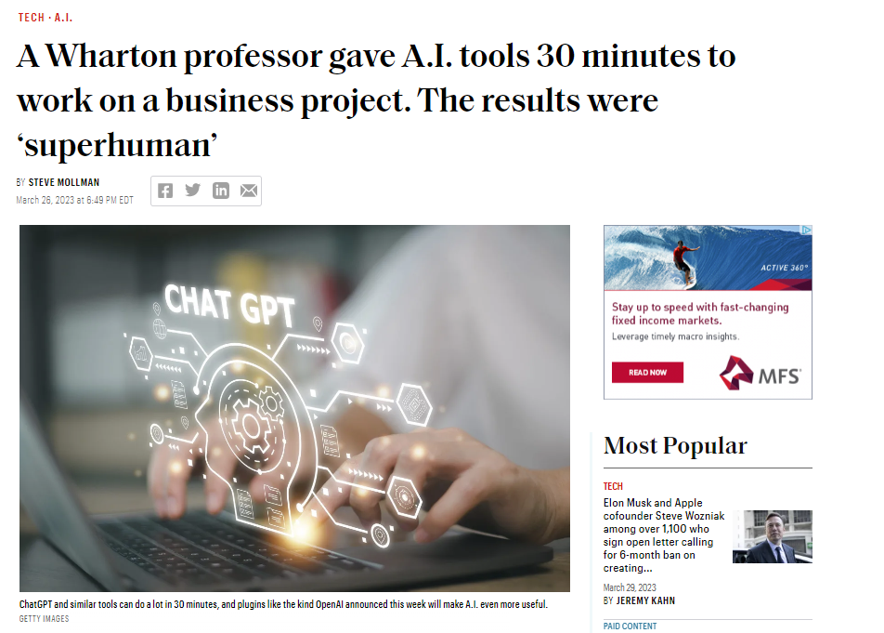
New News
Wharton professor Ethan Mollick used a combination of AI tools to launch a new educational game.
He was able to conduct market research, create an email campaign, design a website, and craft a social media campaign, among other tasks—in just 30 minutes.
Mollick used no more than 20 inputs, actions, or prompts to generate:
9,200 words of content (emails, social posts, etc.)
A working HTML/CSS file
12 images
A voice file
A movie file

